Slide 1


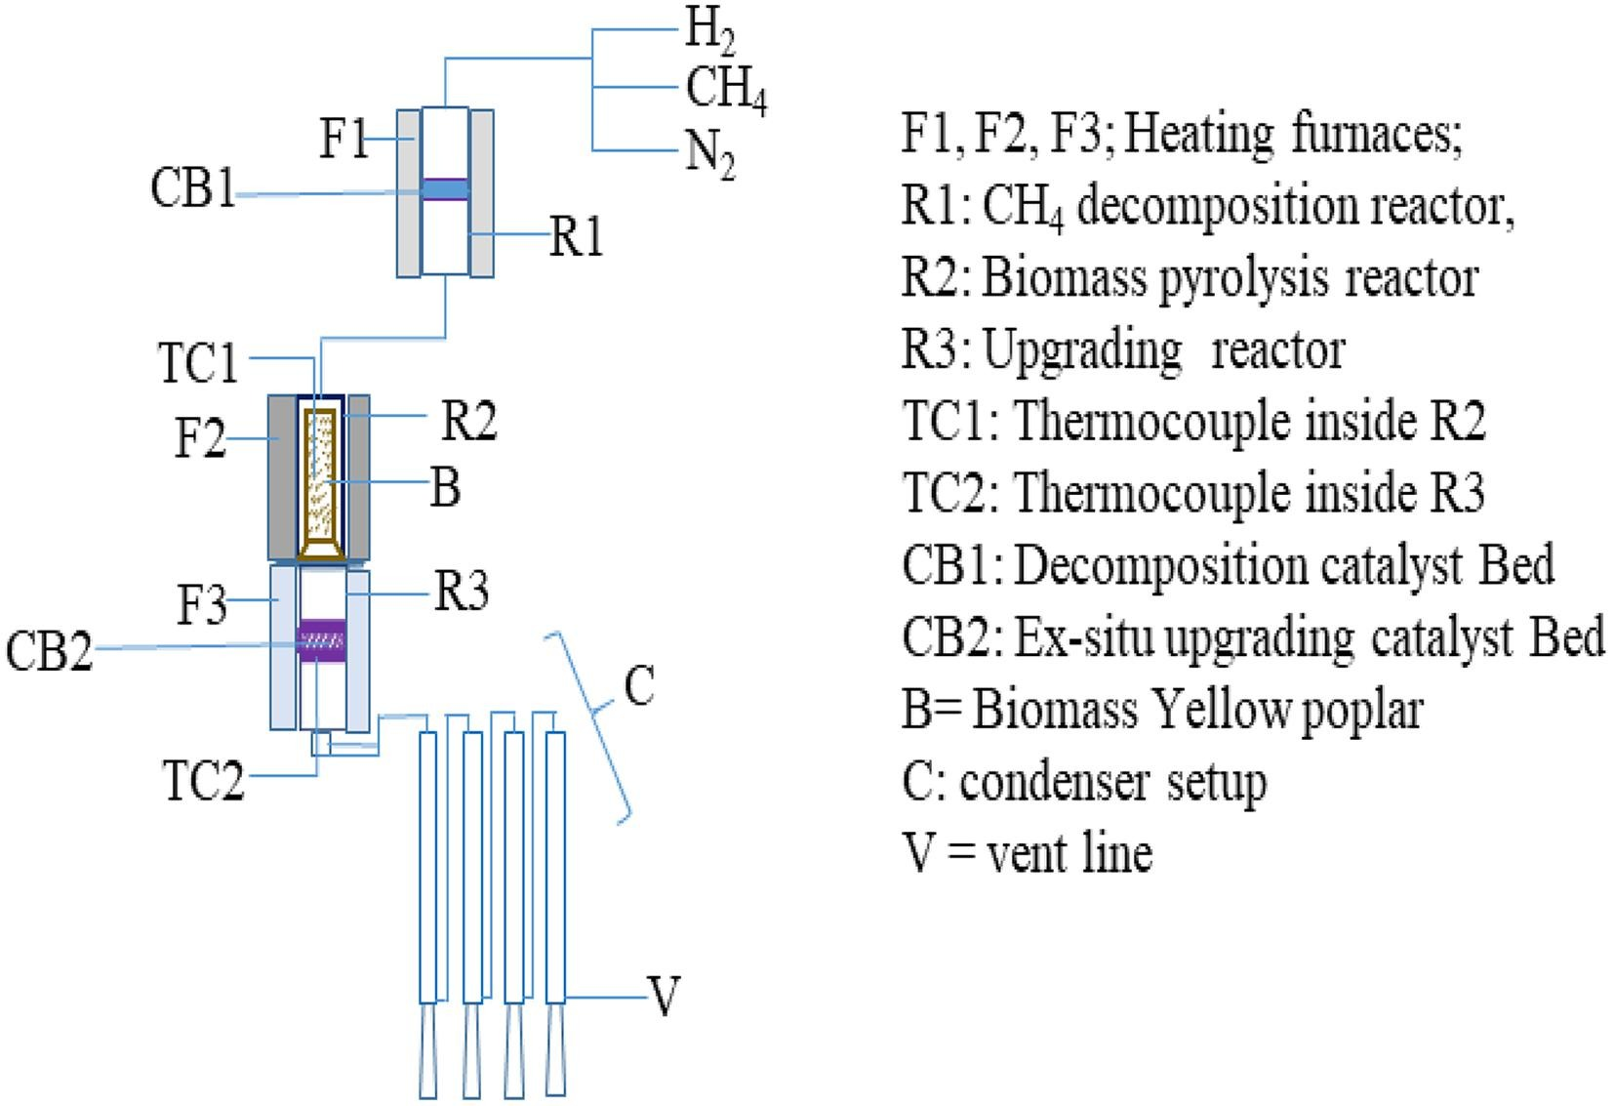
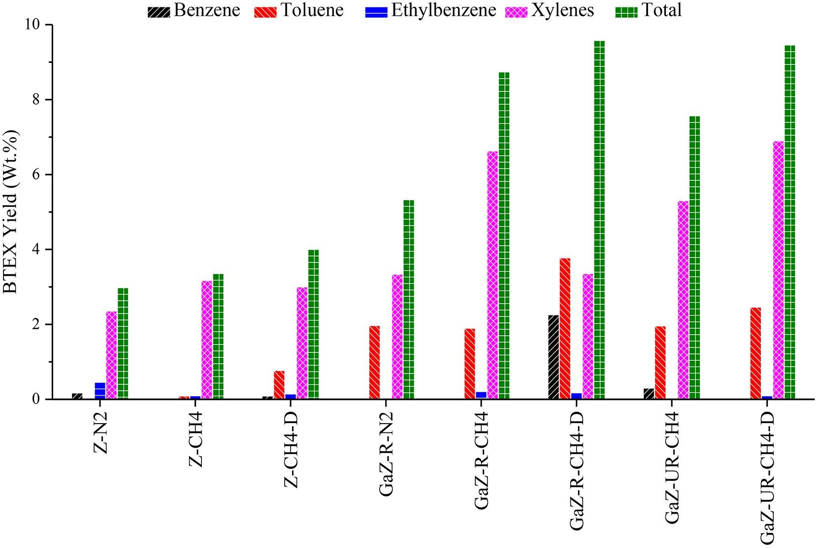
XXIV International Conference on Chemical Reactors ChemReactor-24, September 12- 17, Milan Italy
ENHANCEMENT OF BTEX IN ex-situ CATALYTIC UPGRADING OF BIOMASS PYROLYSIS VAPORS ON
METAL LOADED HZSM-5 CATALYST UNDER METHANE ENVIRONMENT
Young-Kwon Park*
University of Seoul, Seoul, Republic of Korea,
email: catalica@uos.ac.kr
The present study examined the effects of the pyrolysis environment on BTEX (benzene, toluene, ethylbenzene, and xylenes) production in the catalytic upgrading of yellow poplar pyrolysis vapors. Three different gas environments, N₂, CH₄, and pre-decomposed CH₄ stream (10 wt%-Ni/5 wt%-La₂O₃-5 wt% CeO₂-Al₂O₃), which is a mixture of H₂ (55.62%) and CH₄, were studied using two types of zeolite catalysts, HZSM-5, and 1 wt% Ga/HZSM-5. The BTEX yields were enhanced linearly in the order N₂ < CH₄ < CH₄ ex-situ decomposition. The highest BTEX yield of 9.58 wt% was obtained under the CH₄ ex-situ decomposition environment over 1 wt% Ga/HZSM-5. The methane and hydrocarbons derived from biomass were activated on highly dispersed (GaO)⁺ sites and transformed smoothly to BTEX by aromatization on the Bronsted acid sites of Ga/HZSM-5. The hydrogen produced from methane decomposition also assisted in aromatics production through the hydrodeoxygenation of methoxyphenols, guaiacols and catechols.
Key words: Pyrolysis of yellow poplar, Bio-oil, dry-reforming
Introduction:
In the properties of bio oil is very poor can it application were limited to few application such as a fuel in boiler. SO far hydrodeoxygenation (HDO) and zeolite cracking rigorously studied, but till today these technology limited to academic studies because of HDO requires the high pressure (4-25 MPa) and consumes the high purity hydrogen. On the other hand the zeolite has deactivation due to coke formation. The deactivation of zeolite catalysts can be suppressed by applying the metal loading and co-pyrolysis of biomass wit the hydrogen rich molecules such as CH₄ a abundant component of natural gas. Additionally methyl or ethyl and hydrogen radicals from methane pyrolysis can be reacted with biomass-derived pyrolyzates, such as furans, and produce monoaromatics benzene toluene, ethyl benzene and xylenes(BTEX) via the Diels-Alder reaction.
This study examined the effects of the reaction environment on the ex-situ catalytic upgrading of yellow poplar pyrolyzates to improve the BTEX yield under atmospheric pressure using HZSM-5 and Ga loaded HZSM-5 catalysts by ex-situ upgrading process.
Table 2. Gas compositions of non-catalytic and catalytic ex-situ pyrolysis under different environment
Catalyst | Non-Catalytic |  | Z |  |  | GaZ-R |  |  | GaZ-(UR)
Pyrolysis environment | N₂ | CH₄ | N₂ | CH₄ | CH₄-D | N₂ | CH₄ | CH₄-D | CH₄ | CH₄-D
Gas (Vol. %)
H₂ | 6.75 | 4.42 | 2.20 | 2.27 | 7.69 | 3.02 | 5.11 | 5.94 | 3.68 | 6.21
CO | 38.35 | 30.30 | 45.02 | 35.36 | 44.06 | 41.83 | 42.26 | 35.53 | 38.28 | 39.45
CO₂ | 35.61 | 36.08 | 37.19 | 32.31 | 34.00 | 36.34 | 36.05 | 31.92 | 34.64 | 34.29
C₁-C₄
<Methane | 16.16 | 25.70 | 10.08 | 15.80 | 12.52 | 10.17 | 11.73 | 16.97 | 14.63 | 10.90
<Ethane | 1.73 | - | 0.80 | 1.85 | 0.70 | 1.32 | 0.74 | 1.37 | 1.19 | 1.04
<Ethene | - | 2.93 | - | 4.73 | - | 3.57 | 2.14 | 3.49 | 3.63 | -
<Propane | 0.02 | - | 3.95 | 2.82 | - | 0.84 | 0.34 | 0.76 | 0.01 | 3.04
<Propene | 0.27 | 0.37 | 0.10 | 3.74 | 0.04 | 2.39 | 1.45 | 2.96 | 2.97 | 3.95
<(2-methyl-prorane) | 0.01 | - | - | 0.07 | - | 0.02 | 0.01 | 0.15 | 0.14 | 0.16
<Propadiene | - | - | - | 0.08 | - | 0.14 | 0.05 | 0.14 | 0.13 | -
<Butane | 0.34 | 0.01 | 0.25 | - | 0.32 | - | - | - | - | -
1-Butene | 0.02 | - | 0.01 | 0.27 | 0.01 | 0.21 | 0.11 | 0.24 | 0.21 | 0.30
iso-Butene | 0.04 | 0.01 | 0.05 | 0.47 | 0.12 | - | - | 0.34 | 0.32 | 0.44
<cis-2-Butene | 0.70 | 0.03 | 0.34 | 0.22 | 0.53 | 0.14 | - | 0.18 | 0.17 | 0.23
<1,2-Butadiene | - | 0.16 | 0.01 | - | 0.01 | - | - | - | - | -
Total | 100 | 100 | 100 | 100 | 100 | 100 | 100 | 100 | 100 | 100
Experimental:
a)
b)
Z = HZSM-5; GaZ-R = Reduced form of 1 wt.% Ga/HZSM-5; GaZ-(UR) = Unreduced form of 1wt.%Ga/HZSM-5; CH₄-D methane decomposition at 800ºC.
Fig.1. a) Research methodology b) Schematic diagram of the Catalytic ex-situ upgrading reactor
Reaction Conditions:
Pyrolysis temperature : 650 °C, Pressure :1Atmosphere , N₂ Flow rate: 50 ml/min,
For experiments with CH₄ (40% in He) flow rate 50 ml/min
Biomass : Yellow poplar (15.0g)
Ex-situ upgrading catalysts: HZSM-5(5g), Ga/HZSM-5(5g), Ga(UR)HZSM-5(5g).
Pyrolysis Products Analysis:
Condensable Liquid products : GC-MS, KF-Titration
Non Condensable products : GC-TCD, GC-FID
Results & discussion:
Table 1. Comparison of pyrolysis products distribution under different pyrolysis environments
Fig. 2. BTEX yield (wt%) in the ex-situ catalytic upgrading of yellow poplar pyrolysis vapors (Z-N2: HZSM-5 under N₂; Z-CH4: HZSM-5 under CH₄; Z-CH4-D: HZSM-5 under CH₄ decomposition; GaZ-R-CH4: Ga(R)/HZSM-5 under CH₄, GaZ-R-CH4-D: Ga(R)/HZSM-5 under CH₄ decomposition; GaZ-UR-CH4: Ga(UR)/HZSM-5 under CH₄; GaZ-UR-CH4-D: Ga(UR)/HZSM-5 under CH₄ decomposition.
Catalyst | Non-catalytic |  | Z |  |  | GaZ-R |  |  | GaZ-(UR)
Pyrolysis environment | N₂ | CH₄ | N₂ | CH₄ | CH₄‑D | N₂ | CH₄ | CH₄-D | CH₄ | CH₄-D
Bio-oil | 48.9 | 50.5 | 38.1 | 40.2 | 39.9 | 41.3 | 42.3 | 39.4 | 40.5 | 39.7
Char | 21.2 | 21.2 | 22.3 | 22.1 | 21.5 | 21.5 | 21.2 | 21.5 | 21.3 | 21.8
Coke | - | - | 6.0 | 4.0 | 2.4 | 4.4 | 3.2 | 1.6 | 4.8 | 2.0
Gas | 29.9 | 28.3 | 33.6 | 33.7 | 36.2 | 32.8 | 33.3 | 37.5 | 33.4 | 36.5
Total | 100 | 100 | 100 | 100 | 100 | 100 | 100 | 100 | 100 | 100
Water (%) determined by KF-titration
Water (%) | 33.7 | 43.3 | 55.1 | 62.5 | 64.5 | 70.6 | 75.2 | 76.5 | 64.7 | 73.9
Conclusion:
The integration of the ex-situ methane decomposition system with biomass catalytic pyrolysis enhanced BTEX production significantly. CH₄ could be a source of hydrogen and methyl radicals over Ga/HZMS-5. (GaO)⁺ on HZSM-5 helped activate methane and the hydrocarbons derived from biomass, resulting in the addition of these compounds to the hydrocarbon pool inside the zeolites for aromatic production. Hydrogen generated from the ex-situ methane decomposition not only helped the production of BTEX, but also reduced in-situ the less active Ga₂O₃ to active (GaO)⁺ species, potentially allowing the replacement of expensive reduction processes with an external hydrogen supply.
Z=HZSM-5; GaZ-R = Ga(R)/HZSM-5, reduced form of 1wt.%Ga/HZSM-5; GaZ-(UR) = Ga(UR)/HZSM-5, unreduced form of 1wt.%Ga/HZSM-5; CH₄-D methane decomposition at 800ºC.
Acknowledgement:
This work was supported by the C1 Gas Refinery Program through the National Research Foundation of Korea (NRF) funded by the Ministry of Science and ICT (2015M3D3A1A01064899)

