Slide 1
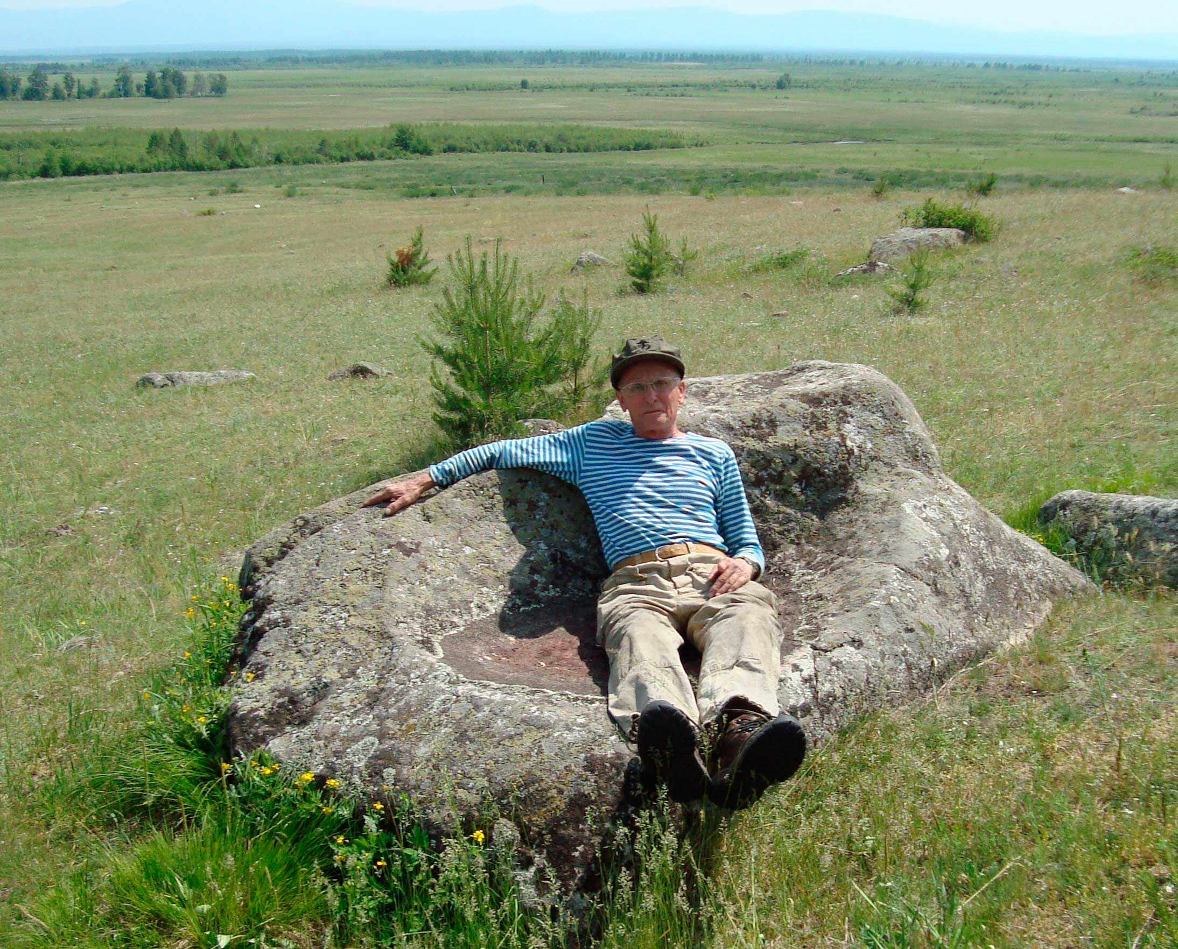
REMOTE SENSING METHODS FOR INVESTIGATING OUTGOING INFRARED RADIATION OF RECENT LARGE REGIONAL FAULTS AND ITS TERRESTRIAL HEAT FLOW AND GEOCHEMICAL HALOES
N.V.Vilor, L. D.Andru-laitis, O. V.Zarubina, B. S.Danilov, and A. V.Klyuchevsky
Institute of Geochemistry SB RAS, Irkutsk, Institute of the Earth’s Crust SB RAS, Irkutsk , Russia
THE MOUNTAIN KING’S ARMCHAIR

Slide 2
Purpose
Determination of intensity of outgoing IR radiation flow of large seismoactive regional faults, which are expose by surface heat flows by remote sensing method and correlation this flow with transfer of mobile chemical elements and its geochemical flows
Items
the remote sensing method of mapping of distribution of intensity of outgoing IR radiation flow for different geodynamic situation
the investigation of nature of surface outgoing IR radiation flow
the investigation of distribution of mobile chemical elements into surface formations of regional faults
the calculation of its geochemical flows by using the conception of geochemical barriers

Slide 3
satellites NOAA, TERRA, AQUA
Brightness of the outgoing electro-magnetic radiation
in the IR band mea-sured by satellites
The area of computing the geometric factor
L
The outgoing electro-magnetic
radiation in IR heat band
F–surface heat flow (mW/m2)–the effective surface radiation of the geostructure
F
The area of subsurface heat-mass transfer
via heat-carriers
The flow was formed inside the radiating layer of the ground
F = F_{gr} + F_{c} + F _{phc} + F_{d}
F_{d}
The subsurface heat flow from the upper part of the earth’s crust.
THE SCHEME OF THE ORIGIN OF THE SURFACE INFRARED
RADIATION OF THE LARGE REGIONAL FAULTS

Slide 4
Geodynamical situations of manifestation of outgoing surface IR radiation flow of large seismoactive regional fault
Type of regional deformation | Region
Tention, rifting | Baikal rift zont (BRZ), Rhine graben, “Afar triangle” + Eastern – African rift
Displacement | San – Andreas transform fault system
Collision | Himalayas, Western- Copetdag structural arc
Block compression, ramp situation | Tarim basin and its folded frame

Slide 5
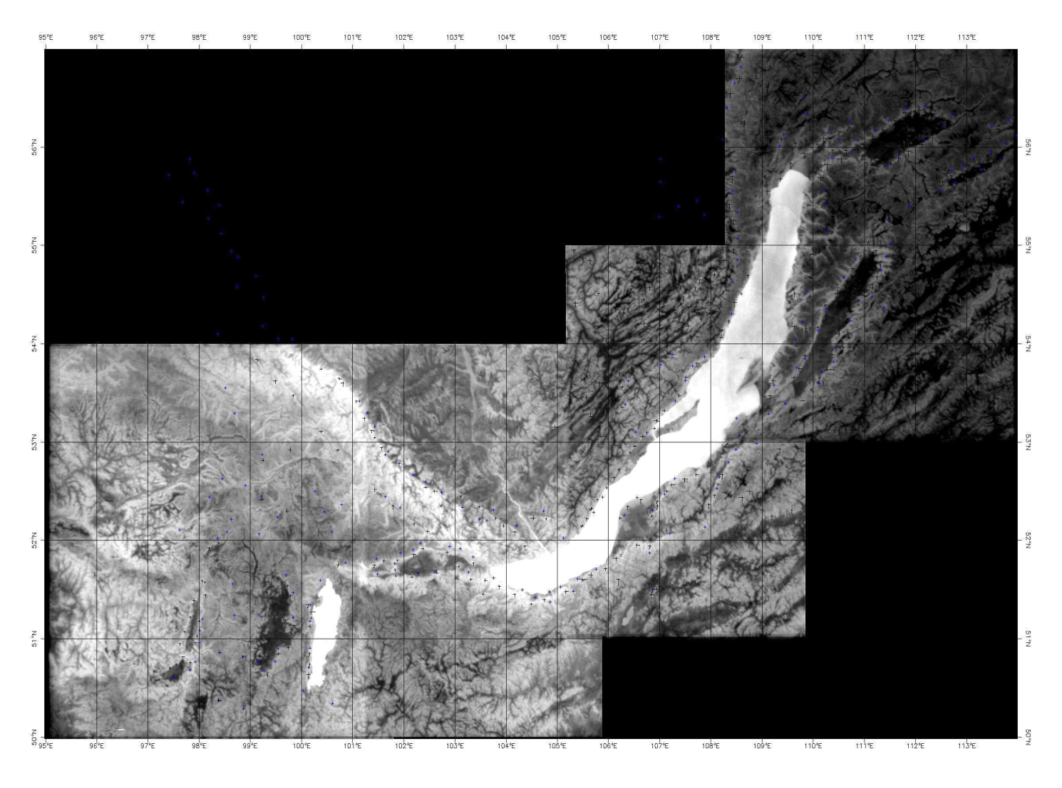
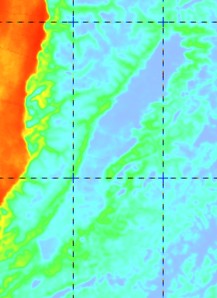
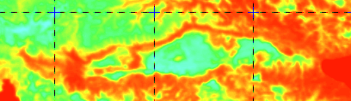
Distribution of outgoing surface IR radiation in the BRZ. 1 – 5 the largest rft depressions: 1- Baikal, 2- Hovsgol, 3 - Tunka, 4 – Barguzin, 5 – Upper Angara, 6 - Darkhat
B
Rift situation. Outgoing surface IR flow large tectonic depressions BRZ. A. Tunka depression. B. Bargoozin depression
A

Slide 6
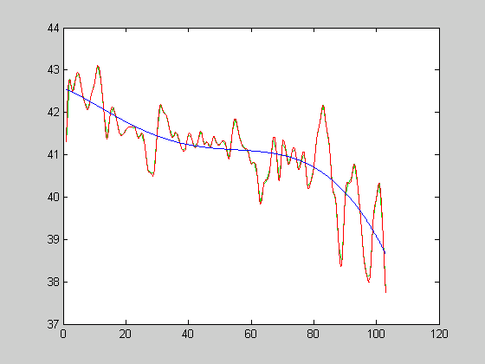
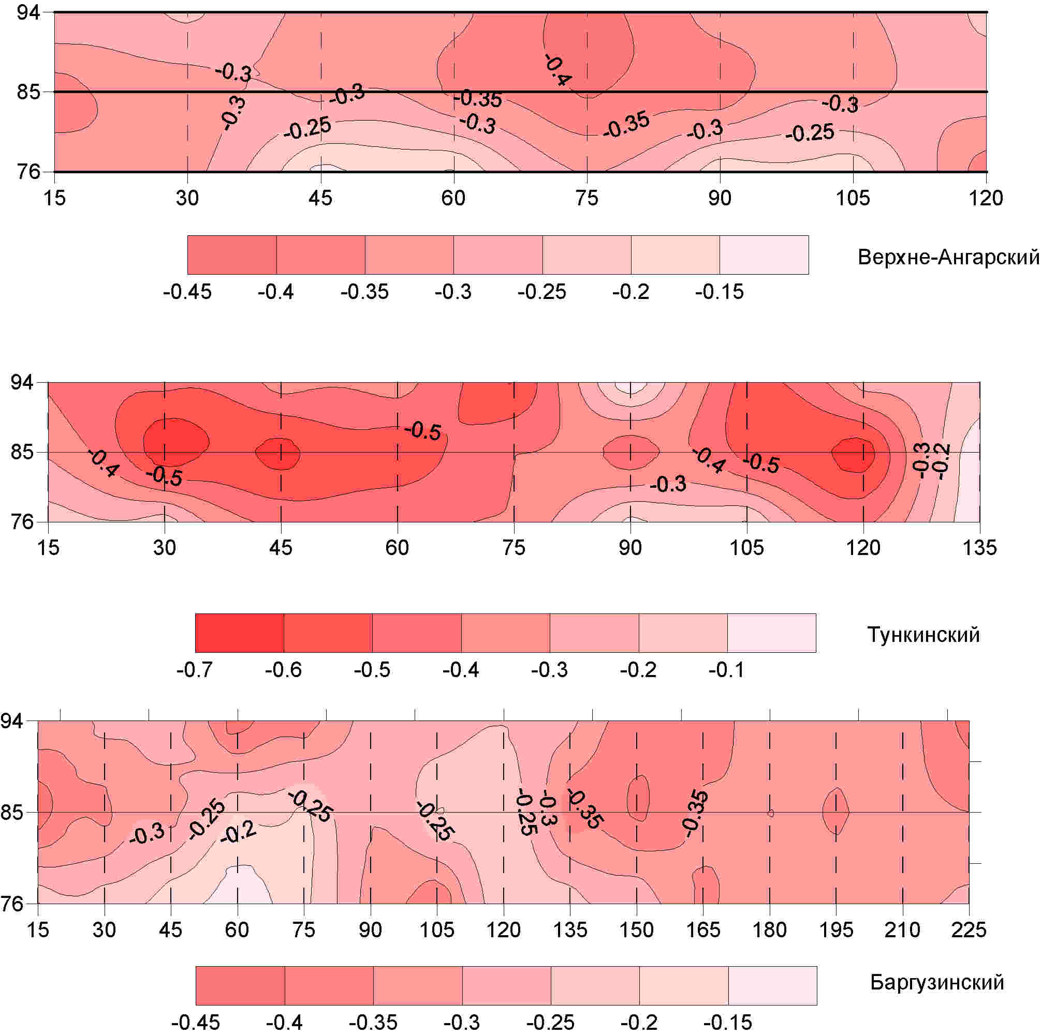
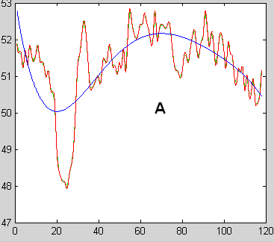
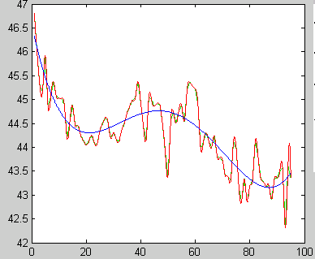
The temporal maps of regional permeability along large faults BRZ for 1976 – 1994 years
A
Upper Angara
B
Tunka
C
Bargoozin
The low length wave of geometric component of plots of outgoing surface IR flows of BRZ’largest faults

Slide 7
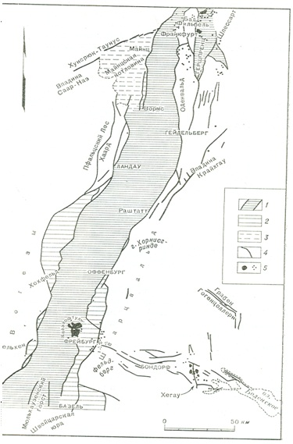
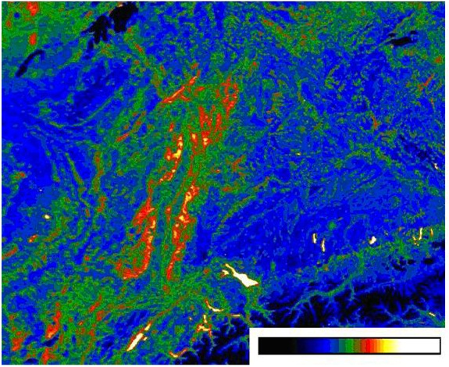
А
Мангейм
Frankfurt
Strasburg
C
Страсбург
Fraidurg
B
Outgoing surface IR flows map of Western Europa part with Rhine graben. A, B, C – large regional faults (after Gorni V.I. 2007)
The structural map of Rhine graben. thermal water springs (after Friedrichsen,1981
famous water spring

Slide 8
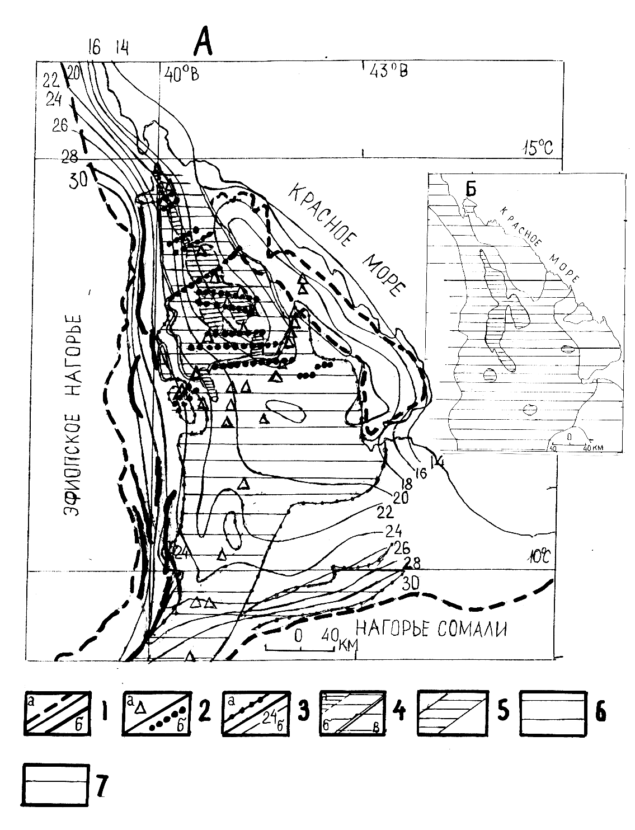
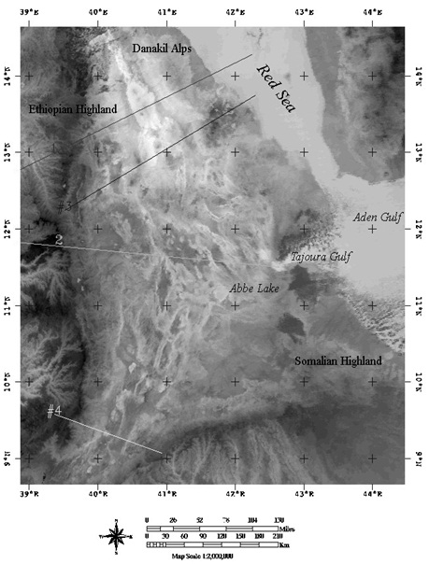
The structural map of Afar
B
The correlation of the depth of bedding of Moho surface and outgoing IR flow
The
IR
flow
The outgoing surface IR flow map of Afar depression and mouth of Eastern African rift
The depth of bedding of Moho surface, km

Slide 9
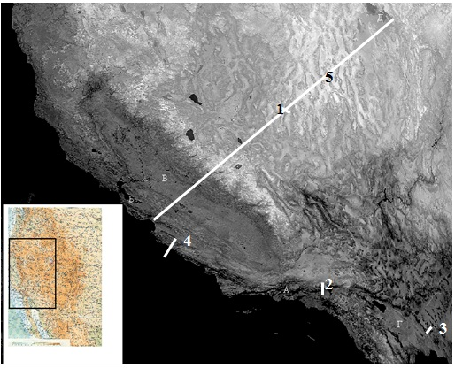
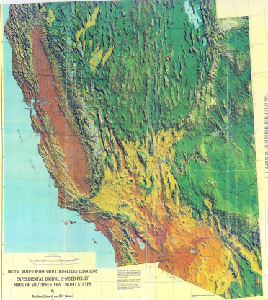
B
C
A
The displacement geodynamic situation. IR radiation distribution on western part of USA(A) and structural maps of San-Andreas transform fault (B) and Big Basin province (C) (after R.L.Cook andJ.A.Thomson, 1970)

Slide 10
IR radiation anomalies of the surface of large faults of San Andreas system (1-3) and on faults of Big Basin province (4-6) F –fault’s tracks
F
F
F
1
2
3
IR
radia-tion temperatu-re, K
F
F
F
5
6
4
Points of dimention

Slide 11
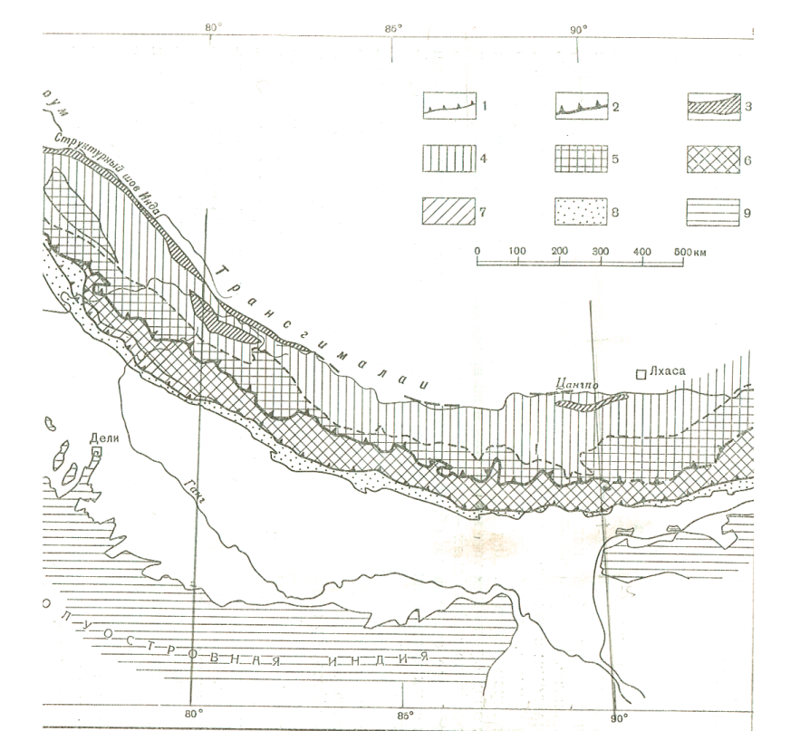
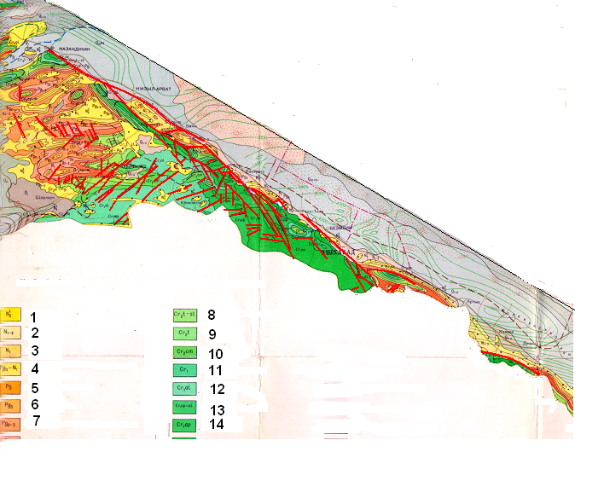
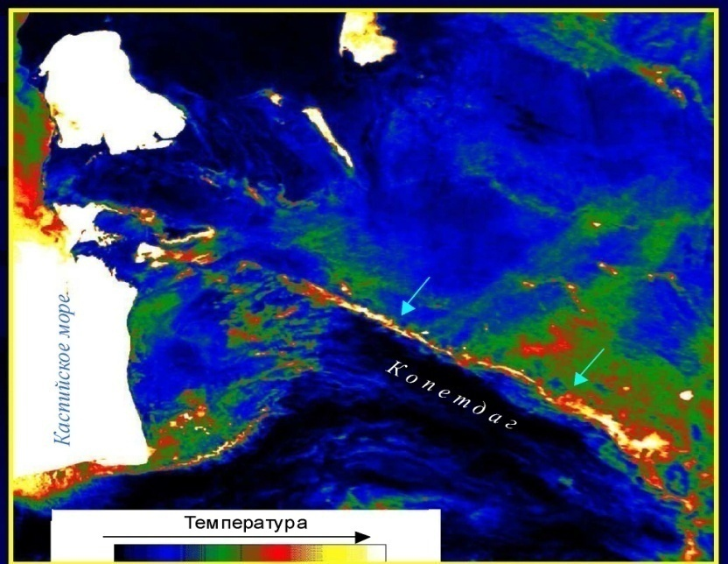
Collision situation. Structural (C) and IR radiation flow intensity (D) maps of Copetdag structural arc (after Tronin, 2010)
A
C
South-Turkmen main fault
D
Kura-Bugaz gulf
B
Kara-Kum desert
Caspian Sea
South-Turkmen fault
Aladag-Binalud displacement
Structural (A) and IR radiation flow intensity (B) maps of the main bord er
fault of Himalayas (after Ganser A.1967, Tronin,Saraf, 2010)

Slide 12
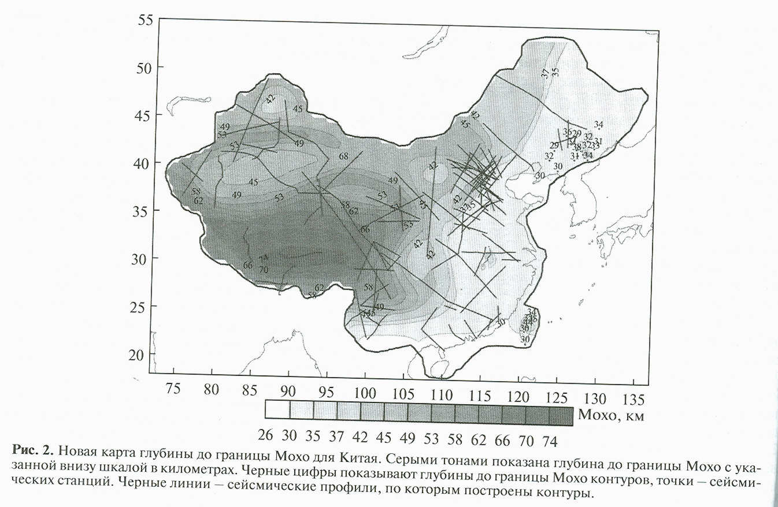
The Tarim
platform
The new map of Moho surface for Chinese territory
by Baranov, @Earth Physics, N1, 2009
Ramp situation
These boundaries are located on the slopes of the uplifted block of the upper crust, which corres-ponds to the massif of the Tarim platform.

Slide 13
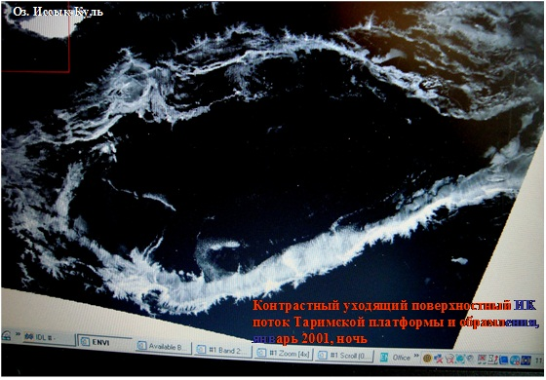
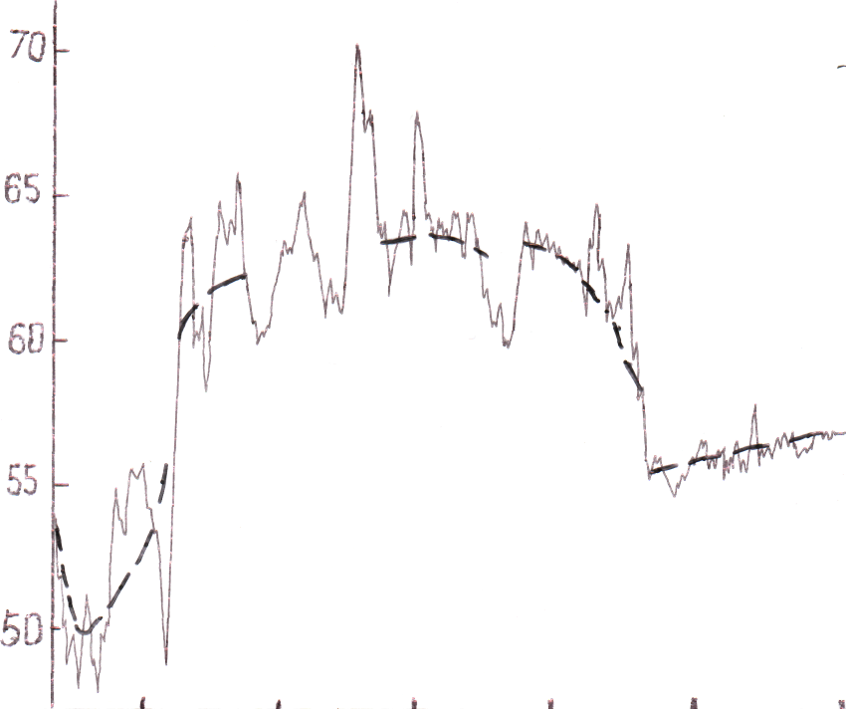
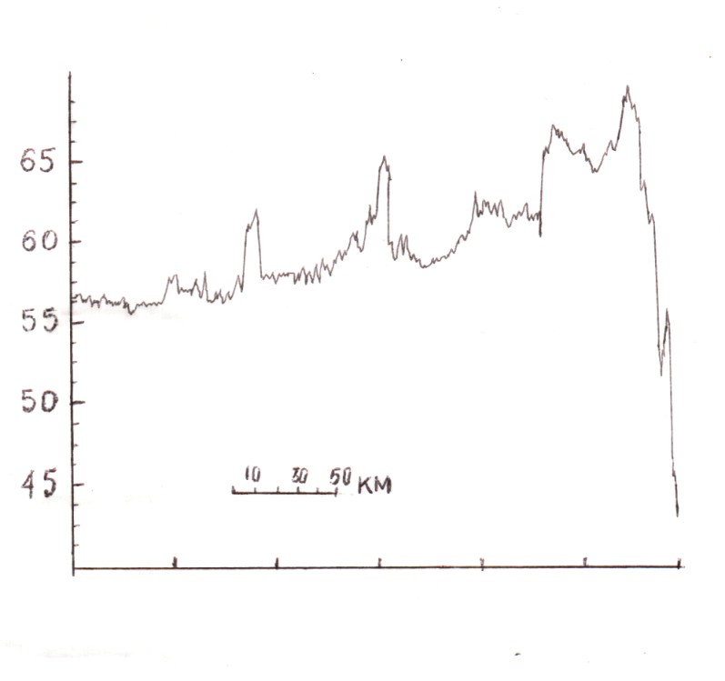
IR flux
The northen boundery
Faults
desert
range
The border zone
IR flux
The southern boundary
faults
Brightness of the contrast outgoing surface IR flow for the Tarim platform and its framing (January 2001, night)
Basin’s upluft
Border zone
desert
range
The distribution of IR flux intensity across Tarim platform
The distance, km

Slide 14
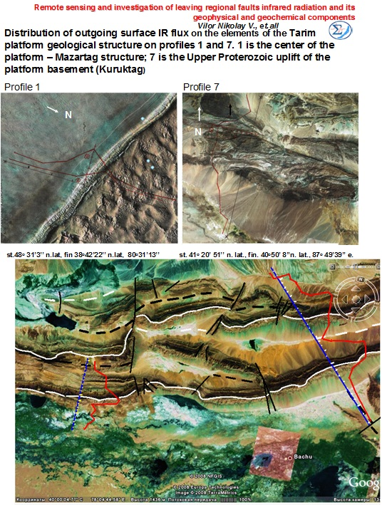
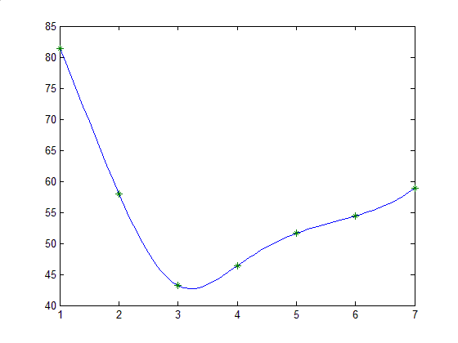
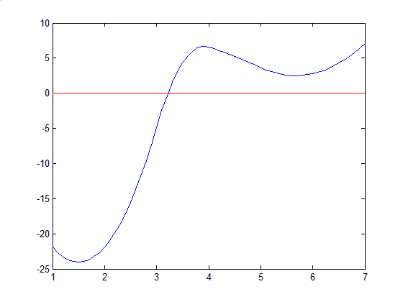
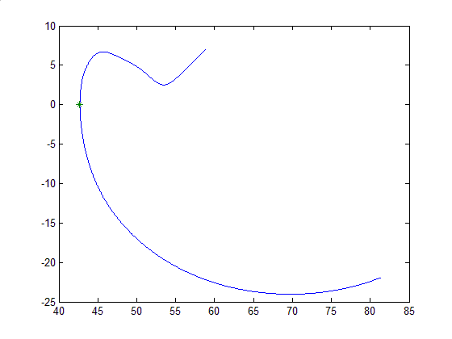
IR flow
The calcula-tion of quasista-tionary IR flow
Mazartag structure
months
Kuruk-tag structure
The derivative of IR flow
The minimum of derivative
Kalpin-tag structure

Slide 15
The transition to the values of brigthness measured for the surface IR flow can be made with the use of the following relation
F = L · G (Gossorg, 1980) (1),
were F - surface IR flow , L - brightness IR flow, G - geometric factor, which writes
G = π ·S · sin2 α = 6.8704 (m2. ster).
Hence the surface IR flow F computed by (1) makes: F = 6.8704 L (mW).
Values of F are added for the components, which form its balance. The addends of such a balance include: Fgr – heat flow of the active ground layer (the result of heat inertia), Fc – heat effect of the surface condensation or crystallization of water vapor, F pch – heat effect of the process of oxidation of gases coming from the ground in the upper part of the active layer, Fd – component of the deep heat flow. Hence, we have:
F = Fgr + Fc + F pch + Fd
The sub-surface endogenic flow Fd is the sum of influences of the conductive and the convective components upon the radiating layer. The difference between the value of the near-surface endogenic flow Fd and the near-surface conductive component Fcnd computed represents the share of the convective component Fcnv . Fcnv = Fd – Fcnd
The calculated surface heat flow of large regional faults of BRZ
Fault | Bright-ness flow, L мW/м².сr.μμм | Surface heat flow, F мW | Depth part of F, F _{dep}, мW | Portion of F depth, мW |  | The part of kon-vektive portion, %
 |  |  |  | konduc-tive F conda | konvec-tive Fconve
Tunka | 103.027 | 707.84 | 323.37 | 25.46±4.14 | 297.86±4.18 | 92
Bargoozun | 85.466 | 587.19 | 362.14 | 25.44±2.69 | 336.71±2.7 | 93
Near-sea | 112.242 | 771.15 | 339.36 | 20.94±1.67 | 318.42±1.67 | 94
Border zone of platf. | 103.64 | 708.09 | 289.62 | 18.79±0.8 | 270.86±0.77 | 94
The calculated surface heat flow of large regional faults of Tarim basin and it folded frame
Fault structu- re | Surface heat flow F, mW | Depth conduc-tive part of F, calulated | Portion of Fdepth, mW
 |  |  | konducti-ve, F conda | konvek- tive, F conve
Mazartag | 61.47 | 40 | 19.59 | 41..88 (68)
Kalpintag | 196.56 | 40 | 19.59 | 176..97 (90)
Choltag | 199.87 | 44 | 20.22 | 179..65 (90)
Kuruktag | 186.86 | 45 | 20.38 | 166.48 (89.1)
Altuntag | 256.56 | 43 | 20.06 | 236.48 (92)

Slide 16
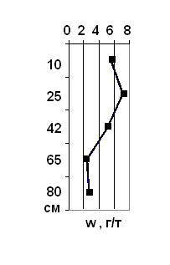
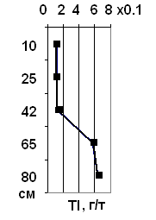
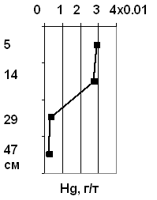
The set of geochemical samples on large seismoactive regional fault’s trakcs of BRZ
A. Border regional zone of Siberian platform and Tunka fault, B. Bargoozin depration
A
B
Depth, cm
Plots of volatile chemical ore element’s concentration distribution into surface formations of Bargoozine regional fault
The concentration is g / t

Slide 17
Geochemical indicators, associated with surface outgoing IR flow of large seismoactive faults of BRZ
Fault | n | Cm | B | Cu | Zn | Pb | As | Ge | Mo | Sn | Ag | Tl | Hg | Со | Сr | Ni | V
Tunka | 88 | Х | 42. | 34.2 | 75.40 | 13.9 | 11.6 | 1.2 | 1.98 | 2.6 | 0.2 | 0.9 | 0.1 | 16.1 | 81 | 68 | 68.2
 |  | ±σ | 2.0 | 1.32 | 1.12 | 1.31 | 1.62 | 0.4 | 1.35 | 0.9 | 0.2 | 1.0 | 0.1 | 1.3 | 1 | 1 | 1.3
Bargoo-zin | 75 | Х с | 14.3 | 25.9 | 112.1 | 17.9 | 6.14 | 1.2 | 1.55 | 3.1 | 0.2 | 0.7 | 0.1 | 16.7 | 51 | 39 | 95
 |  | ±σ | 1.1 | 1.18 | 1.05 | 1.03 | 1.33 | 0.3 | 1.25 | 1.0 | 0.1 | 0.4 | 0.1 | 1.0 | 1 | 1 | 1
Border zone of platform | 91 | Х | 20.6 | 22.8 | 69.65 | 12.4 | 17.4 | 1.2 | 1.25 | 2.3 | 0.3 | 0.8 | 0.6 | не определены
 |  | ±σ | 2.1 | 1.28 | 1.25 | 1.59 | 2.21 | 0.6 | 1.82 | 1.2 | 0.3 | 1.4 | 1.5
Geotherm. field Kucheger |  | Х | 20.3 | 23.9 | 88.65 | 18.2 | 14.3 | 3.9 | 1.14 | 2.2 | 0.74 | 0.6 | 0.1 | 11.9 | 42 | 36 | 60.3
 |  | ±σ | 1.1 | 1.33 | 1.19 | 1.1 | 1.61 | 1.7 | 1.09 | 1.1 | 1.5 | 0.4 | 0.2 | 1.1 | 1.1 | 1.2 | 1.1
Fault | Indicators of geochemical specialization of faults
 | High concentration, g / t |  | According to dispersion |  | According to geochemical association
 | C_{max} | Back-ground | 9 elements F₁/F₂ | 15 elements, F₁/F₂ | 9 elements | 15 elements | Main / secondary
Tunka | B, Cu, Cr | B, Cu | Ge, B / Tl, Mo | B / Mo | Tl, Ag, Mo, B | Hg, As, Ag, Mo | Ag, Mo/ Hg, As, Tl
Bargoozin | Zn, V | Zn, V | Ag, Cu / Pb, Tl | Ni, As / Pb, Mo | Tl, Cu, Ag, | Mo, As, Tl | Tl / Cu, Ag, As
Border zone of platform | As, Hg | Hg | Cu, Zn / Tl, Mo | Mo, As / Zn | Mo, Tl, Ag | Mo, Hg, As, Ag | Mo, Ag / Tl, Hg, As,
Geothermal field Kucheger | Ge, Ag | Ge, Ag | не расс- читано | Zn, Pb / V, Co | не рассчит. | Hg, Ag, Mo, Ge | Hg, Ag, Ge / Mo

Slide 18
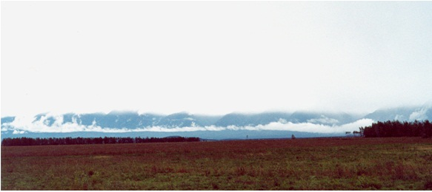
Surface ionization level of near ground air for Tunka fault track
П, geochim. flow = [С comp : (S ∙ t)] ∙10 ⁶ = kg/km² ∙ year.
Fault | geochim. flows, kg/km2 ∙ year |  |  |  |  |  | SHF, мWт | F dep, мWт
 | As | Tl | Hg | Ag | Mo | Ge
Tunka | 3.252 | 0.226 | 0.020 | 0.089 | 0.189 | не оп | 707.84 | 323.37
Bargoo-zin | 0.879 | 0.139 | 0.013 | не оп | не оп | не оп | 587.19 | 362.14
Border zone | 1.671 | 0.229 | 0.037 0.055 | 0.018 | 0.139 | не оп | 708.09 | 289.62
Thermal zone Ku-cheger | 21.44 | 0.413 | 0.021 | 0.479 | не опр | 7.267 | 74 Wт/м² | 9.553 МW
fault
rim zone
depression
Geochemical flows of large seismoactive regional faults of BRZ
Cordomorphous cloud above Tunka fault track
fault track

Slide 19
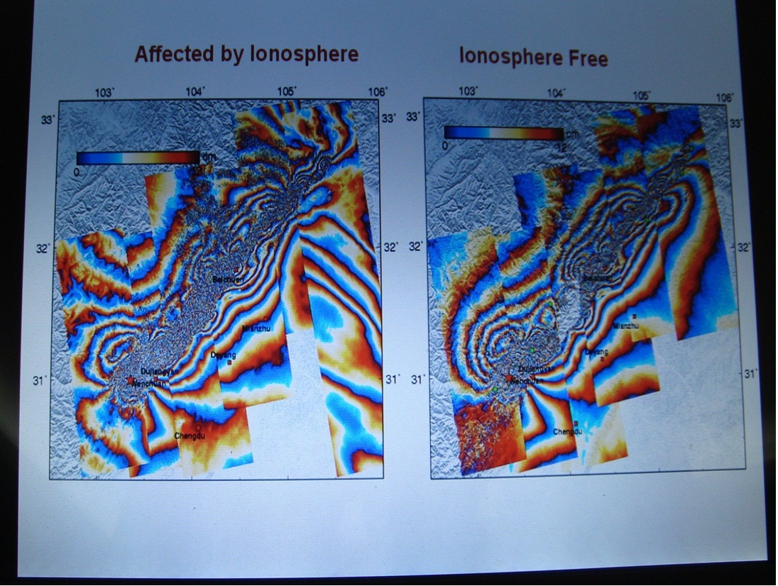
Thank's a lot for Your attention
Ionospheric perturbations above large seismoactive fault, associated with Wenchuan Mw=8.0 earthquake on 12 May 2008 in Sichuan, China (after Xiao-Li Ding et al., Urumqi, 2009)

