Slide 1




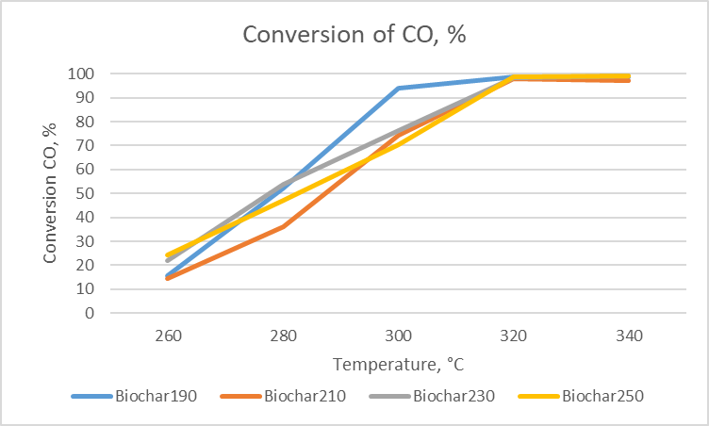
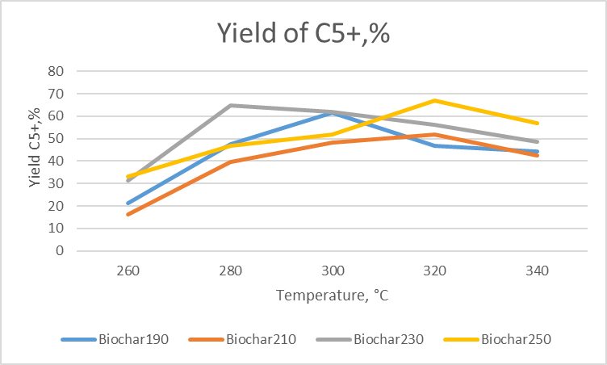
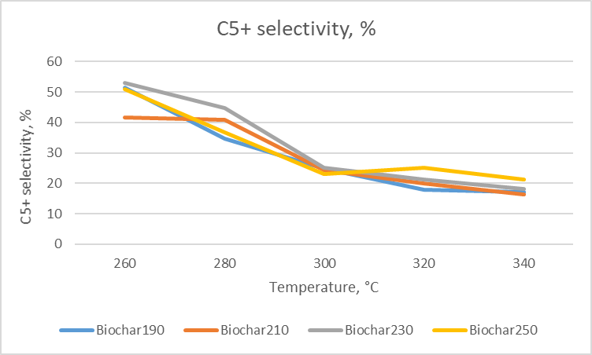
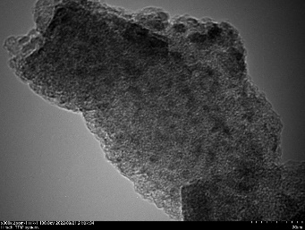
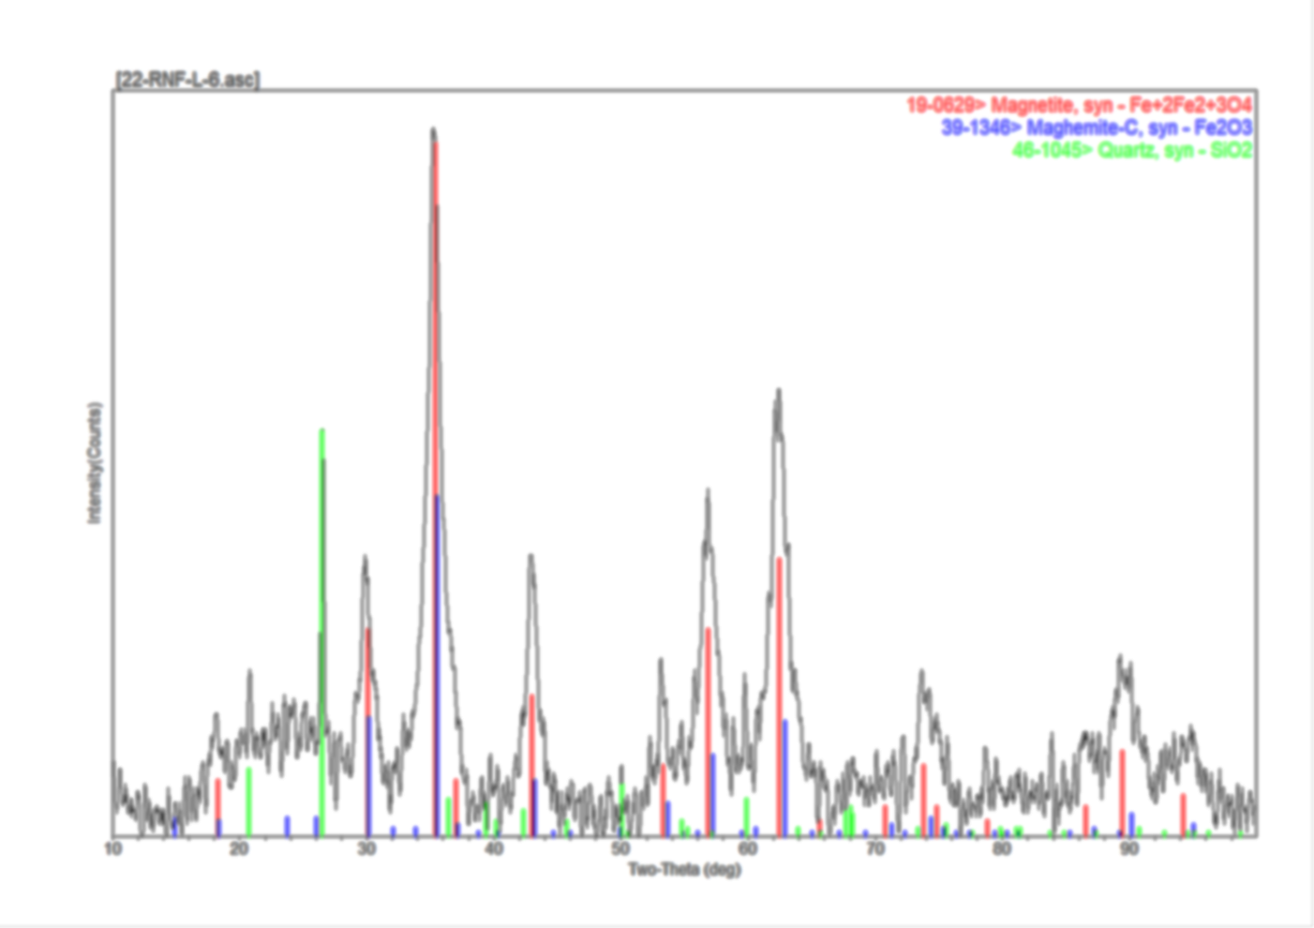
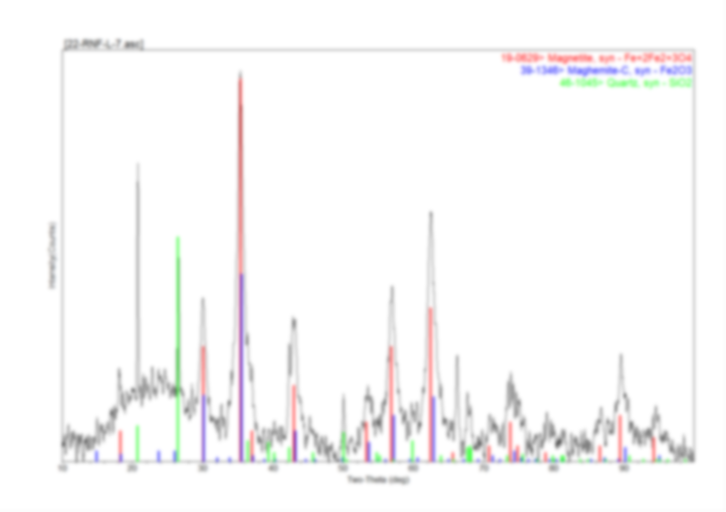
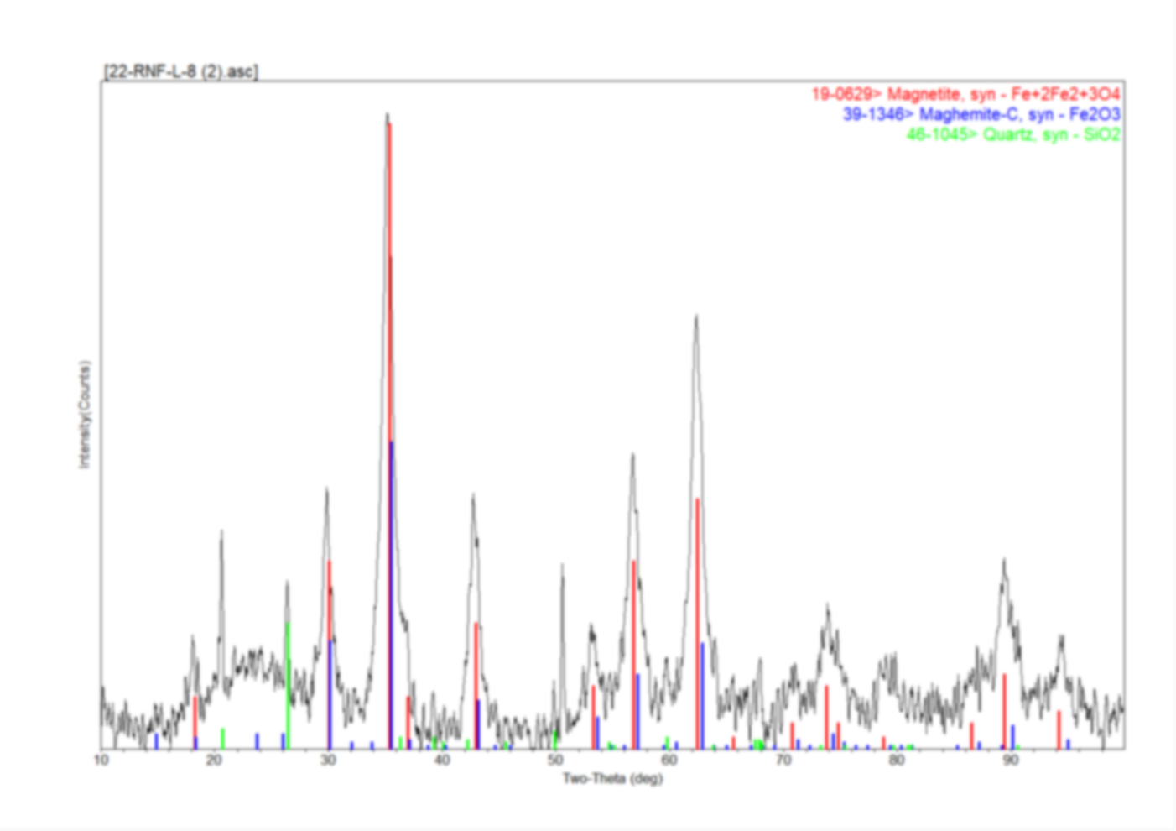
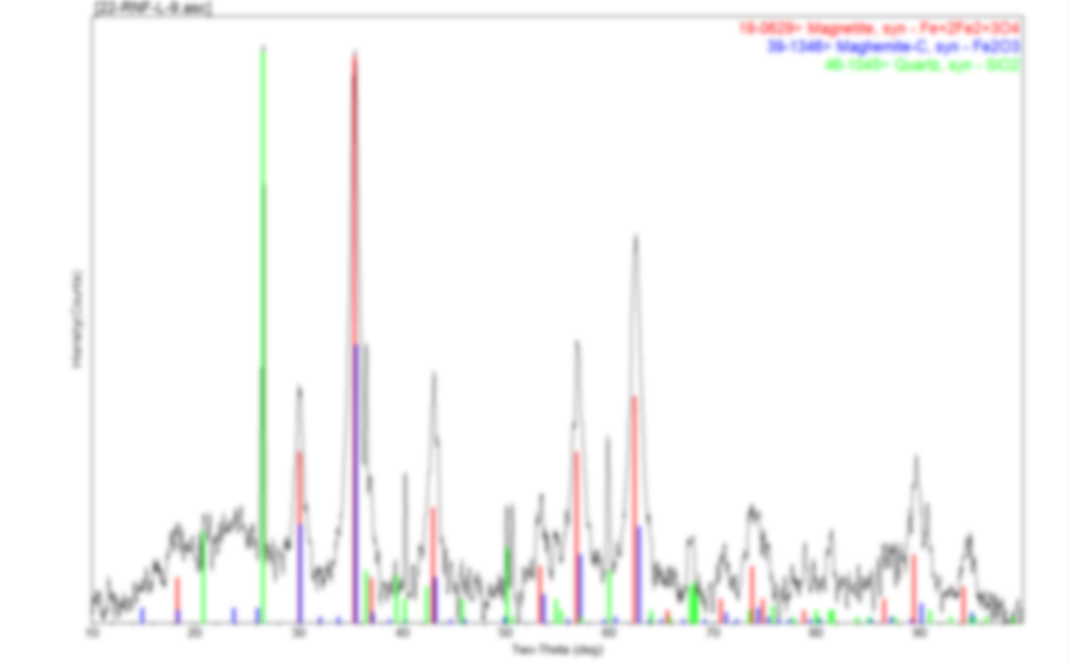

8thAsian Symposium on Advanced Materials, Novosibirsk
2023, 3-7 July
Composite CO Hydrogenation Catalysts Based on Lignin and Metal Salts
Krysanova K.O.^{1,3},Sotnikova A.E.², Ivantsov M.I.¹, , Grabchak A.A.¹
1 – A.V.Topchiev Institute of Petrochemical Synthesis, RAS (TIPS RAS), Moscow, Russia
2 – National University of Oil and Gas «Gubkin University», Moscow, Russia
3 – Samara State Technical University (Samara Polytech), Samara, Russia
E-mail: k_krysanova@ips.ac.ru
TIPS RAS
Introduction
Catalyst preparation
Fischer-Tropsch synthesis (FTS) is a key step of biomass-to-liquid (BTL) technology to convert biomass into a wide range of liquid hydrocarbon fuels and highly valued chemicals. This reactivity makes iron-based catalysts a good choice to convert synthesis gas derived from coal or biomass into fuels because both have relatively low H2:CO ratios [2]. In recent years, carbon-encapsulated metal nanoparticles have been reported as a new type of nanostructured carbon material. The nanoparticles have a typical core-shell structure of metal cores surrounded by carbon shells.
The catalysts were obtained by the incipient wetness impregnation method of hydrothermally treated lignin. Hydrothermal carbonization of lignin was carried out at temperatures of 190-250°C.
Next, the dried solid residue of hydrothermal carbonization was impregnated with iron nitrate (Fe(NO3)3∙9H2O) dissolved in a water-alcohol solution (1:1 vol.). The resulting mixture was dried in a water bath at a constant temperature of 96°C. After complete drying, the sample was calcined in a fixed bed reactor in an inert atmosphere at 400°C for 1 hour.
The hydrothermal carbonization is a process commonly used to upgrade biomass for use as a fuel or feedstock to produce high value added products such as liquid hydrocarbons or adsorbents. The process carried out in the temperature range of 190-250°C, in an anaerobic atmosphere, at autogenous water vapor pressure [2].
The possibility of obtaining catalytic systems from hydrothermally treated lignin that are active in the process of CO hydrogenation (Fischer-Tropsch synthesis) was studied in this work.
1. HTC, 190-250°C
2. Drying ( 22°C)
1. Incipient wetness impregnation
(
2. Drying (96°C)
Fe(NO3)3∙9H2O, water-alcohol solution)
1. Calcination (400°C)
Lignin
Biochar
Precursor
Catalyst
Characterization of the materials
Catalytic activity and thermal stability
 | N, % | C, % | H, % | О, % | Ash,% | Specific surface areaп (BET), m²/g | Pore size, А°
Lignin | 0,69 | 55,2 | 5,58 | 31,99 | 6,54 | 9,3 | 119
BIochar 190°С | 0,64 | 64,32 | 5,51 | 25,06 | 4,47 | 23,3 | 102
BIochar 210°С | 0,65 | 63,09 | 4,49 | 26,35 | 5,42 | 22,7 | 101
BIochar 230°С | 0,81 | 65,01 | 4,69 | 23,75 | 5,74 | 13,9 | 90
BIochar 250°С | 0,84 | 65,4 | 5,58 | 18,47 | 9,71 | 5,2 | 38
CO conversion was close to 100%, the yield of C5+ hydrocarbons reached 67 g/m3, the selectivity for the formation of C5+ hydrocarbons varied from 10 to 60%.
Polyconjugation system
FTIR spectra of lignin and biochar obtained by HTC of lignin: 1. Lignin; 2. Biochar 190°C; 3. Biochar 210°C; 4. Biochar 230°C; 5. Biochar 250°C.
It was shown that the catalytic systems obtained by the biochar impregnation method allow a uniform distribution of the active iron-containing phase over the surface of the catalytic system . The particle size was 3-15 nm.
Fe₃O₄, Fe₂O₃
Fe₃O₄, Fe₂O₃
BIochar 250°С
Сomposition of obtained hydrocarbons in the presence of BIochar 250°С catalyst
T,°C | Group composition |  |  | Fractional composition |  |  | α
 | paraffins | iso-paraffins | olefins | С5-С10 | С11-С18 | С19+
280 | 44 | 45 | 11 | 16 | 67 | 17 | 0.84
300 | 40 | 35 | 25 | 62 | 30 | 8 | 0.74
320 | 39 | 46 | 15 | 50 | 41 | 9 | 0.71
340 | 41 | 46 | 13 | 26 | 59 | 15 | 0.86
Biochar 190°C
Biochar 210°C
Fe₃O₄, Fe₂O₃
Fe₃O₄, Fe₂O₃
Conclusions
The fundamental possibility of forming catalytically active systems based on lignin in the Fischer-Tropsch process is shown. Hydrothermal carbonization of lignin made it possible to obtain a stable carbon material with a functionalized surface, which makes it possible to effectively immobilize ions of the active component.
Biochar 230°C
Biochar 250°C
Literature
Acknowledgement
[1] Zennaro R., Pederzani G. et all. (2001). Quantitative Comparison of Supported Cobalt and Iron Fischer Tropsch Synthesis Catalysts. Studies in Surface Science and Catalysis. 136. 513-518.
[2] Al Ramahi M., Keszthelyi-Szabó G., Beszédes S.. (2021). Coupling hydrothermal carbonization with anaerobic digestion: an evaluation based on energy recovery and hydrochar utilization. Biofuel Research Journal. 31.
The work was carried out within the framework of the Russian Science Foundation project No. 22-23-00900. The studies were carried out using the equipment of the Common Use Center "Analytical Center for Problems of Deep Oil Refining and Petrochemistry" of the Institute of Petrochemical Synthesis of the Russian Academy of Sciences.

