Slide 1
Hydraulic fracturing in mining. Protection of a degassing well in a coal seam from air infiltration through the rock mass
Institute of Mining SB RAS (Novosibirsk, Russia)
Azarov A.V, Patutin A.V., Shilova T.V., Serdyukov S.V.
This work supported by Ministry of Science and Higher Education (Russia)
Project RFMEFI60417X0172
Novosibirsk
2019

Slide 2
Outline
Features of the HF method application in the development of solid mineral deposits
HF in underground conditions:
– weakening of hard roof of coal seam
– intensification of coal methane recovery
– protection of underground workings by impermeable screens
Underground workings protection:
– methods for transverse crack formation
– hydraulic fracture propagation close to the mine (numerical modeling)
– fluids for creating protective screens by the HF method

Slide 3
Hydraulic fracturing in mining
Rock failure – fracturing of monolithic hard rock
weakening of hard roof of coal seam
destruction of large rock fragments (quarries)
Creating channels to intensify the injection and/or drainage of fluids
coal degassing
underground leaching of metals, extraction of viscous oils by thermo-mining method
Creation of impervious screens in the rock massif for isolation of mine workings from the zones of anthropogenic impact
protection of degassing wells in the coal from air suction from the working’s atmosphere
protection of underground galleries from steam breakthrough through rocks around production wells
elimination of water breakthroughs in the underground workings

Slide 4
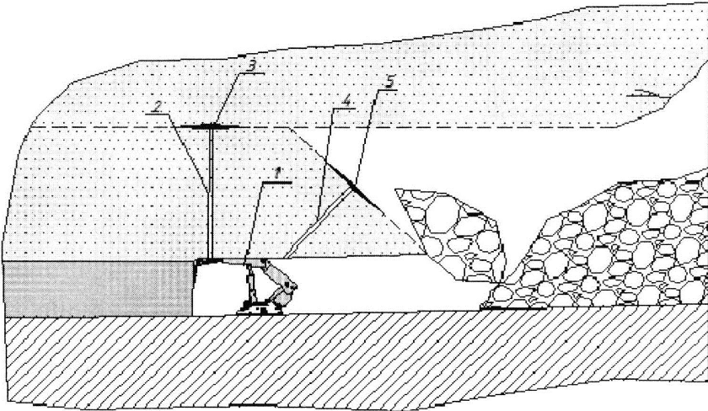
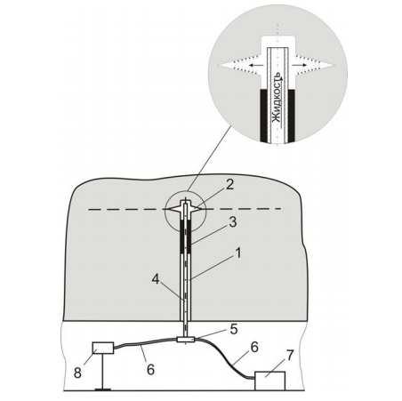
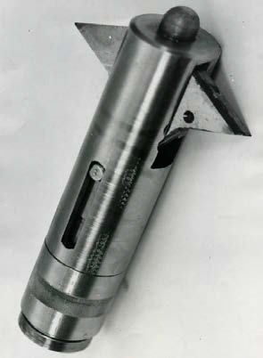
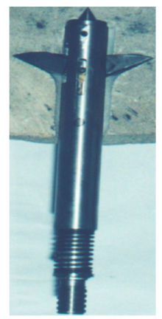
Weakening of hard roof of coal seam
roof
coal
coal
working
working
1 – powered roof support with shearer; 2, 4 – borehole; 3, 5 – fracture
Purpose:
Creation of cracks in the roof of the coal seam for its controlled collapse
Characteristics:
transverse fracturing at the bottom of borehole with a length of up to 30 m
the initiating slot of a transverse orientation is cut on the borehole wall
hydraulic fracturing is carried out with water, rarely with 15% hydrochloric acid solution
2 – slot former; 3 – packer
(Klishin et al., 2011; He et al., 2012)

Slide 5
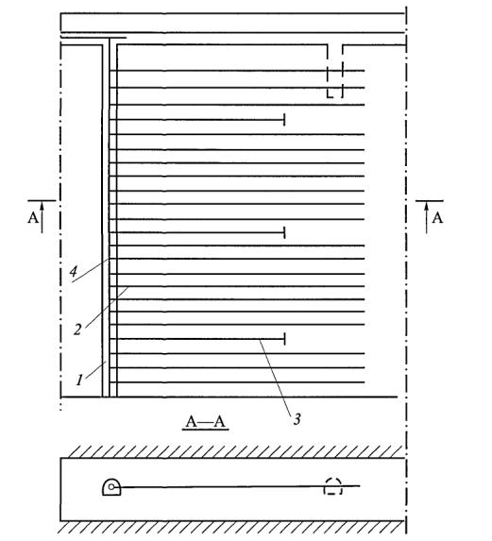
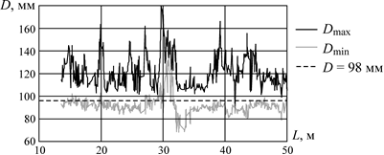
Intensification of coal degassing
Usually hydraulic fracturing is carried out with water in uncased boreholes without proppant. Boreholes are drilled from mine workings up to 100 m long. At the mouth there is a casing up to 30 m long. The annulus is filled with polymer.
There are some developments for in-mine hydraulic multi-fracturing along or across wells, mostly without proppants. The main problem is low strength of coal, borehole collapse, equipment sticking, complexity of sealing fracturing intervals due to the variability of the borehole profile
Typical degassing scheme with hydraulic fracturing through boreholes underground working
D, mm
L, m
2 - degassing well; 3 - HF well;
4 - degassing pipeline

Slide 6
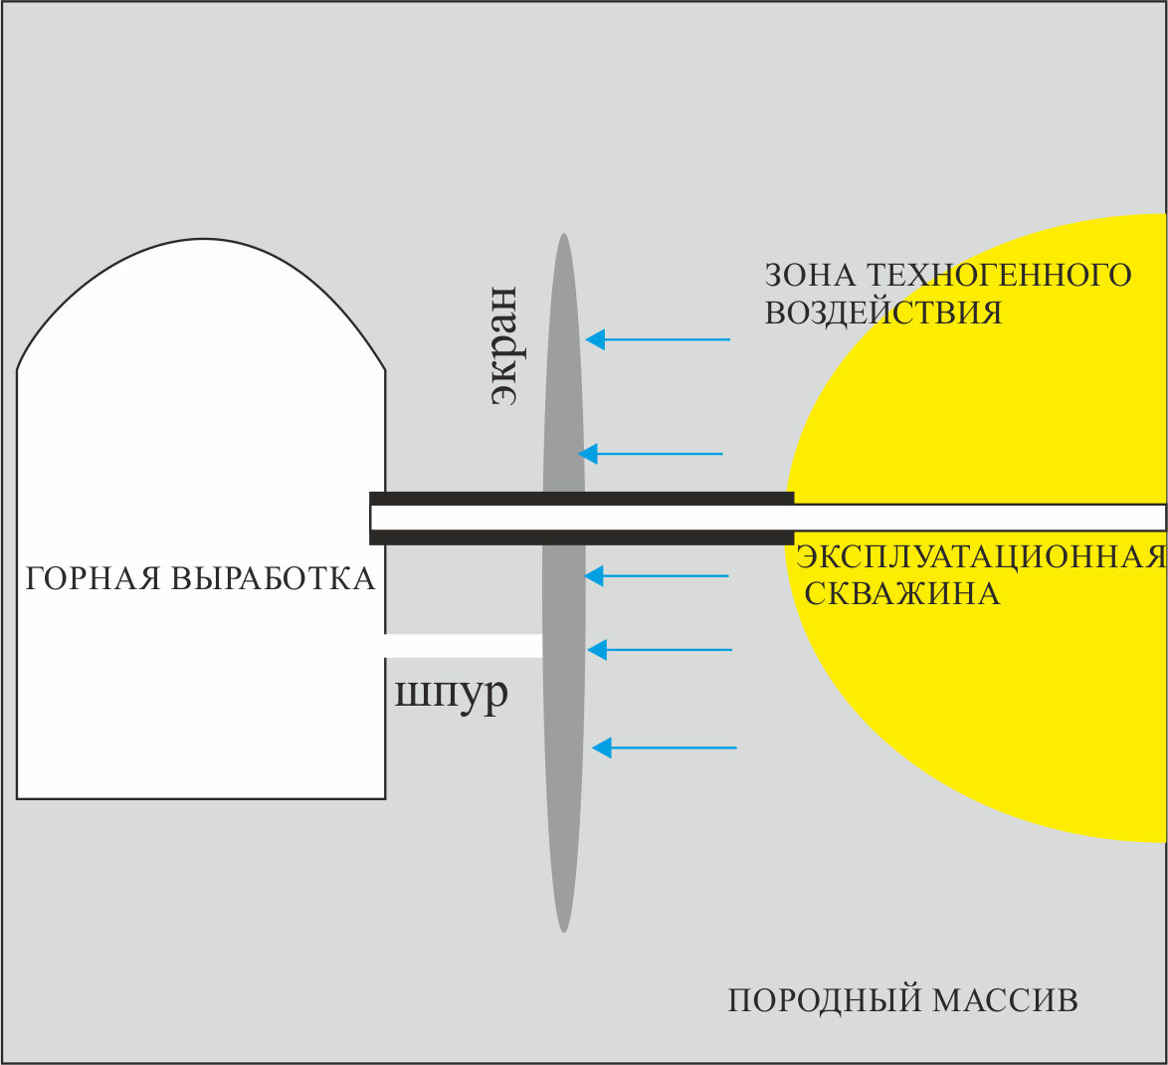
Protection of underground workings
Formation a protection screen
Low-volume hydraulic fracturing is carried out to eliminate the hydrodynamic connection between the mine workings and the vacuum zone of the degassing borehole (through disturbed rocks in the vicinity of the mine and the well)
It is made from an additional borehole 2–10 m deep with the formation of a transverse crack with a radius of 3–5 m.
The cavity of the crack is filled with insulating composition.
anthropogenic impact zone
screen
Underground working
degassing well
borehole
rock massif
The main tasks that need to be solved at the same time:
Creating a transverse crack at the bottom of a well
Accounting for the influence of mine workings on the fracture shape
Hydraulic fracturing fluids
Technical solutions for low-volume fracturing, especially in terms of efficient sealing of the fracture interval

Slide 7
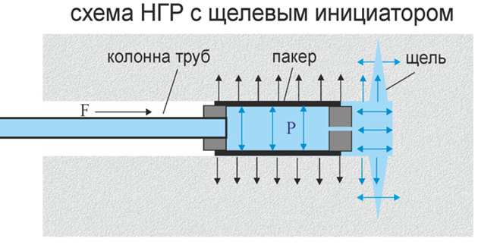
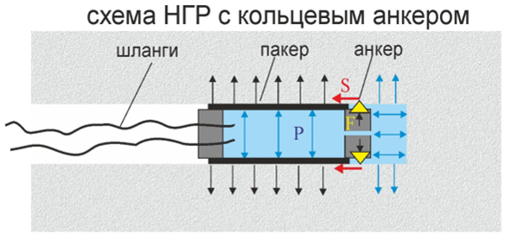
Transverse fracture formation at the bottom of a borehole
drill string
packer
slot
HP hoses
packer
anchor
Standard method with borehole wall’s cutting
Method with anchoring
The method is based on cutting an annular slot with the depth of up to one radius of the borehole
Mechanical cutting tools are used which is very energy consuming. Usually these tools are installed on the drill string instead of the drill bit, which leads to ineffective use of the drilling rig
For HF operation a packer on the pipe with a support on the drilling rig is used
The fracture is formed due to additional tangential loading of the borehole’s walls with an anchor. An additional tangential load arises by pushing the packer with working fluid in the fracturing interval
It is carried out in one operation without a drilling machine. Instead of a column of pipes flexible high-pressure hoses are used
This approach has some simplicity of technical solutions when 2-component fluids are used

Slide 8
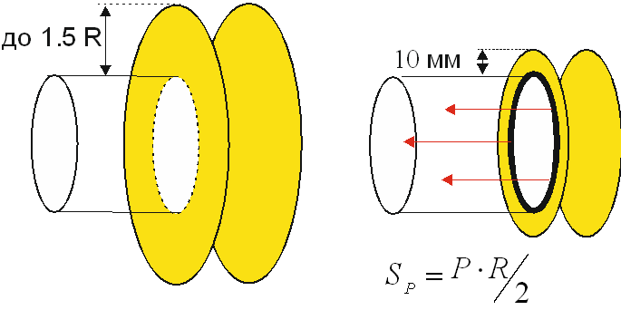
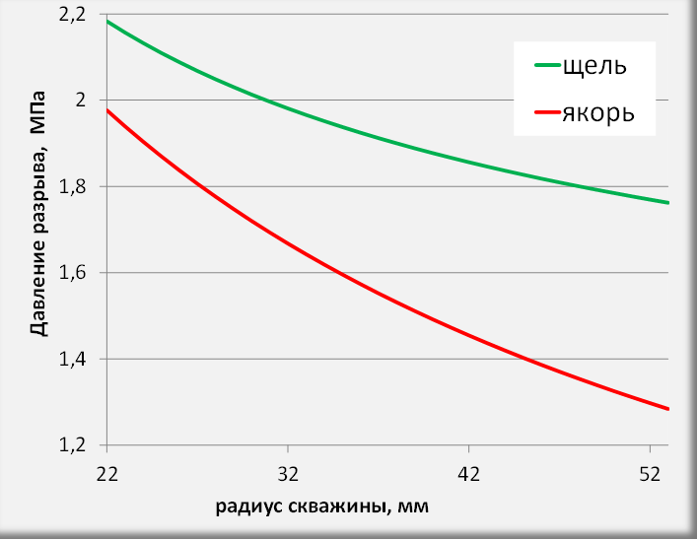
Comparative evaluation of transverse fracturing methods
A comparative analysis of the two methods was carried out through the known equations for the fracturing pressure expressed through the stress intensity coefficients
Calculation of the fracturing pressure at slot and anchor methods
up to 1.5 R
10 mm
slot
anchor
fracturing pressure, MPa
Models of disk cracks that are loaded:
a – force S_{p} distributed on the circle R
b – internal pressure P on the surface of the disk R
с – internal pressure P on the surface of the annular disk area
borehole radius, mm
a
b
c
The presented graphs show that the fracturing pressure according to the scheme with an anchor is lower than under the scheme with a slot for all considered values of R

Slide 9
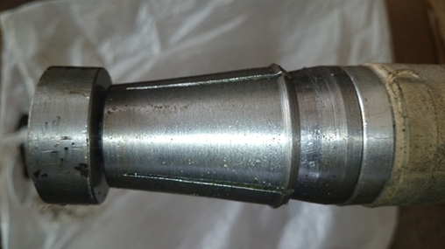
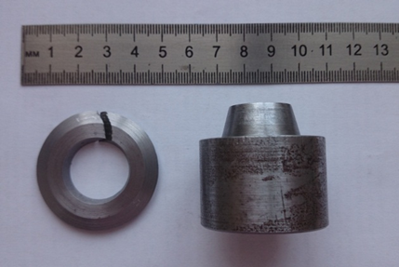
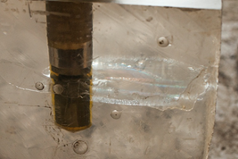
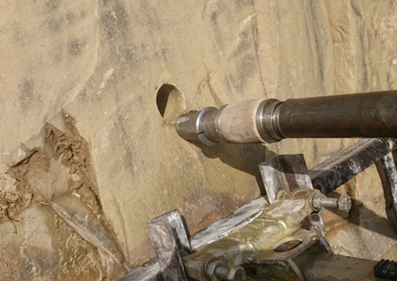
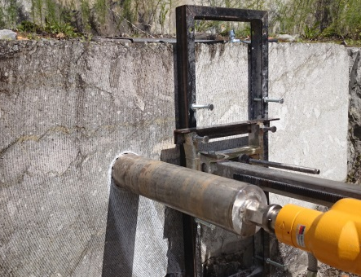
Transverse hydraulic fracturing with anchoring
Fracturing tool with anchor (prototype)
Anchor
Anchor
improved modification
Plexiglass
Sandstone
Marble

Slide 10
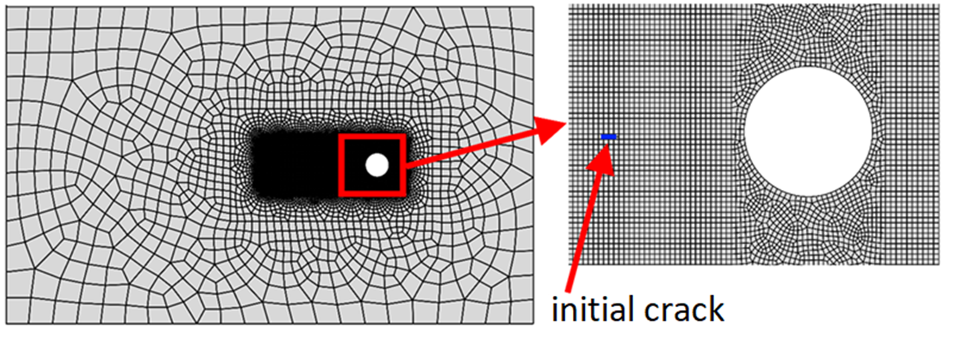
Description of the problem
In order to calculate the trajectory of crack propagation during its formation near the underground working numerical modeling was performed
2d model with a working in the form of a circle, mesh and initial crack
There is a hydrostatic pressure P_{h} inside the model (σ_{x} =σ_{y})
Underground working boundary (circle) is free
Viscous fluid flow is set to the initial crack; Poiseuille flow model within the crack
The medium is elastic, homogeneous; plane strain problem

Slide 11
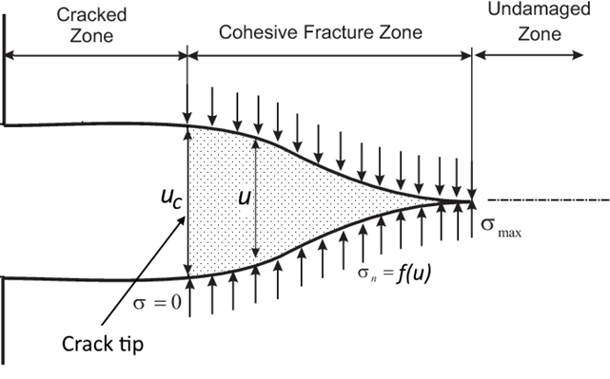
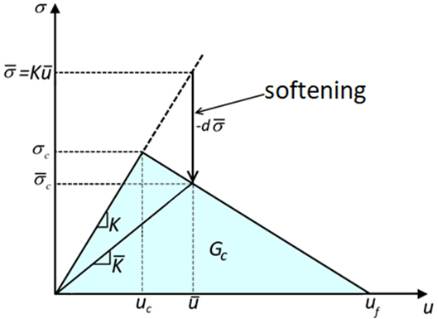
Simulation of hydraulic fracturing close to underground working
Modeling crack propagation based on:
eXtended Finite Element Method (XFEM) is used to model the propagation of the fracture and the flow of the fracturing fluid. XFEM is intended for discontinuities/fractures modeling and is based on the concept of local nodal enrichment functions and phantom nodes
Cohesive zone model (CZM) was used to model the softening of the rock
We used the implementation of these approaches in the ABAQUS software
Cohesive zone model
Bilinear law of material softening

Slide 12
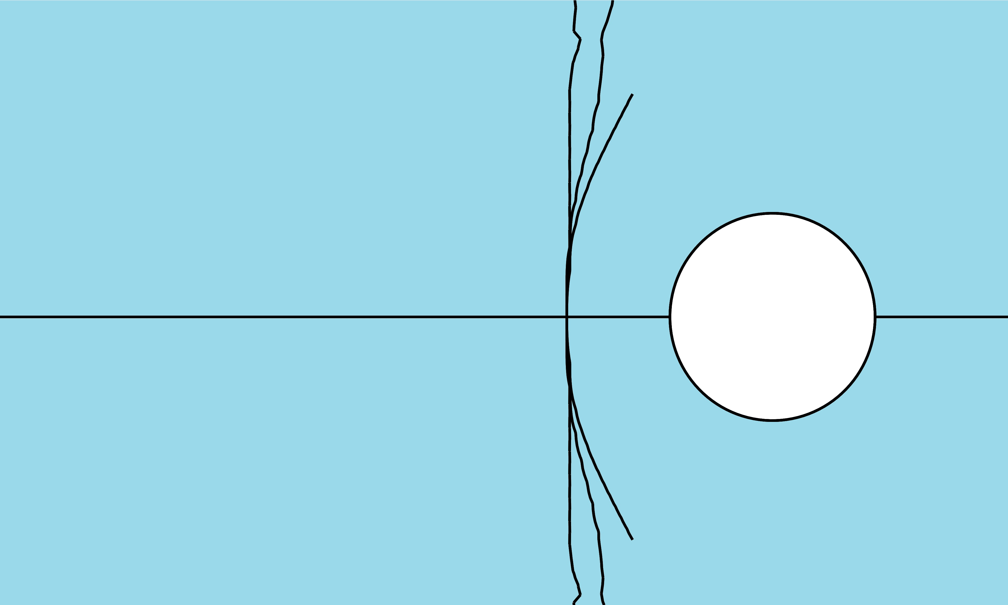
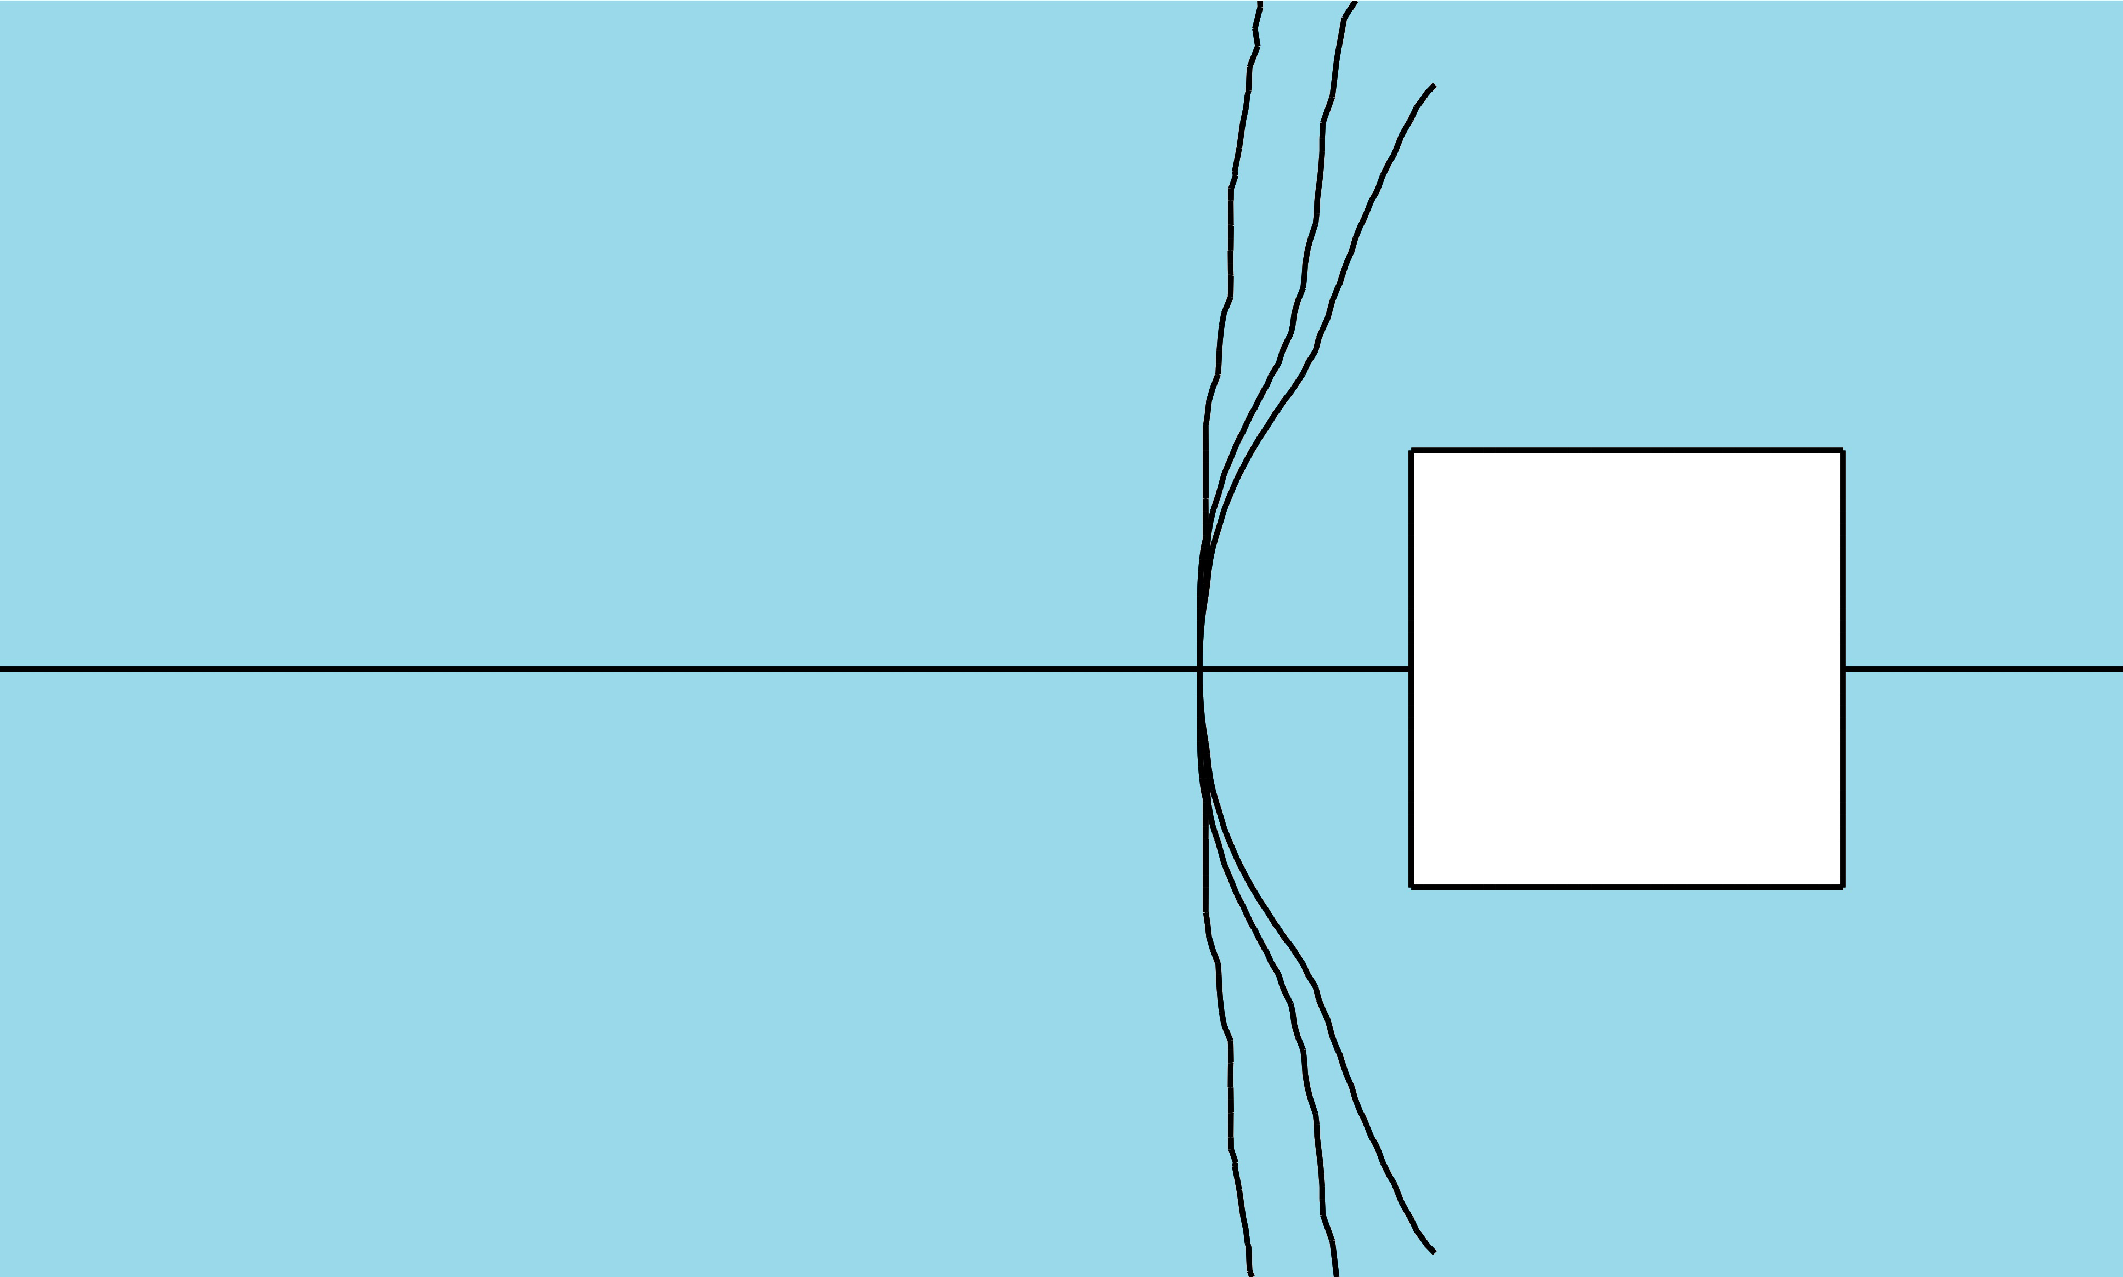
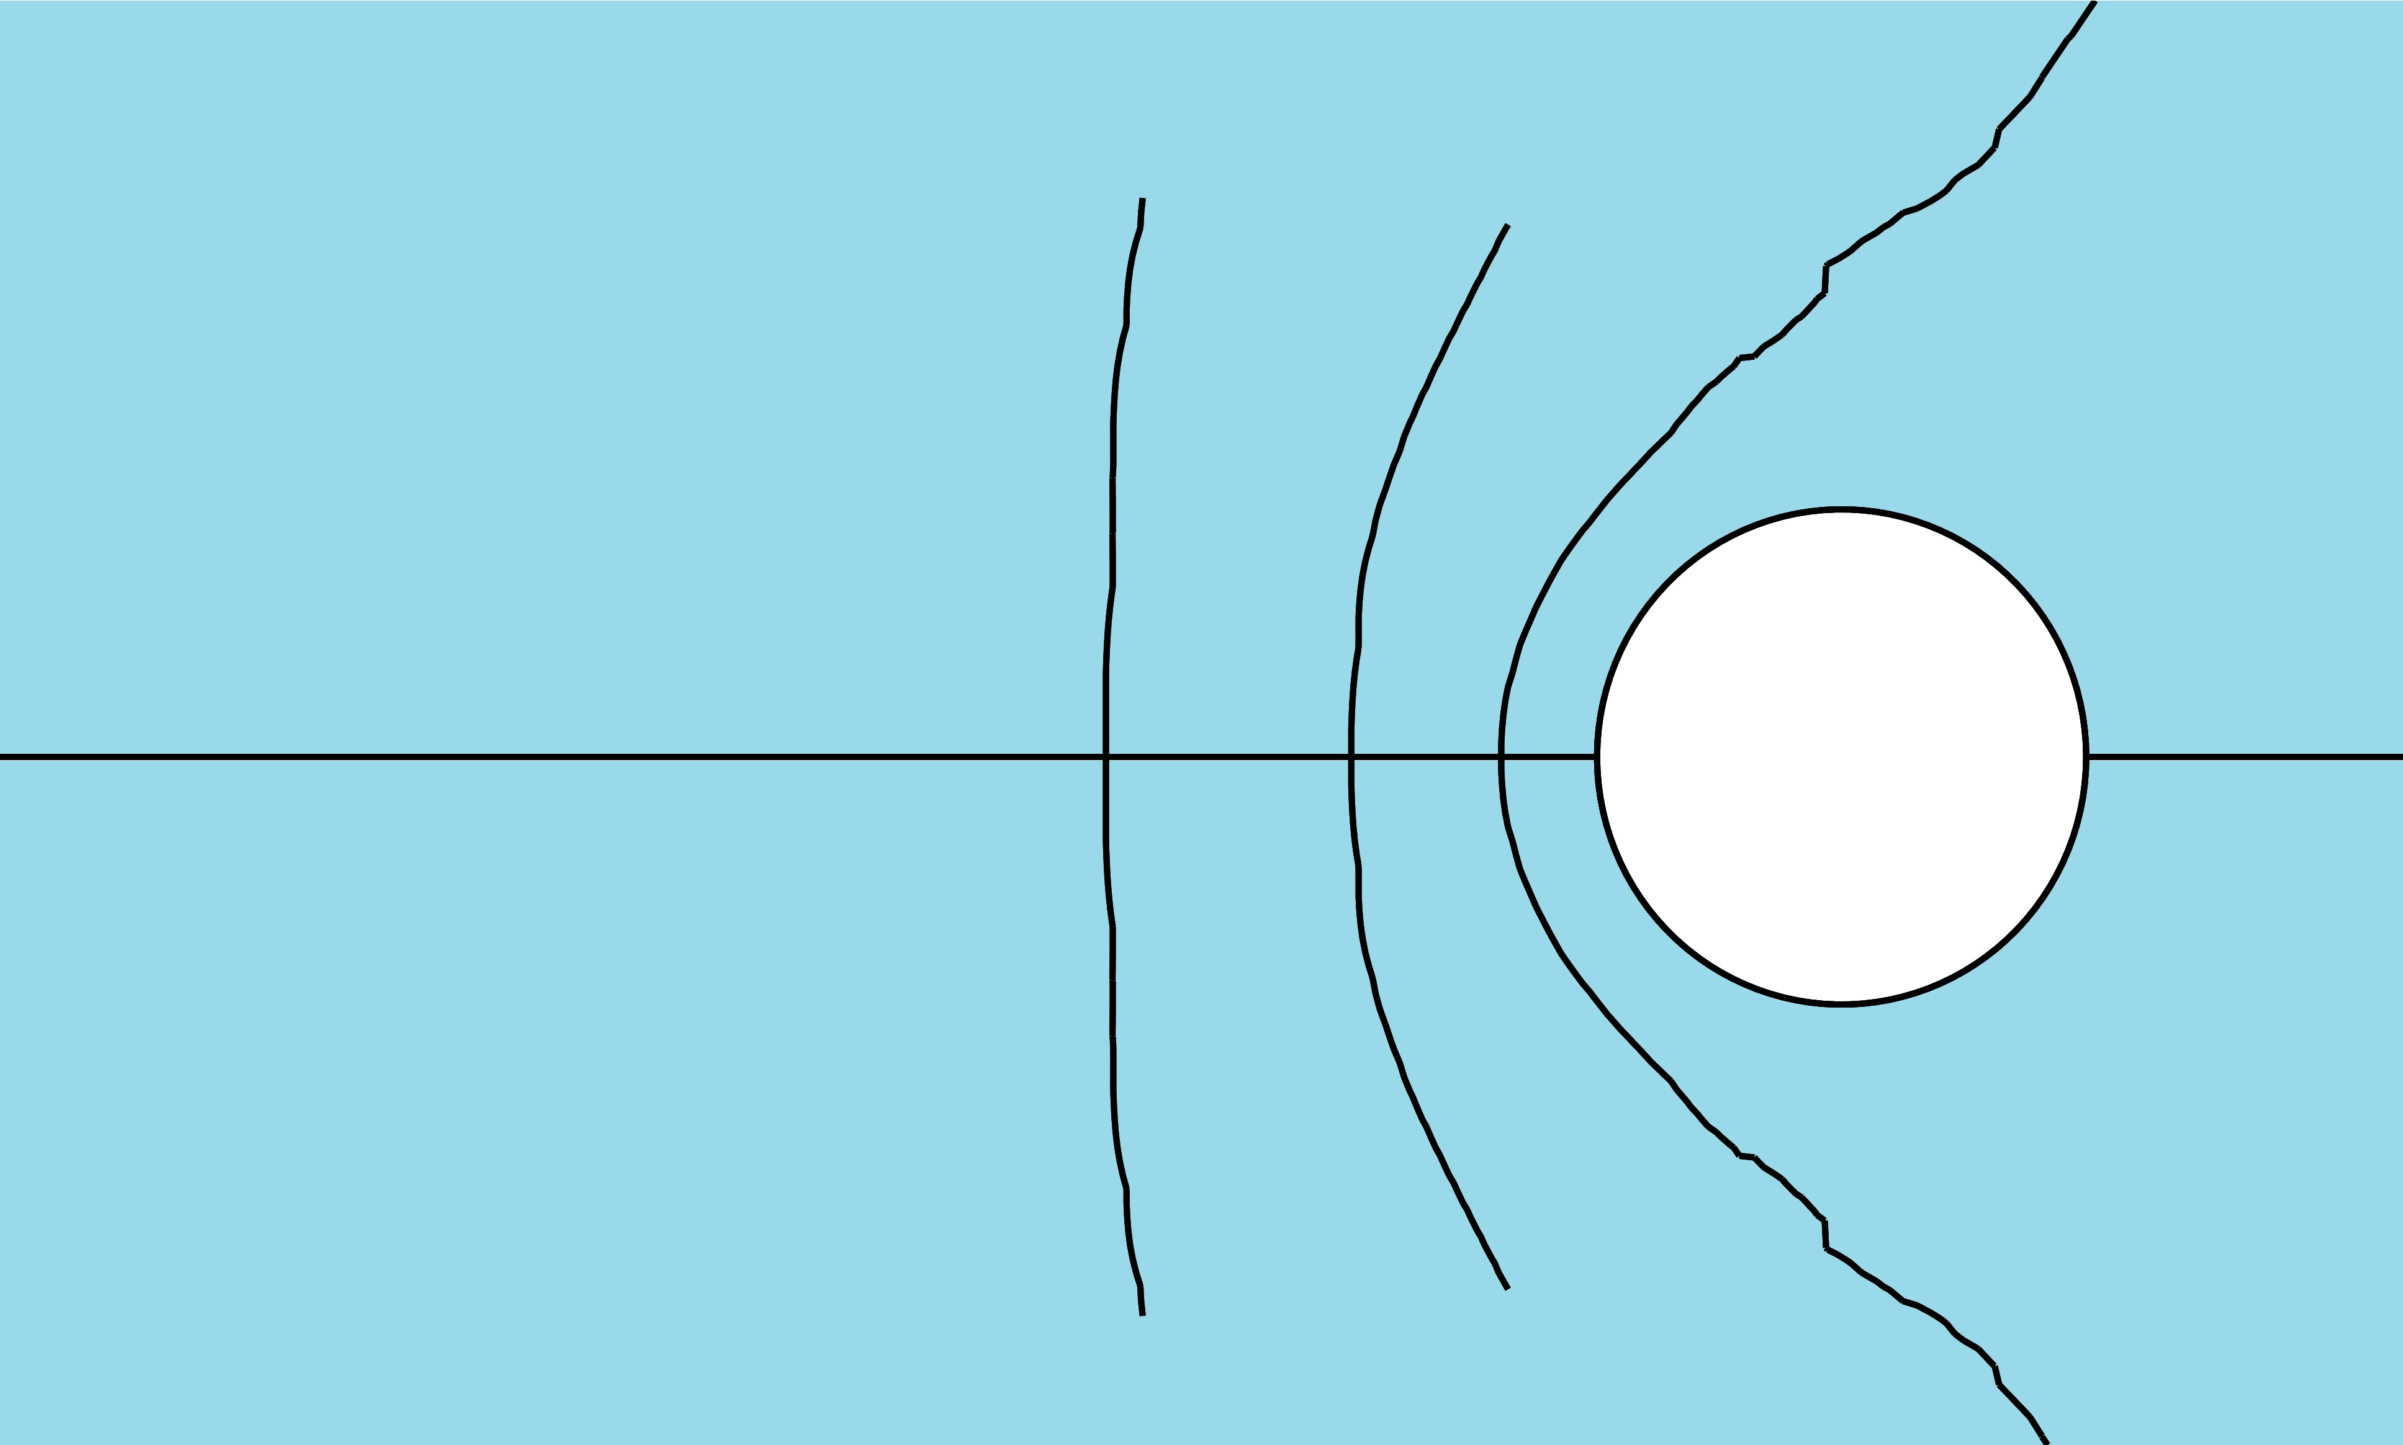
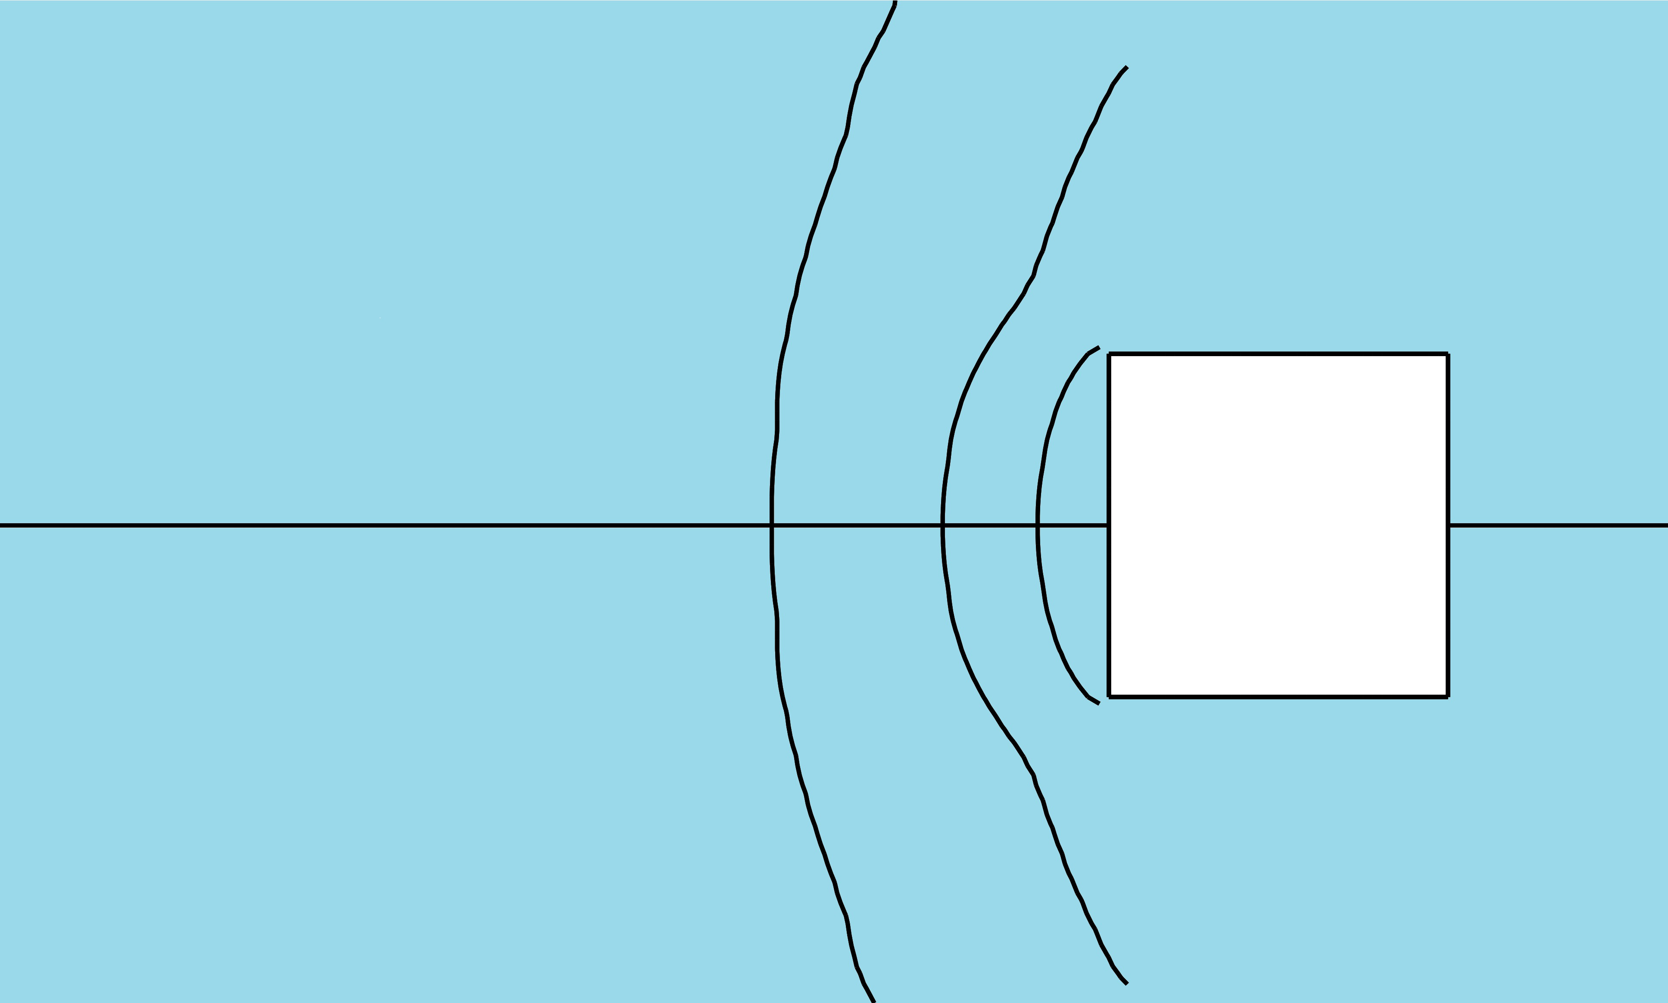
Impact of working on the crack path
Hydrostatic pressure inside the model was 0, 3.5, 15 bar
0 bar
15 bar
Hydrostatic pressure inside the model was 15 bar
d=2R
d=R
d=0.5R
Near the underground excavation the crack trajectory depends on the ratio of external stresses and tensile stress σ_{с}
At non-uniform stress field the trajectory of crack propagation also depends on the direction of the principal stresses

Slide 13
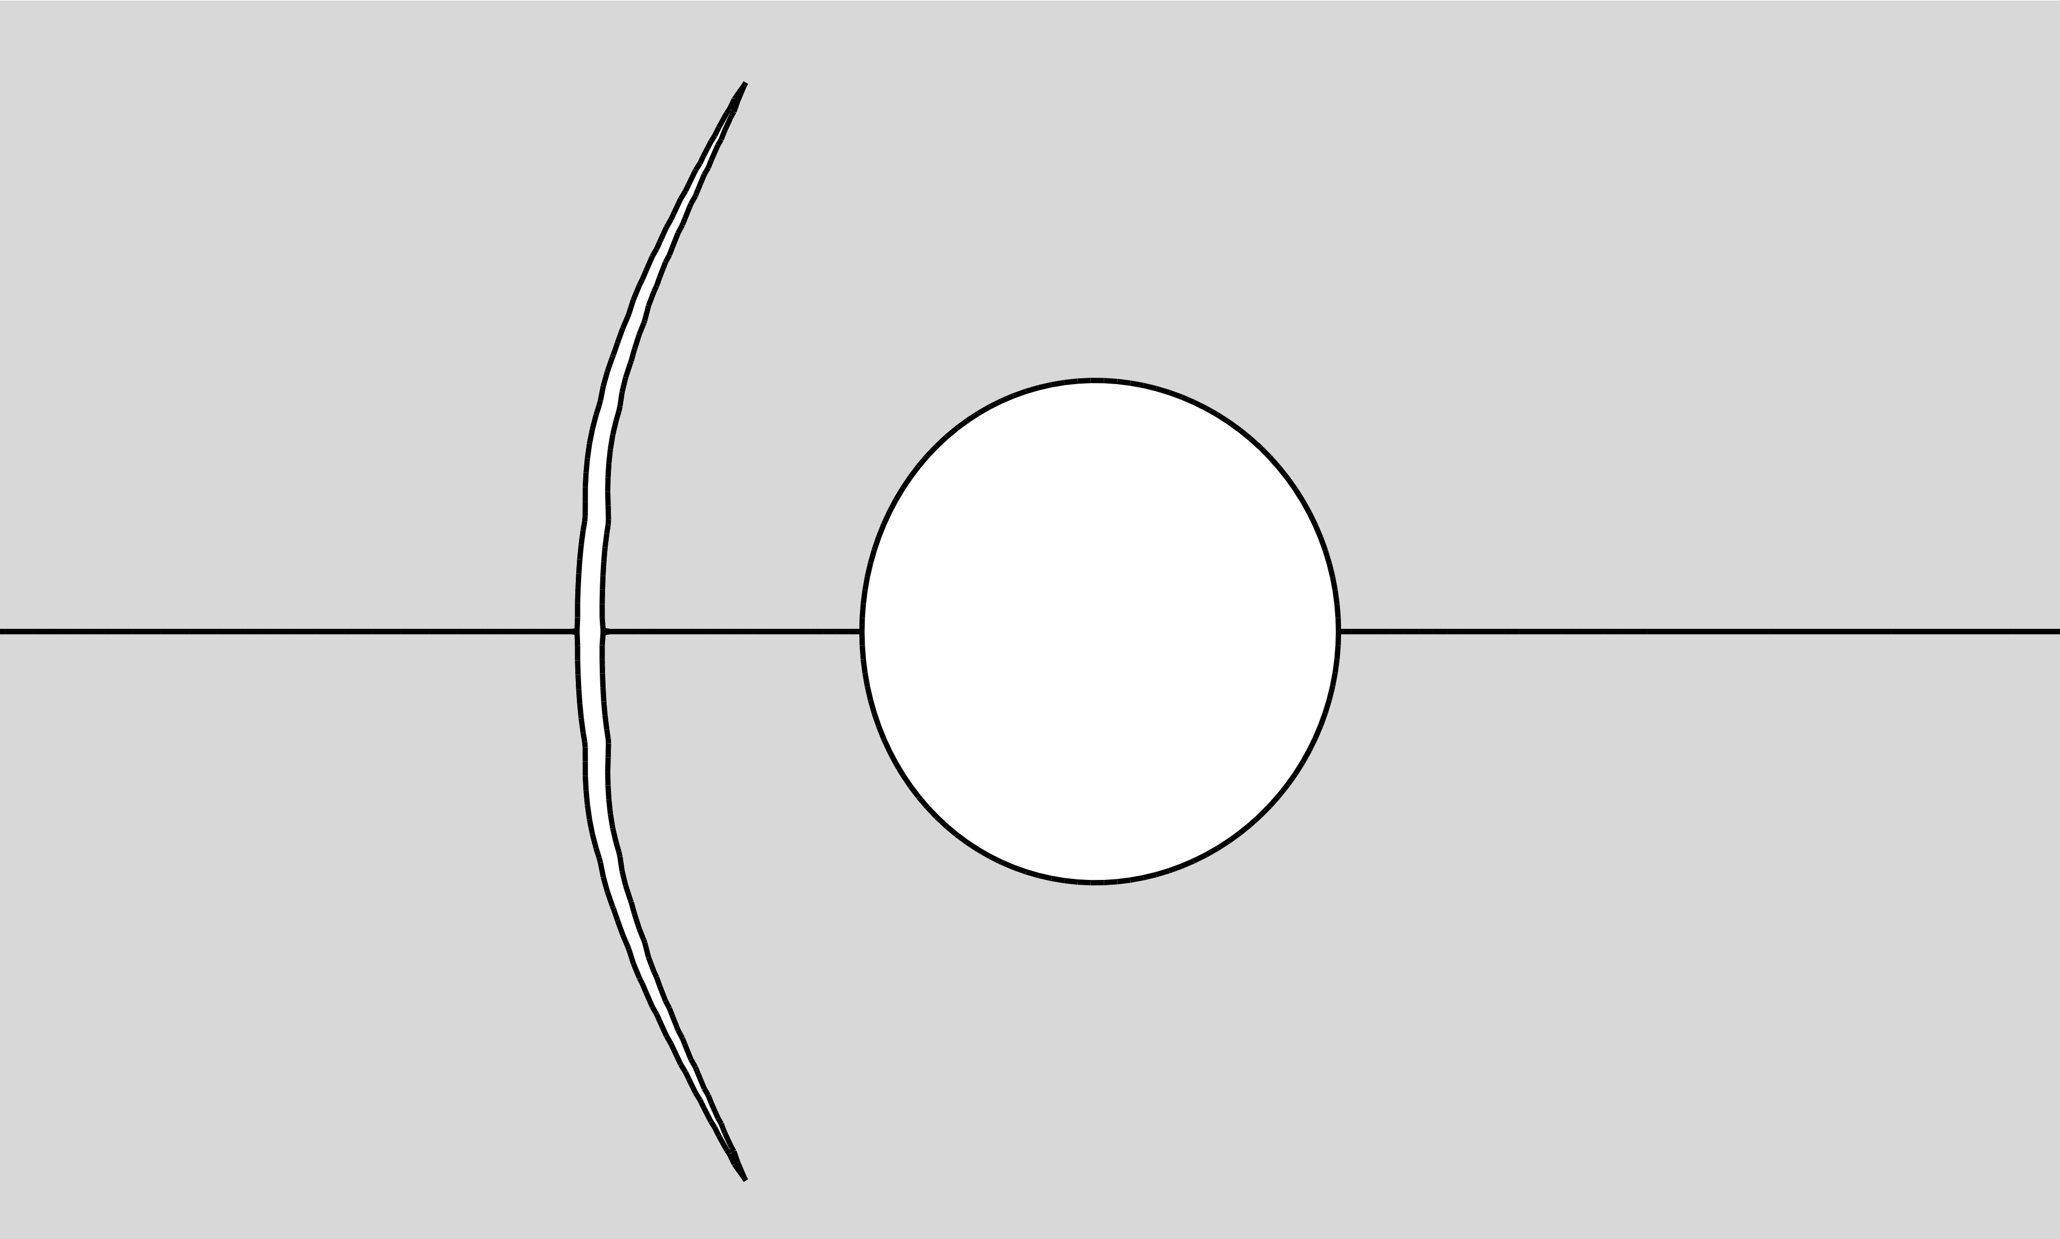
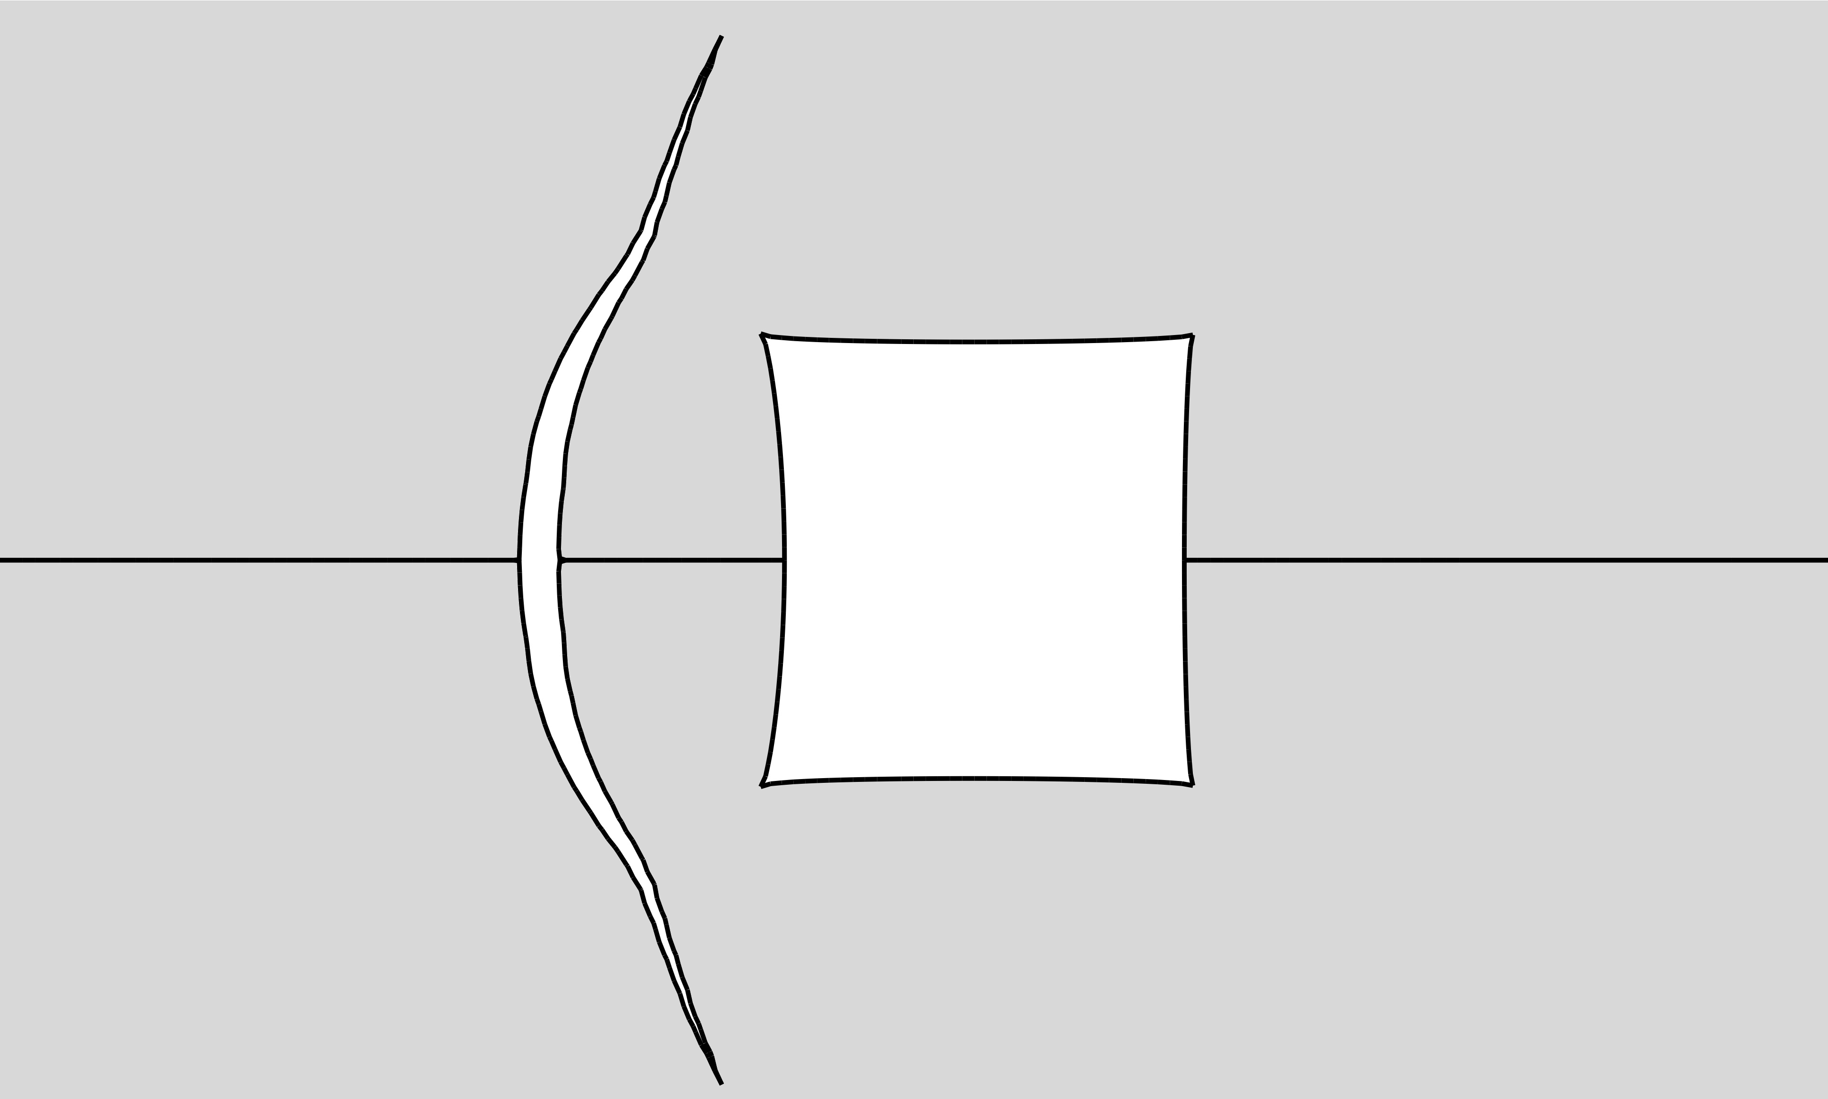
Impact of working on the crack opening
Cracks that form the impervious screen (parallel to the sides of underground working)
Horizontal cracks propagating in the direction of underground working
Asymmetrical opening of cracks due to the free working’s boundaries leads to an increase in screen volume
The cross-section of the working is deformed by a fracture influence (rock breakdowns are possible)
Note: openings and deformations are not in scale!

Slide 14
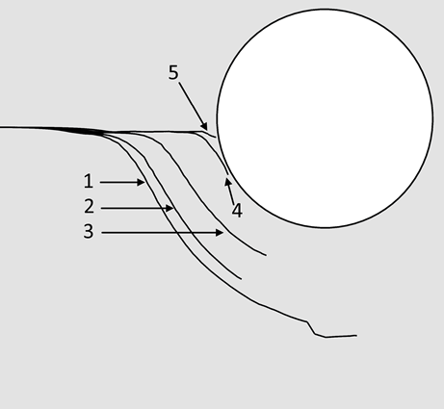
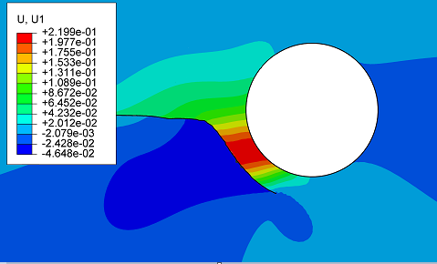
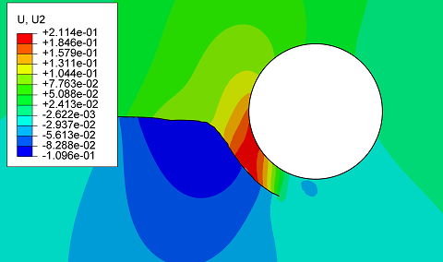
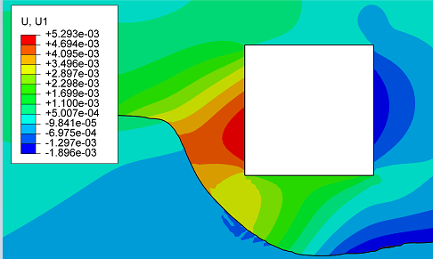
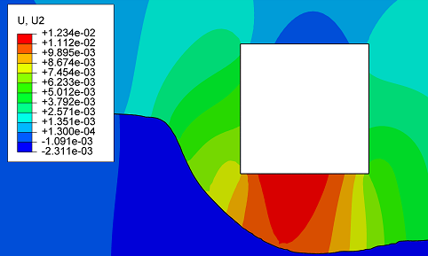
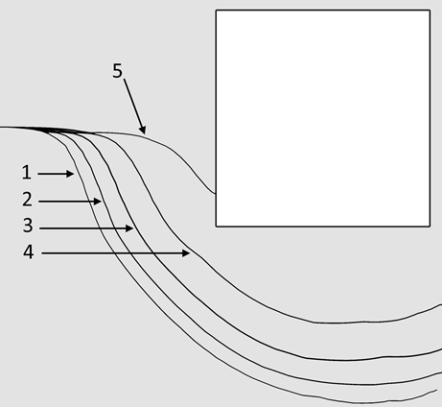
Impact of working on cracks that grow in its direction
Trajectories
Vertical displacements
Horizontal displacements
The smaller σ_{с} / P_{h} ratio, the greater the distance from the underground working at which the crack deviation begins.
For large values, the crack begins to grow into the working.
From a certain injection volume the crack stops growing
in length. At the same time, its opening and deformation of the area between the fracture and the development increases.
σ_{с} to P_{h} ratio: 1 – 0.125; 2 – 0.25; 3 – 0.5; 4 – 1.0; 5 – 2.0

Slide 15
Fluids for creating screens by the HF method
The success of the HF operation in most cases determined by the fluid. The development and study of the properties of such fluids is an important task in creating technologies based on HF.
Basic requirements:
Low viscosity of injected chemical compositions
Reliable insulation – no permeable "windows" in the screen under rock pressure
Two methods and compositions for filling the protective screen have been developed:
Solid filler based on organic resin without proppant
Elastic filler based on acrylate resins with light proppant

Slide 16
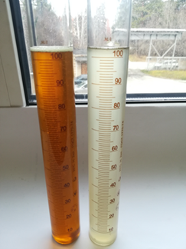
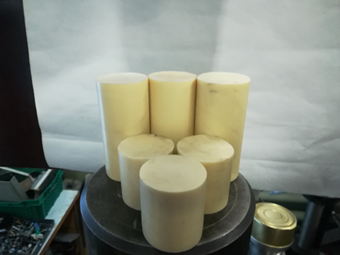
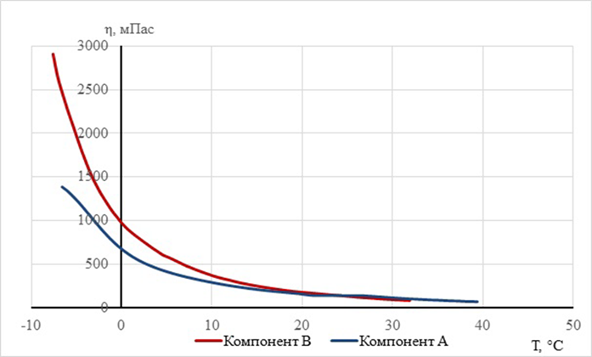
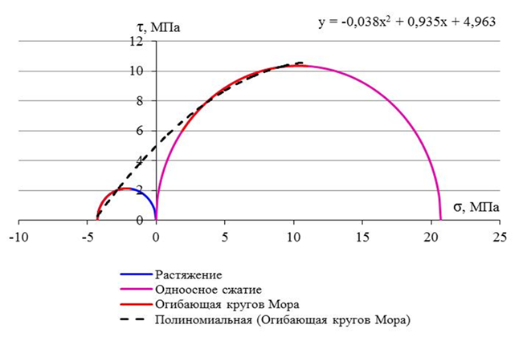
Protection screen with solid filler
2-component organic composition
The components of the composition are pumped through separate channels in the fracturing interval, where they mix and enter the crack. Within 2-4 minutes a solid polymer is formed.
The start time of the reaction at 25°C | 2’15” – 2’30”
Setting time | 3’30” – 4’00”
Foaming factor | 1
Max. reaction temperature, °C | 45
Density at 25°C for A and B, kg/m³ | 1380 / 1164
A and B components
Samples
Components viscosity on temperature
Strength certificate
visc, mPas
τ, MPa
E = 255 МПа
σ₁ = 4.3 МПа
comp A
comp B
σ, MPa
The screen with solid filler retains continuity and insulating properties when exposed to superheated steam (for example, when thermo-mining viscous oils)

Slide 17
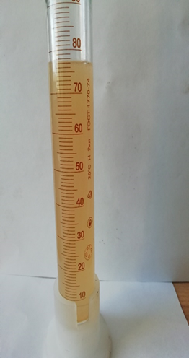
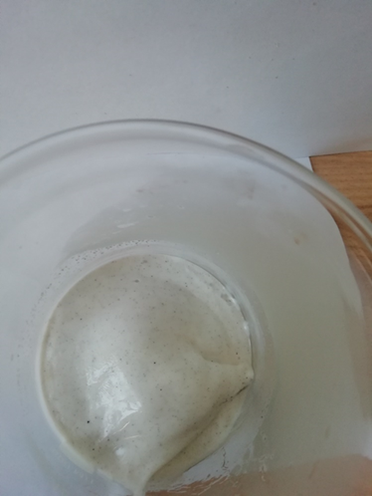
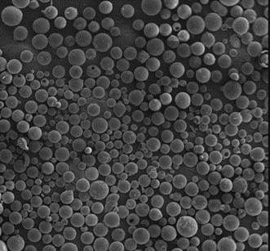
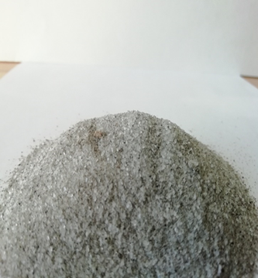
Protection screen with elastic filler
2-component acrylate composition with light proppant
The presence of solid inclusions (proppant) gives the following additional properties:
prevents the screen from closing under the influence of compressive rock stresses
gives a low shear strength to the screen with an elastic filler. This allows to stop cracks developing towards underground working (e.g. during intensification of coal gas recovery)
Component A
Final sample of elastic composition with proppant
Proppant – hollow aluminosilicate microspheres
Component B – oxidizer and proppant mixture
(dissolved in water)

Slide 18
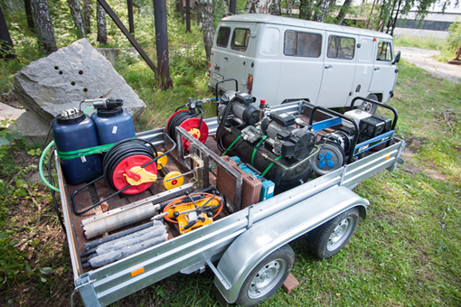
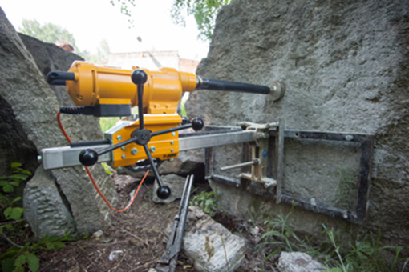
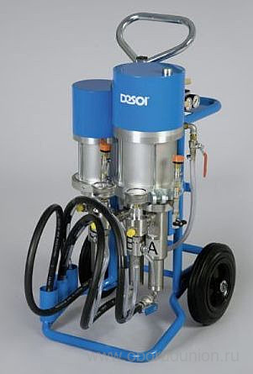
Set of equipment for small-scale HF
Set of equipment for small-scale HF
Diamond Core Drilling Machine
Gas power station (for quarries)
Air compressor (for quarries)
Dual-channel high-pressure pump for pumping aqueous solution and polymer compositions
Fracking tools
High pressure hoses, cables
Fluid tanks

Slide 19
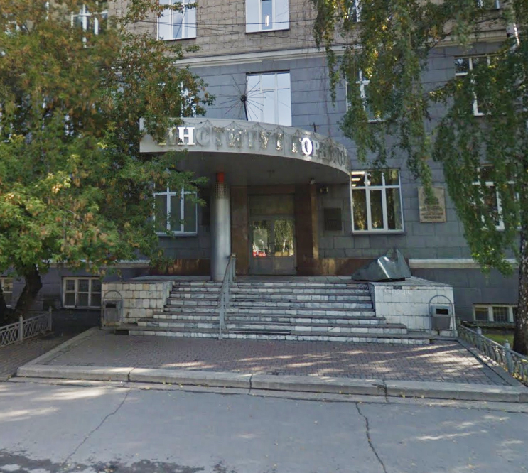
Thank you!
Lab of Physical Methods of Impact on the Rock Mass
Chinakal Institute of Mining SB RAS, Novosibirsk, Russia
Anton V. Azarov
Junior Researcher
antonazv@mail.ru
Andrey V. Patutin
PhD in Technical Sciences
Senior Researcher
andrey.patutin@gmail.com
Tatyana V. Shilova
PhD in Technical Sciences
Researcher
shilovatanya@yandex.ru
Sergey V. Serdyukov
Dr in Technical Sciences
Head of the Laboratory
ss3032@yandex.ru

