Slide 1
Coupled thermo-hydro-mechanical problems of fracture mechanics, 2019, July 1-5 Novosibirsk, Russia
Hydraulic fracturing of concrete cylinders in a non-uniform stress field
Valerii A. Blinov¹, Mikhail A. Legan¹, Alexey N. Novoselov¹
¹ Lavrentyev Institute of Hydrodynamics, Siberian branch of the Russian Academy of Sciences, Lavrentyev ave. 15, Novosibirsk, 630090, Russia

Slide 2
INTRODUCTION
An experimental study of the hydraulic fracture of thick-walled cylinders with the application of a diametrical load was carried out on specimens in the form of cylinders with a central circular hole and a circular hole located at a distance of half the radius from the center of the cylinder at an angle of 45 degrees to the load application line.
The modeling of the fracturing process taking into account the inhomogeneity of the stress state near the hole was carried out using the boundary elements method (in the variant of the fictitious load method) and the gradient fracture criterion. Calculation results of the ultimate pressure were compared with experimental data.

Slide 3
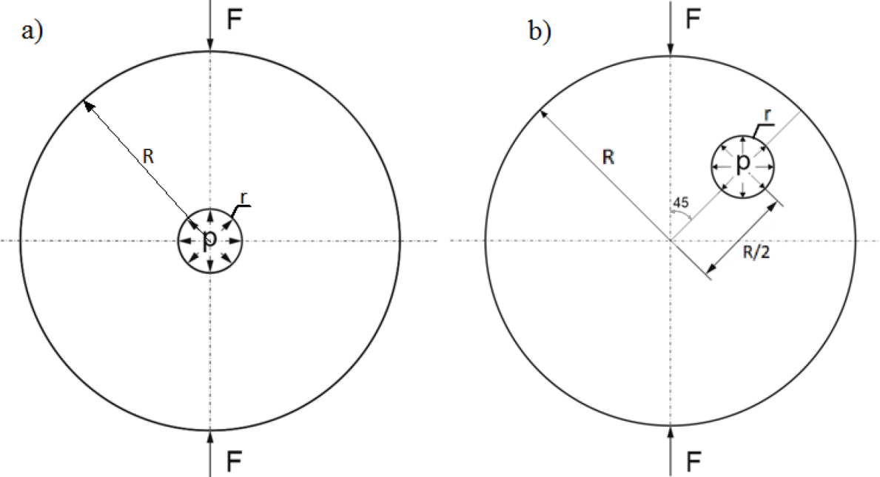
Fig.1 Experimental schemes. a) central hole; b) hole located at a distance of half the radius from the center of the cylinder at an angle of 45° to the load application line.

Slide 4
Gradient fracture criterion
In the gradient criterion for the determination of the load at the instant of fracture initiation, the effective stress rather than the maximum stress is compared with the ultimate strength of the material .
$$σ_{e}=\frac{σ_{1}}{1−β+\sqrt{β^{2}+L_{1}g_{ν}}}$$
$g_{ν}$ – relative gradient of the positive normal stress acting on the plane, including the area of the first principal stress at the considered point of the body where the plane and the area have a common normal$,$
$$g_{ν}=\frac{\left|grad σ_{ν}\right|}{σ_{ν}}$$
$L_{1}$ – parameter having the dimension of length and characterizing the heterogeneity (defectiveness) of the material;
$β$ – is a non-negative dimensionless parameter, which can be considered as an approximation parameter.
The parameter $L_{1}$ is found from the condition for matching the gradient criterion with linear fracture mechanics and is expressed in terms of known material characteristics – the ultimate strength $σ_{b}$ and the critical stress intensity factor $K_{Ic}$:
$$L_{1}=\left(2/π\right){K_{Ic}^{2}}/{σ_{b}^{2}}$$

Slide 5
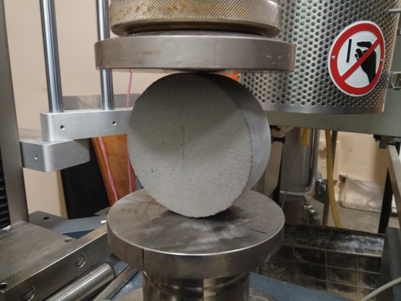
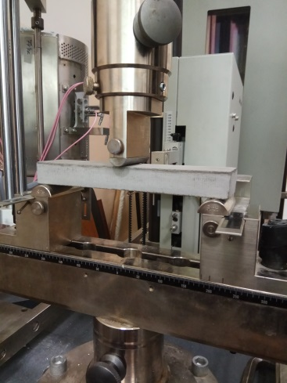
Determination of concrete properties
λ – ratio of the half-length of the notch to the radius (R) of the cylinder
t – cylinder thickness
K_{Ic}=0,221 MPa m^{1/2}
Fig.2 Test for obtaining K_{Ic}
Obtaining maximum tensile stress (σc ) using gradient fracture criterion
Fig.3 Bending test for obtaining σc

Slide 6
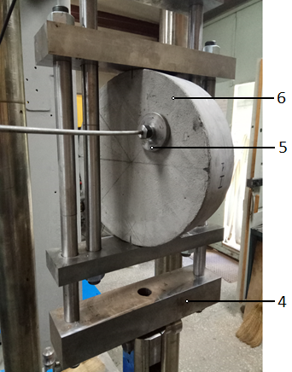
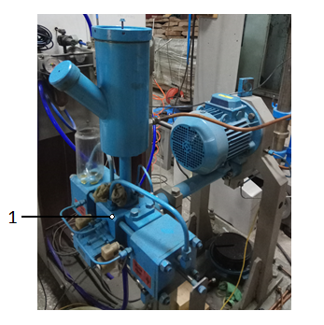
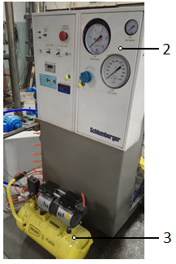
High oil pressure experimental machine for a hydraulic fracture experiments
Fig.4 Experimental setup:
High oil pressure machine
Control panel
Air compressor
4. Compression setup
5. High oil pressure line
6. Concrete specimen

Slide 7
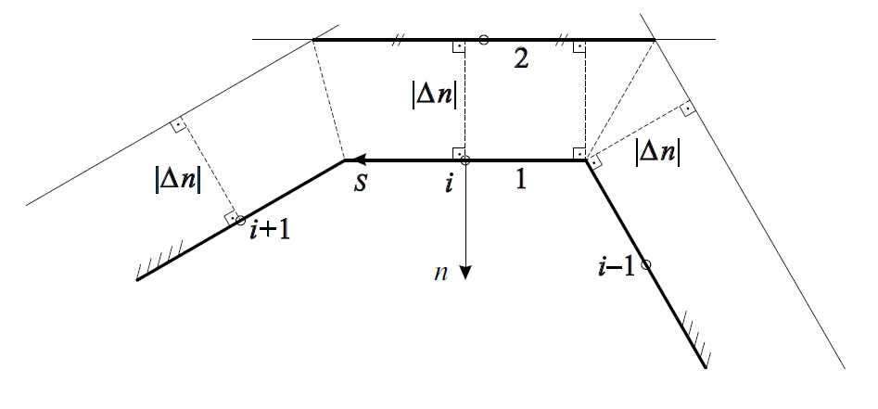
Algorithm of joint application of the gradient fracture criterion and the boundary elements method
The stresses at inner points can be found with a satisfactory accuracy only provided that the distance between these points and the contour is longer than the length of a single element.
we find stresses $σ_{v}^{i}$ at the middle points of the boundary elements and the tangential derivatives along the contour${{∂σ}_{v}^{i}}/{∂s}$ at these points.
we draw a new equidistant boundary-element broken line forming an auxiliary contour in the body at a short distance $\left|Δ_{n}\right|$ from the boundary elements of the main contour.
Fig.5. Main (1) and auxiliary (2) countours.

Slide 8
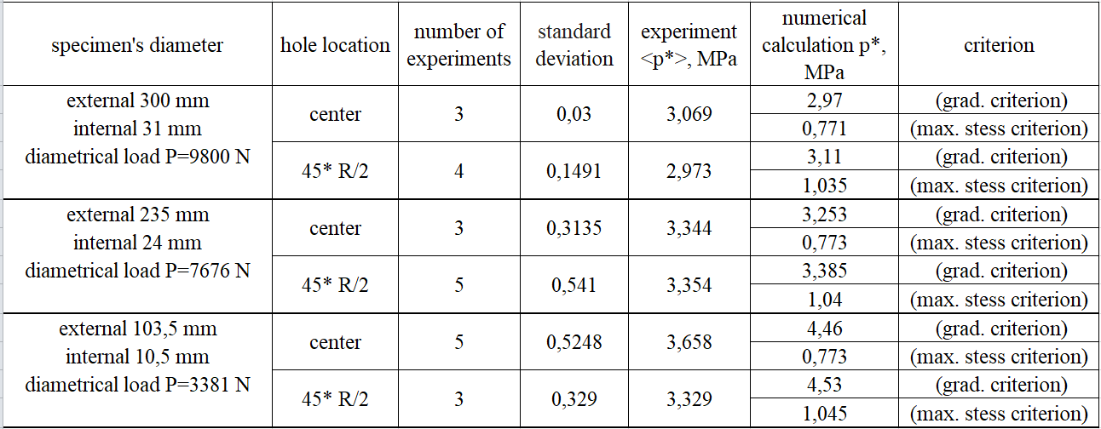
Table. Comparison of experimental data and calculation results

Slide 9
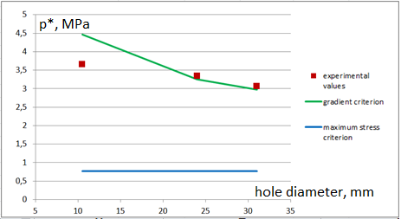
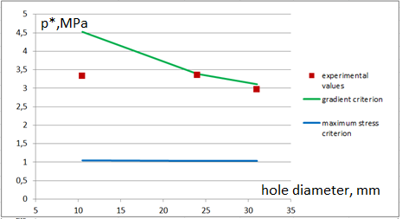
Results comparison
Fig.6 Comparison of the results for a central hole case.
Fig.7 Comparison of the results for a 45° R/2 located hole case.

Slide 10
Conclusion
An experimental study of hydraulic fracturing of thick-walled concrete cylinders compressed along the diameter with holes located in the center of the cylinder and displaced from the center was carried out on a modified installation. The cylinders were made of concrete based on sand and high alumina cement grade 40. The Zwick / Roell Z100 universal testing machine performed experiments on the destruction of concrete under conditions of bending. With the help of the boundary element method, the local maximum stress criterion and the gradient fracture criterion, fracture simulation in non-uniform stress fields was carried out. It is established that the local maximum stress criterion gives significantly lower values of the breakdown pressure during hydraulic fracturing. It is shown that using the gradient criterion, it is possible to obtain a satisfactory agreement between the results of calculations and experimental data on hydraulic fracturing in non-uniform stress fields. Experimental study showed scale effect in concrete specimens with stress concentrators.

Slide 11
