Slide 1
Numerical investigation of the interaction between hydraulic fractures and natural fractures in porous media based on an enriched FEM
Yun Zhou¹, Diansen Yang¹, Xi Zhang^{1,2}, Weizhong Chen¹
¹State Key Laboratory of Geomechanics and Geotechnical Engineering
Institute of Rock and Soil Mechanics of Wuhan, CAS
²On leave from CSIRO Energy, Melbourne, Australia
July 2019 Novosibirsk

Slide 2
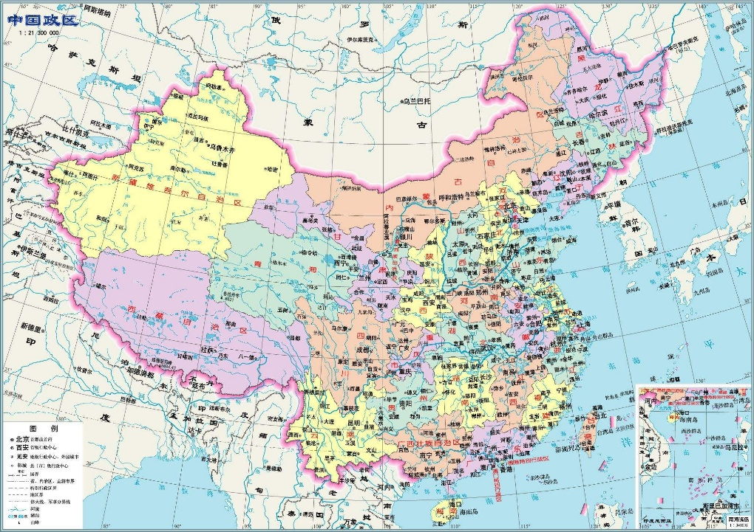

Institute of Rock and Soil Mechanics, Chinese Academic Science founded in 1958 at Wuhan, Hubei Province
433 staff (Prof.Ge Xiurun, Academician); 251 scientists; 230 postgraduate students
State key laboratory of Geomechanics and Geotechnical engineering
Research funds: ~ 150 millions RMB/ year;
Scientific Outcomes: >300 SCI publications/year, 50 patents/ year

Slide 3
Outline
Introduction
Numerical Model
Validation
Numerical Results
Conclusions

Slide 4
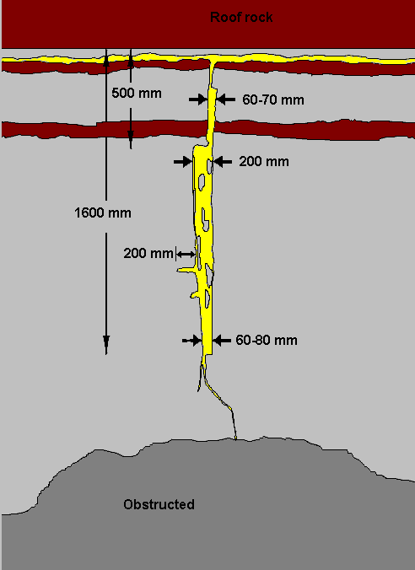
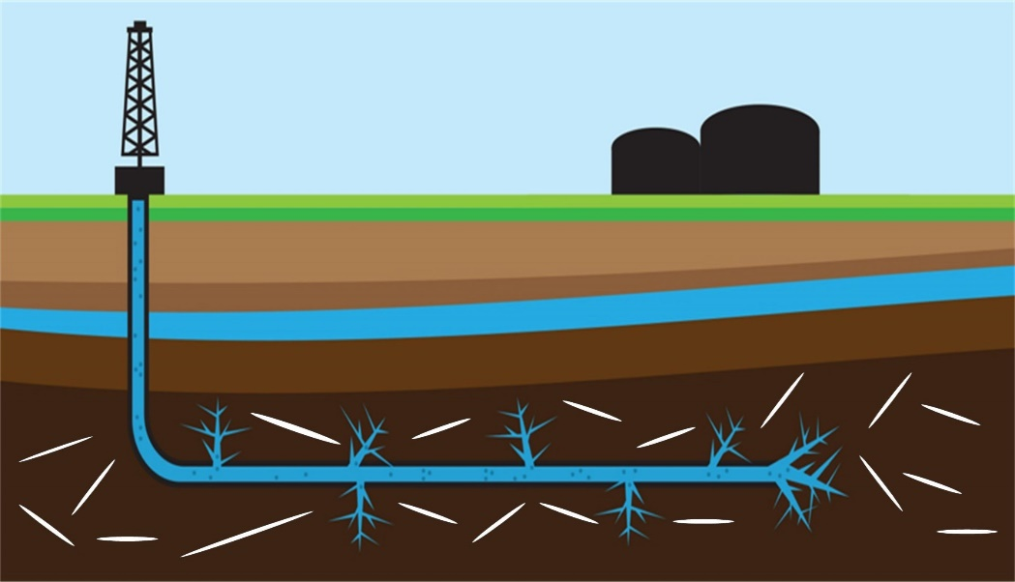
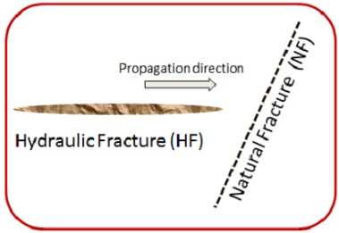
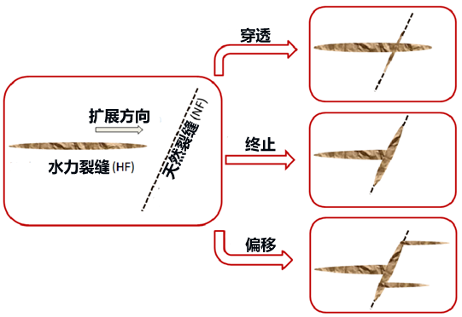
Applications Of Hydraulic Fracturing
Petroleum
Mining
NFs
Crossing
Arrest
Offset
Different interaction scenarios
What is the interaction mechanisms between HFs and NFs and how to quantify？

Slide 5
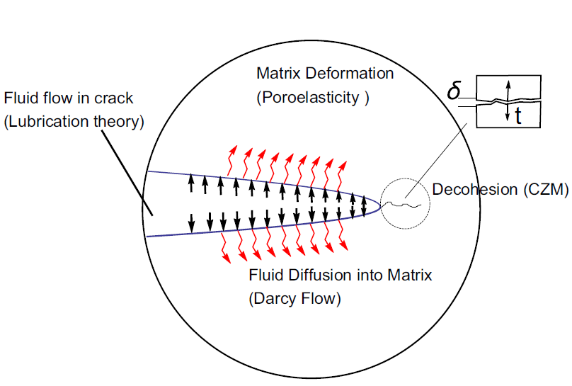
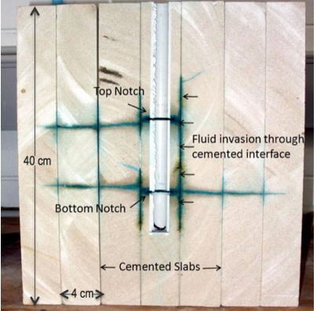
Hydraulic Fracture Growth in Porous Media
Fluid flow within fracture
Fluid leakage through the surface
Pore fluid flow in matrix
Crack tip propagation
Deformation of the matrix
Physical process of hydraulic fracturing (Kovalyshen and Detournay, 2010)
Rock are not always impermeable
Fluid leakage is severe during the crossing process
The poroelasticity of the matrix
The influence of fluid leakage on interaction scenario
(Llanos 2017 RMRE)

Slide 6
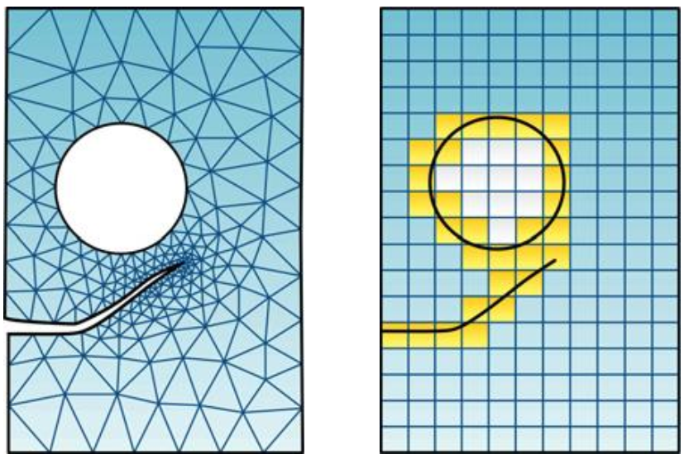
XFEM for Hydraulic Fracturing
2D XFEM Method
Difficulties in mesh generation
Refined mesh near crack tip
Re-meshing after crack propagation
High computational efficiency
FEM
XFEM
Fully coupled model based on XEFM (Lecampion 2009)
Interaction mechanisms between HFs and NFs (Gordeliy and Peirce, 2013)
Consider 2D fluid leakage during fracture crossing (Khoei and co-authors…)
Multiple fractures include intersection (Dahi and Olson, 2013,…)

Slide 7
Outline
Introduction
Numerical Model
Validation
Numerical Results
Conclusions

Slide 8
Governing Equations
Fluid leakage from the surface
Fluid pressure applied on opened fracture surface (No lag)
Frictional contact of NF
An initial opening is assigned to NFs
Computational Domain
Governing equations
①Equilibrium equation
②Continuity equation in matrix
③Continuity equation in fracture

Slide 9
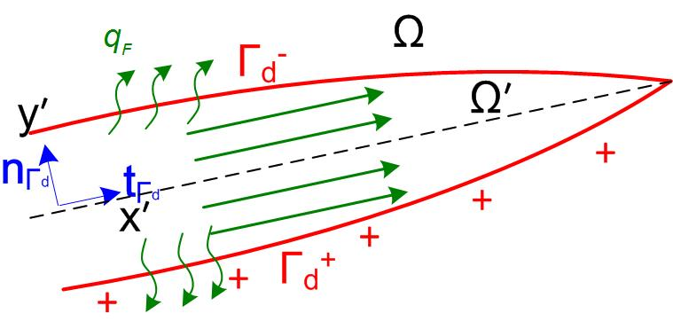
2D Model
Weak form of governing equations
Fluid Leakage from surface in 2D
(2014 Khoei)
is assumed for pressure field
Internal boundary conditions

Slide 10
Shape Functions
XFEM Discretization
U
P
Enrichment strategy for single fracture
Signed distance function

Slide 11
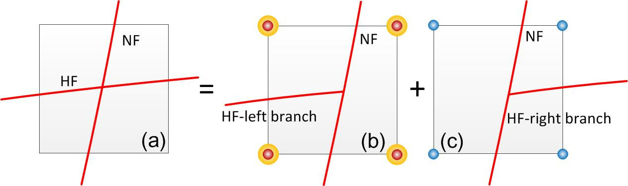
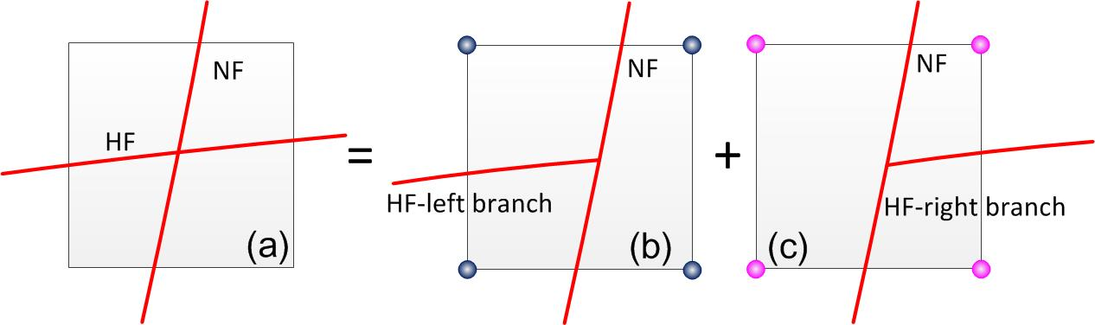
Fracture Intersections
XFEM Discretization (Extended to X-intersections)
Khoei et al, 2018 for junctions
U
Heaviside enriched node
Junction enriched for U(left junction)
Junction enriched for U(right junction)
P
Junction enriched for P(left junction)
Junction enriched for P(right junction)
Left
Right
m, s are fracture numbers.
Left
Right
Left
Right

Slide 12
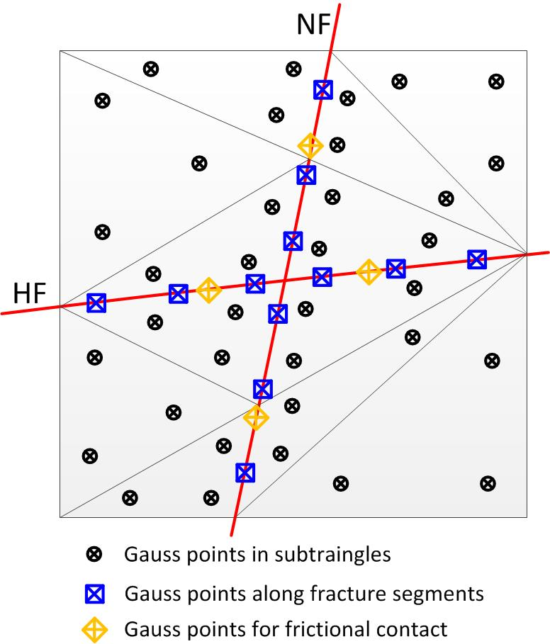
Natural Fracture Friction Law
Penalty Method
Substitute it as a traction in weak form and integration
Subregions and integral scheme
1. Normal XFEM element
2. T-junction element
3. Intersection element

Slide 13
HF-NF Intersection
After find fracture propagation direction (Erdogan and Sih, 1963)
HF coalescence
The maximum hoop tensile stress criterion is adopted when d_{c}>r_{s}
HF merge with the NF when d_{c}<r_{s}
HF re-initiation
Calculate the NF-parallel normal stress along the right side of NF
Determine the average tensile stress of each fracture segment(1,2,3…)
The HF will cross if average tensile stress is higher than the tensile strength
New HF propagates perpendicular to the direction of maximum principle stress

Slide 14
Numerical Equations
Solution procedure
U-P Discretized equation
Time domain discretization
Residuals of coupled equations
Jacobian matrix
N-R Iteration step

Slide 15
Outline
Introduction
Numerical Model
Validation
Numerical Results
Conclusions

Slide 16
Single Fracture
Hydraulic fracturing in permeable media—Solve 2D leakoff problems
Parameters | Value
Elastic modulus E | 16GPa
Poisson ratio v | 0.2
Biot’s coefficient α | 1
Porosity ϕ | 0.2
Solid density ρ_{s} | 2000kg/m³
Fluid density ρ_{w} | 1000kg/m³
Solid compressibility K_{s} | 36GPa
Fluid compressibility K_{w} | 3GPa
Computation Model
Material Parameters
Input Parameters
 | Fluid viscosity μ | Injection Rate Q₀ | Critical stress intensify factor K_{IC} | Matrix permeability K_{m} | Dimensionless toughness κ
Case 1 | 0.01Pa·s | 0.001m²/s | 1.8MPam^{0.5} | 1×10⁻¹⁴m² | 0.99
Case 2 | 1×10⁻⁴Pa·s | 0.0005m²/s | 2.2MPam^{0.5} | 1×10⁻¹⁵m² | 4.37

Slide 17
Validation
Numerical results vs KGD Solution (Hu and Garagash, 2010)
Dimensionless leak-off coefficient
C₁=0.17（T=10s）
C₂=0.13（T=10s）

Slide 18
Outline
Introduction
Numerical Model
Validation
Numerical Results
Conclusions

Slide 19
HF-NF Interaction
Computational model (2D)
Parameters | Value
Approaching angle(α_{c}) | 90°（A-E）
Horizontal confining stress (σ_{x}) | 5MPa
Vertical confining stress (σ_{y}) | 4MPa
Critical stress intensify factor (K_{IC}) | 1.5MPam^{1/2}
Distance between Point E and F (L_{d}) | 1m（A-E）
Fracture deflection Cases
Case | NF coefficient of friction λ | NF initial opening w₀ | Injection rate Q₀ | Fluid viscosity μ | Matrix permeability K_{m}
A | 0.4-1 | 0.025mm | 6×10⁻⁴m²/s | 10mPas | 1×10⁻¹⁴m²
B | 0.8 | 0.01mm-0.075mm | 6×10⁻⁴m²/s | 10mPas | 1×10⁻¹⁴m²
C | 0.8 | 0.025mm | (4-10)×10⁻⁴m²/s | 10mPas | 1×10⁻¹⁴m²
D | 0.8 | 0.025mm | 6×10⁻⁴m²/s | (5-100)mPas | 1×10⁻¹⁴m²
E | 0.8 | 0.025mm | 6×10⁻⁴m²/s | 10mPas | (0.1-2)×10⁻¹⁴m²

Slide 20
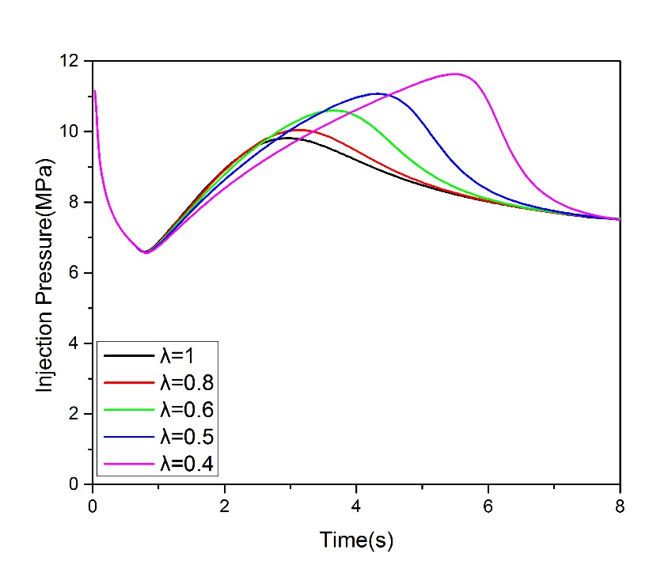
NF coefficient of friction λ
F
Smaller coefficient of friction λ
Larger injection pressure peak
Slippage of NF becomes easier
More fluid is stored in HF
Crossing becomes difficult
T=2s

Slide 21
NF initial opening w₀
T=2s
Smaller initial opening w₀
Larger injection pressure peak
Less fluid can flow in NF
Smaller fluid pressurized zone
Larger probability for crossing
T=2s

Slide 22
Injection rate Q₀
Q · T=2E-3
Q · T=2E-3
Lower injection rate(Same volume Q₀T=C)
Larger injection pressure peak
More leakage and less fluid stored in NF
Smaller opening of NF
Larger probability for crossing

Slide 23
Injection rate Q₀ (contd.)

Slide 24
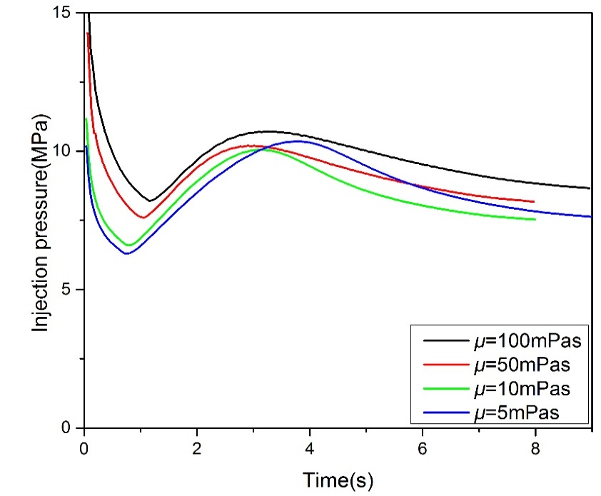
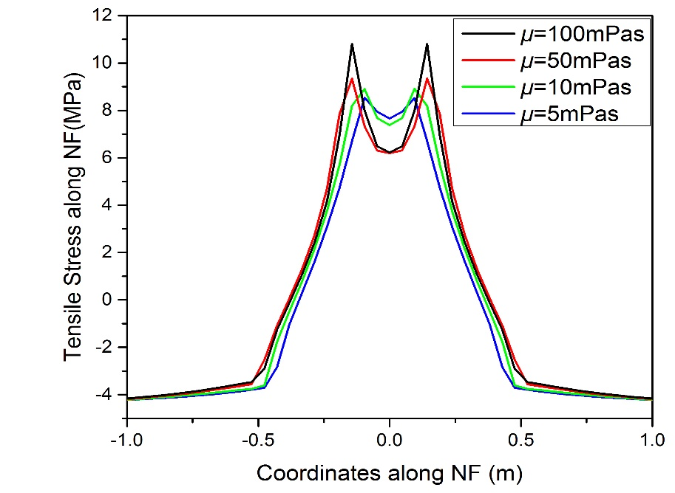
Fluid viscosity μ
T=2s
Lower fluid viscosity μ
Pressure peak decreases and re-increases
HF meets NF at early time
More leakage and smaller opening of NF
Smaller probability for crossing
T=2s

Slide 25
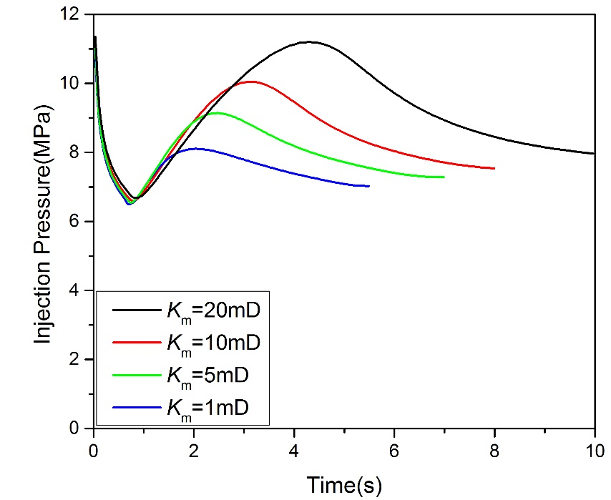
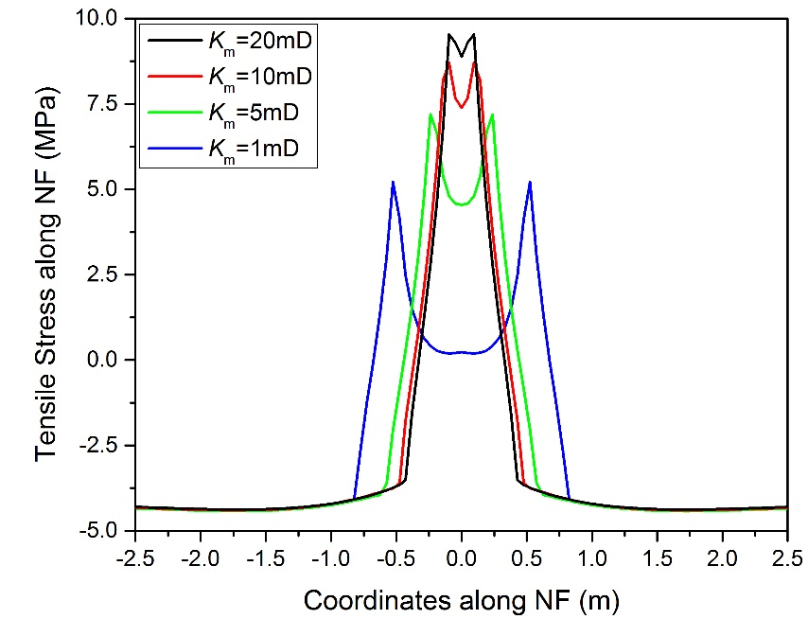
Matrix Permeability K_{m}
T=2s
Larger matrix permeability
Larger injection pressure peak
Less fluid can flow into NF
More leakage and smaller opening of NF
Larger probability for crossing

Slide 26
Fracture Crossing Cases
Different Approaching angles α_{c}
Crossing(90°)
Offset(75°)
Diversion(60°)
Diversion(45°)
Normal opening of HF and NF at different times
Pressure contours（Pa）at T=12s

Slide 27
Outline
Introduction
Numerical Model
Validation
Numerical Results
Conclusions

Slide 28
Conclusions
A fully coupled hydro-mechanical model based on X-FEM is developed.
Treatment for fracture intersection in X-FEM is considered.
Injection pressure changes are different than impermeable matrix
Strong leakage when lower injection rate and fluid viscosity are used
Different interaction scenarios between HF and NF can be handled by the proposed model.
Future work
More comparisons
More cross criteria between HF and NF need to be tested
Fracture network formation modeling

Slide 29
Thank you for your attention！
Email: zhouyun17@mails.ucas.edu.cn
or
xi.zhang@csiro.au

