Slide 1
Materukhin A. V., Maiorov A.A., Gvozdev O.G.
15th International Asian School-Seminar "Optimization Problems of Complex Systems (OPCS)
The results of computer simulation of data acquisition systems based on distributed smart geosensor networks

Slide 2
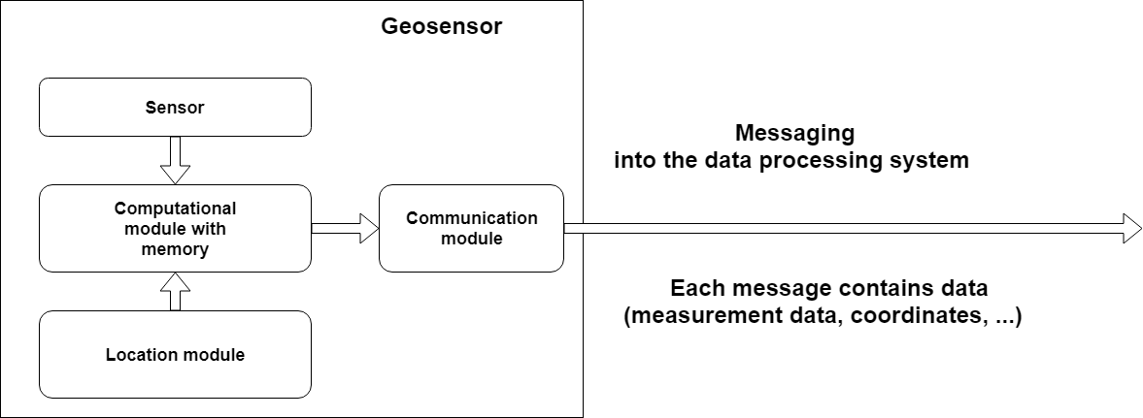
Generalized geosensor

Slide 3
Trends in the use of geosensors:
From statics → to motion
From single geosensors → to geosensor networks
The need for continuous data processing

Slide 4
PURPOSE AND OBJECTIVES OF THE STUDY
PURPOSE
Development of a method for assessing scalability potential of data data acquisition systems based on distributed smart geosensor networks
OBJECTIVES
To set the approach to simulate the operation of the data acquisition systems based on distributed smart geosensor networks
To study the statistical properties of data processing in the main components of the data acquisition systems based on distributed smart geosensor networks
Within the framework of the developed approach to obtain probabilistic estimates for various parameters characterizing the functioning and efficiency of the simulated data acquisition systems based on distributed smart geosensor networks

Slide 5
The developed approach to simulate the operation of data acquisition systems based on distributed smart geosensor networks
The basic idea of our approach
The simulated system is treated as stochastic, since its operation significantly affected by various random factors – the location of each geosensor at the time of the measurements; the time of each measurement of each geosensor; the latency associated with data transmission from geosensor to the processing system, etc.

Slide 6
The developed approach to simulate the operation of data acquisition systems based on distributed smart geosensor networks
Basic provisions
1. The mathematical model of the input data is some multidimensional random variable X.
2. The output of system Y, also representing some vector, is uniquely determined by the implementation of this random variable X.
3. The relation X and Y is defined by the system operator L: Y=L(X).
By specifying the statistical characteristics of X and knowing the operator of the system L (X), it is possible to determine the statistical characteristics of Y using simulation.

Slide 7
The developed approach to simulate the operation of data acquisition systems based on distributed smart geosensor networks
The simulation should allow to estimate
1. Maximum stable system bandwidth
2. The degree of degradation of the system (in terms of latency) under various loads

Slide 8
Why is it impossible to solve our problem using the existing systems of discrete-event simulating?
This is due to the complexity of the description in abstractions of these software tools of such properties inherent in modern computer systems as:
1. Preemptive multitasking
2. Use of virtual memory (swapping memory, active use of copy-on-write, deduplication of memory pages, etc.),
3. OS level virtualization and hardware virtualization.
In addition, it is difficult to simulate processes in using the existing systems of discrete-event modeling (disk access caching, hardware and software raid arrays, tiered storage systems (cache on SSDs), systems such as software defined storage, etc.).

Slide 9
Set of units for computer simulation of data acquisition systems based on distributed smart geosensor networks
ContinousSource(Т, D) | A source of messages of some type T generating messages with an interval determined by the distribution of D
LimitedSource(Т, D, I, K) | A source of messages of some type T generating groups of messages in the quantity determined by the distribution of D with interval I and the total number K
Sink | The unit terminating the existence of the message
Noop | The unit transmits the message without changes and delays
Counter(CounterEnter, CoutnerExit) | The unit counting the number of messages between the input and output. Introduced to simulate algorithms whose complexity depends on the number of messages being processed

Slide 10
Set of units for computer simulation of data acquisition systems based on distributed smart geosensor networks
Converter(ConverterPolicy(N,M,T)) | The unit that converts accumulated messages according to the ConverterPolicy (N, M, T) policy, where ConverterPolicy (N, M, T) is the policy for converting N messages of any type to M messages of type T.
SequentialDelay(D) | The unit ordering messages and introducing into their passage a delay determined by the distribution of D. Introduced to simulate calculations and access to input-output means.
DependentSequentialDelay(f) | The unit organizing the messages and introducing into their passage a delay determined by the function f (D, Ni), where D is a given random distribution, and Ni is the current number of messages in counter i.
IndependentDelay(D) | The unit contributing in the passing of messages independent delay determined by the distribution D. Introduced for modeling conditionally unlimited communication channels
Lock(LockEnter, LockExit) | The unit limits the number of messages that can be between input and output. Introduced to simulate sequential algorithms or limited computing resources (e.g. CPU cores).

Slide 11
Statistical properties of data processing in the main components of the data acquisition systems
We have studied a number of statistical properties of the main components at the experimental stand, in particular:
1. Latency of packet transmission over the network via UDP,
2. IPC latency between NUMA nodes,
3. IPC latency within a single NUMA node
4. Latency of access to HDD for reading.
5. Latency of access to the HDD for recording

Slide 15
Latency degradation depending on the number of geosensors

Slide 17
Developed generalized high-performance scheme for applying algorithms of determining spatial predicate values

Slide 19
Latency degradation depending on the number of geosensors

Slide 21
Conclusions
The results of computer simulation of data acquisition systems based on distributed smart geosensor networks showed:
1. The simulation results by the approach performed by us are consistent in general with the results of previously conducted bench experiments and allow us to estimate the scalability potential of the system.

Slide 22
Conclusions
The results of computer simulation of data acquisition systems based on distributed smart geosensor networks showed:
2. The scalability potential of the systems using relational databases is quite limited. Data acquisition systems in the configuration under study provide the necessary processing continuity at a stream rate from the geosensor network to approximately 450-500 messages per second.
For the simulation, we used indicators obtained from a test bench with configuration: 2 Intel Xeon processors CPU E5-2690, 2.90GHz, 256Gb RAM.

Slide 23
Conclusions
The results of computer simulation of data acquisition systems based on distributed smart geosensor networks showed:
3. The potential of the framework we developed is high - in the same configuration, it can provide the necessary processing continuity at a stream rate from the geosensor network to about 13,000 messages per second.

Slide 24
Conclusions
The resulting discrete-event simulating of system, due to the possibility of parameterization of models, allows you to quickly evaluate the performance of the developing data acquisition systems in given conditions, or optimize their configuration for a given nature of the load.

Slide 25
Thank you for your attention!

