Slide 1
Sub-Interval Analysis. First Results Alexander Harin aaharin@yandex.ru As the main source, see the E-Book "Introduction to Sub-Interval Analysis and its Applications" in Open Access at http://ideas.repec.org/b/zbw/esmono/62286.html 27 September, 19.30. Auditorium 515. Seminar Sub-Interval Analysis. Detailed introduction

Slide 2
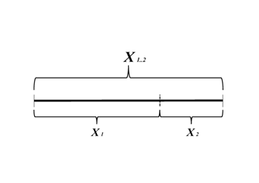
What is It?
What is a Sub-Interval?
A sub-interval is simply
a part of an interval.
?
You may see an example
of an interval X_{1..2} and its sub-intervals X₁ and X₂
in the above Figure.

Slide 3
What is It?
What is
a Sub-Interval Analysis?
The sub-interval analysis is based on a very simple and clear idea:
The sub-interval analysis
is a tool to calculate
the characteristics of a whole interval
by means of characteristics of its sub-intervals.

Slide 4
The sub-interval analysis
A tool to calculate
the characteristics
of a whole interval
by means of characteristics
of its sub-intervals.
You may see an example
of an interval X_{1..2} and its sub-intervals X₁ and X₂
in the above Figure.

Slide 5
What for is It?
What for is
the Sub-Interval Analysis?
To treat Inexact Data
To treat Incomplete Data
To treat Numerous Data

Slide 6
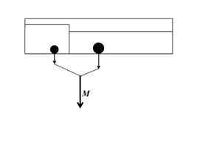
Where is the weight? Box with two Sub-Boxes 1.

Slide 7
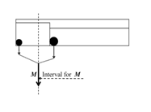
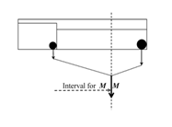
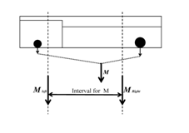
Where is the weight? Box with two Sub-Boxes 2.

Slide 8
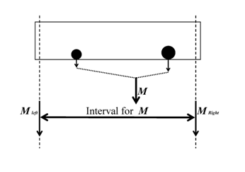
Where is the weight? Sub-Boxes treat Inexact Data Sub-Boxes improve the Precision

Slide 9
First Results of Sub-Interval Analysis as a New Branch of Interval Analysis
New Tools
New Theorems and Hypotheses. New realms for Interval Analysis
New Prerequisites of Applications
New Fields of Applications

Slide 10
Tools, Theorems and Hypotheses of It
1) Sub-Interval Arithmetic
Incomplete Data Analysis
Sub-Interval Images
2) Theorems of Precision Improvement Theorems of Restrictions Theorems of Interval Character
of Incomplete Knowledge
3) Hypothesis of incompleteness
for measurement interpretation
Hypotheses of Degrees of Cognition

Slide 11
"Ring of formulas"

Slide 12
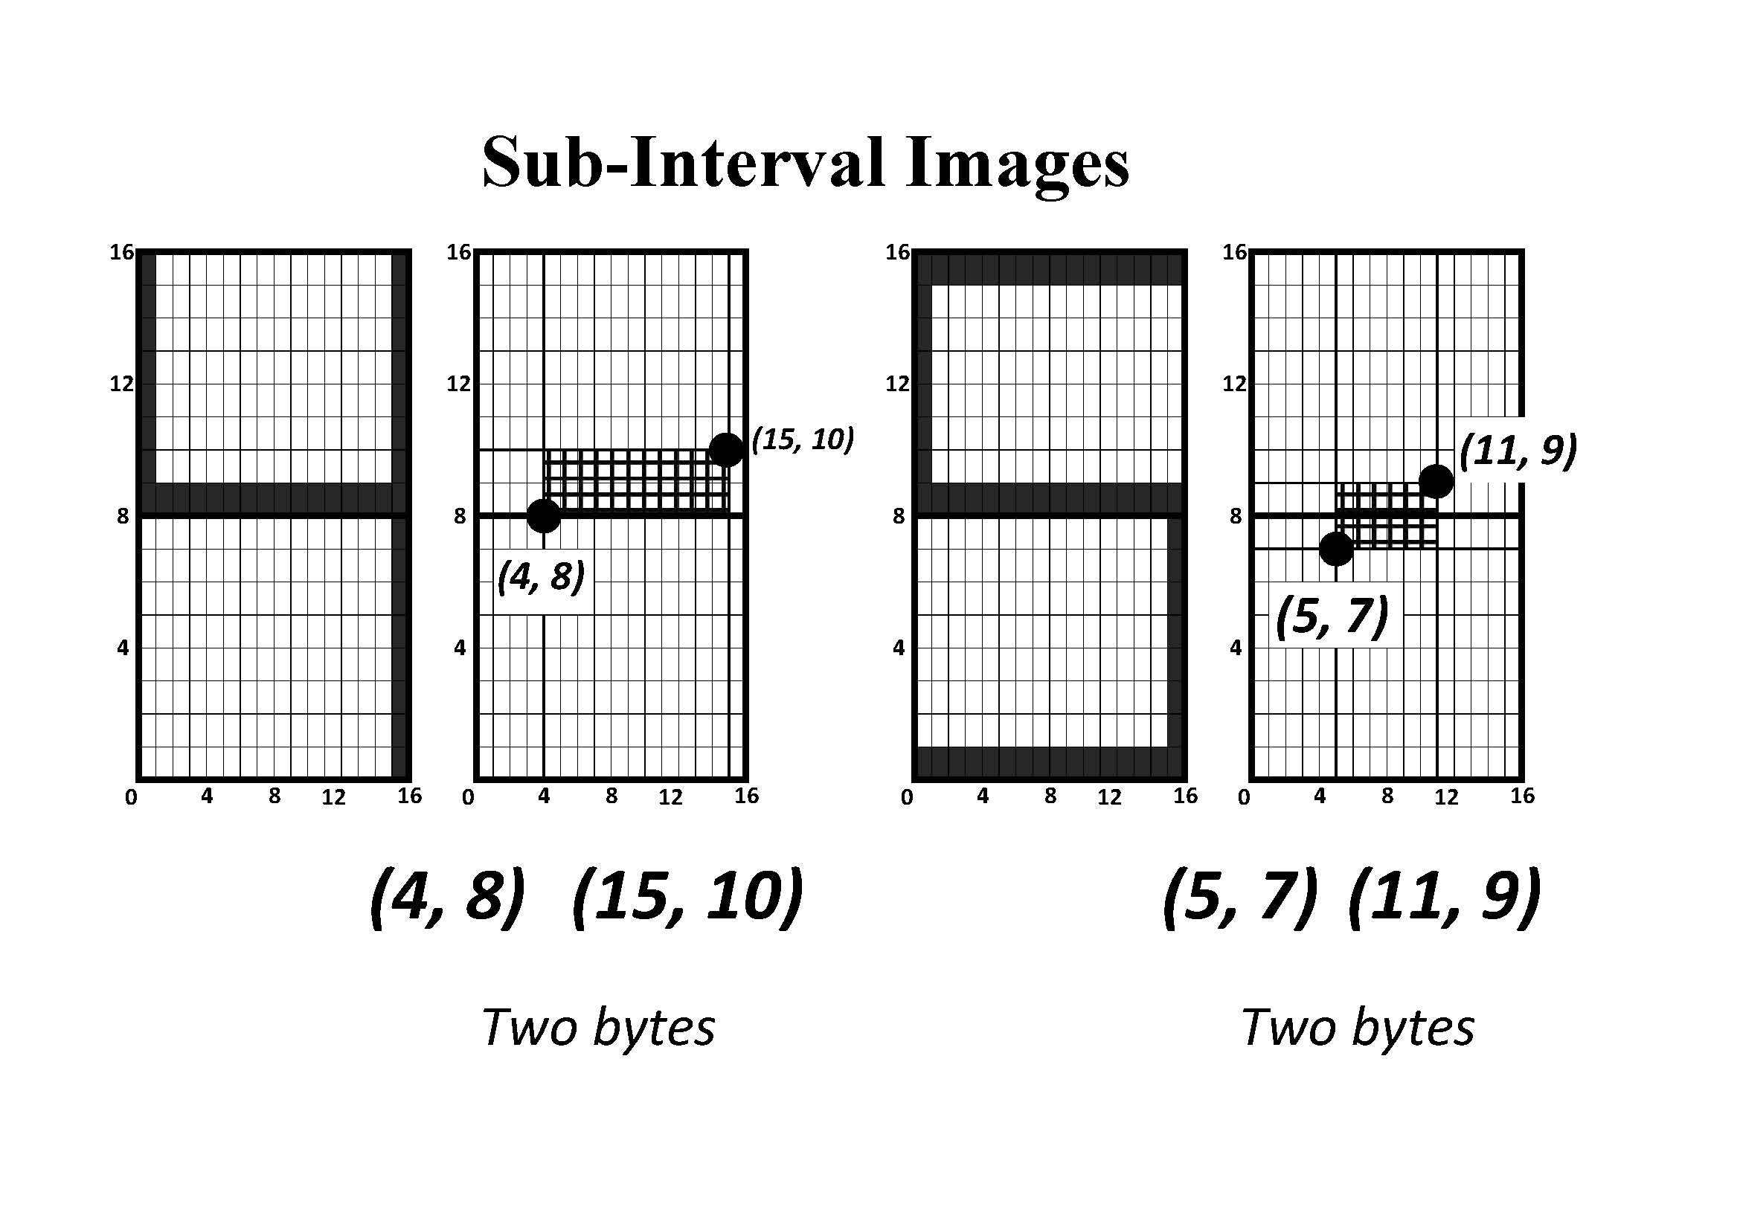
What is It?
General tasks of It

Slide 13
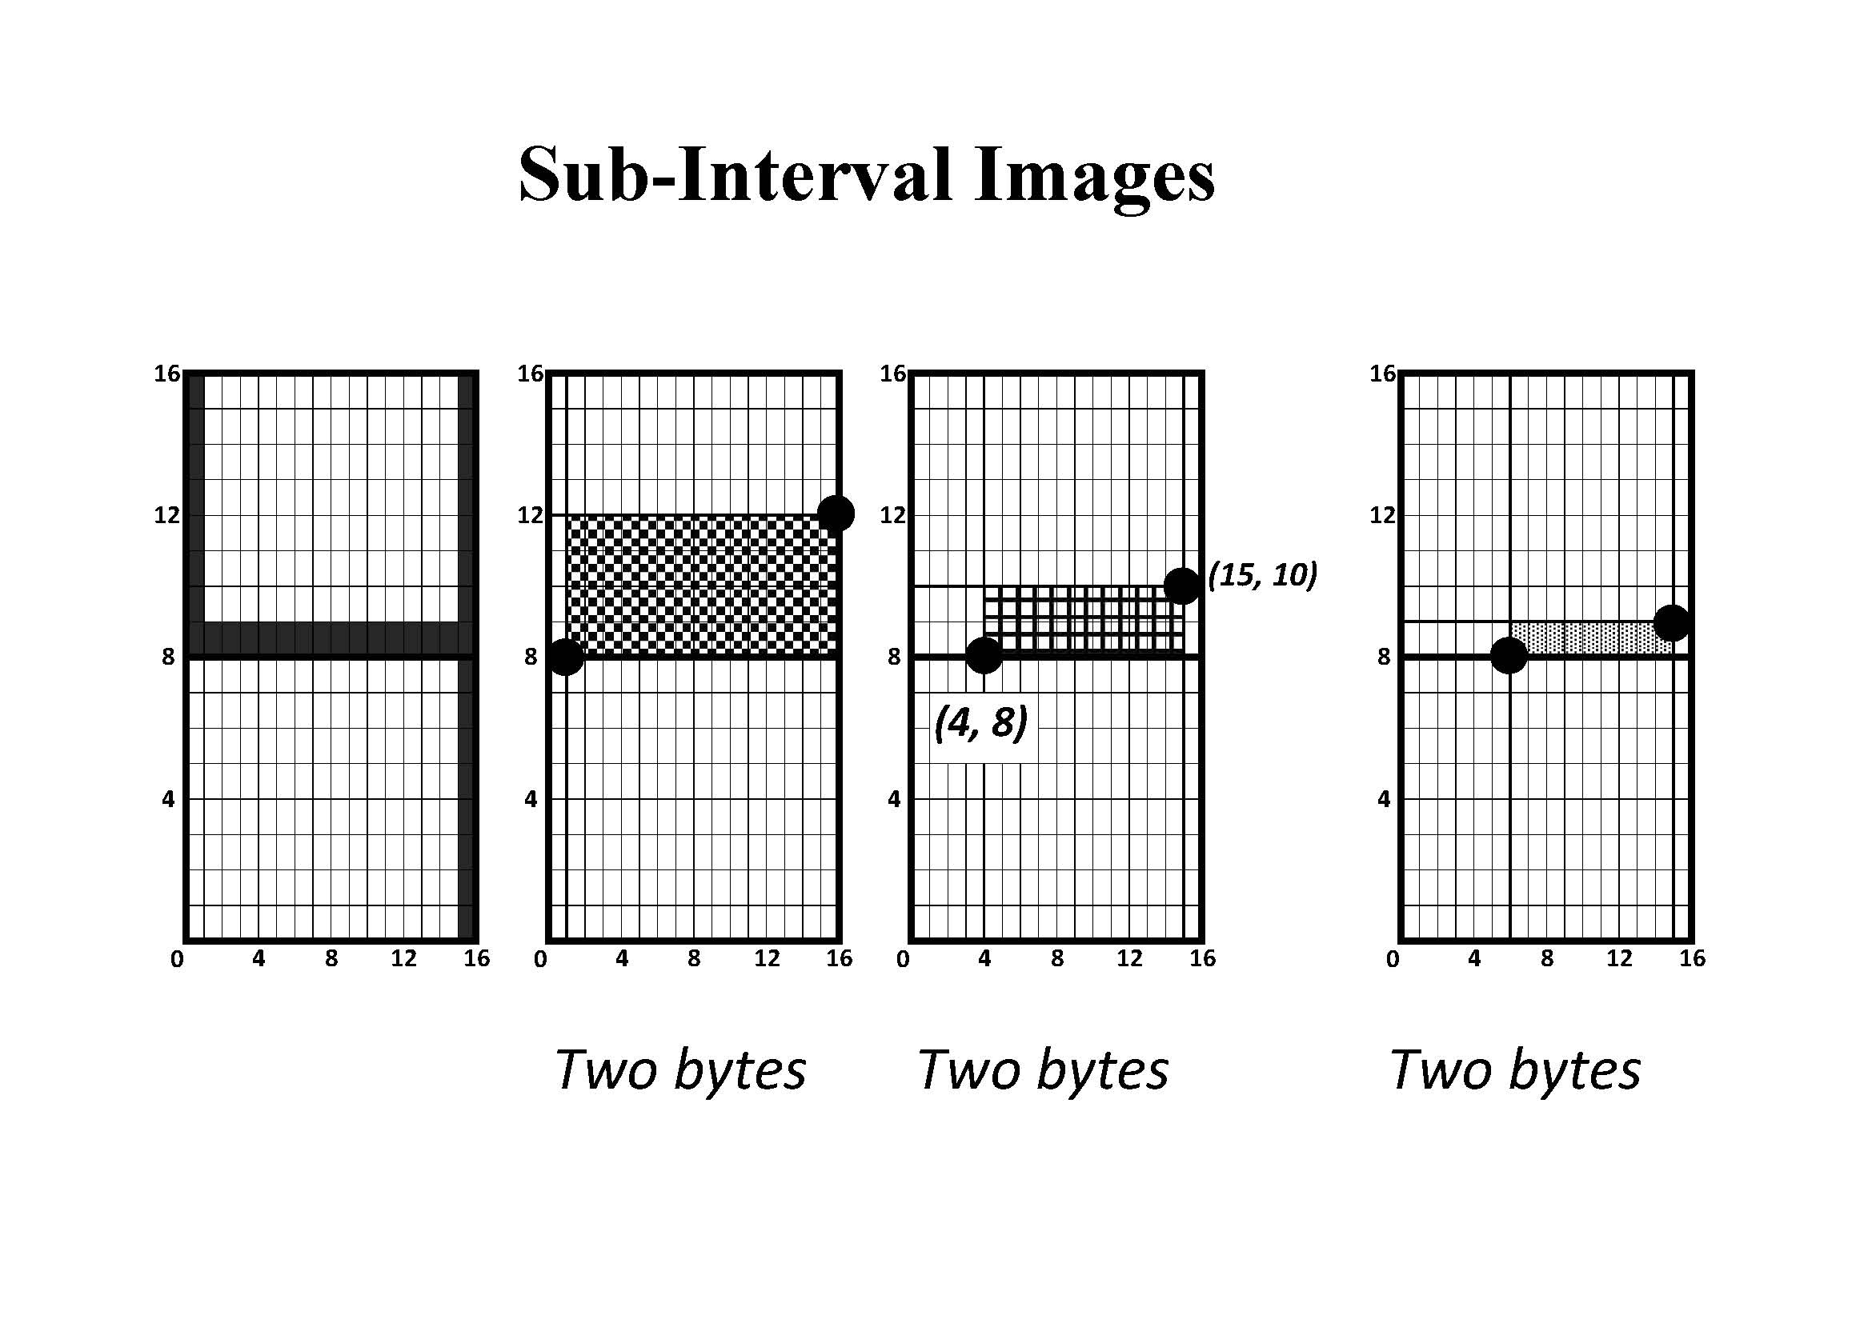
4

Slide 14
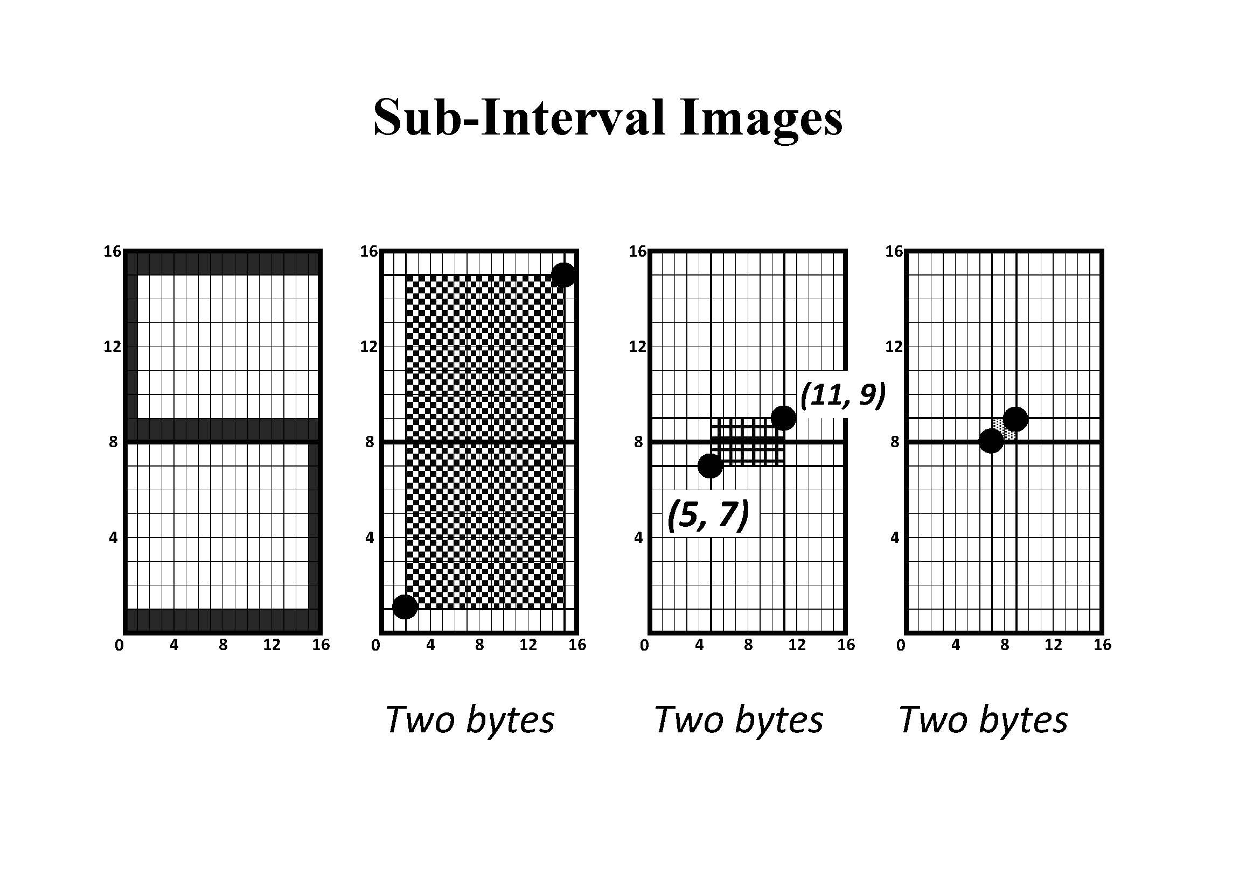
5

Slide 15
Prerequisites of Applications for It
Simplicity and exactness
Advantages of mean versus total
Low volume, high speed, high capacity
Advantages of incomplete data analysis
Time sub-intervals
Space sub-intervals
Enumeration sub-intervals
Statistical sub-intervals
Fourier sub-intervals
Large databases

Slide 16
Particular Fields for It
Economics
Internet
Military
Sociology
Technics
Statistics
Fourier Analysis

Slide 17
Sub-Interval Analysis. Alexander Harin aaharin@yandex.ru As the main source, see the E-Book "Introduction to Sub-Interval Analysis and its Applications" in Open Access at http://ideas.repec.org/b/zbw/esmono/62286.html 27 September, 19.30. Auditorium 515. Seminar Sub-Interval Analysis. Detailed introduction. General Picture

