Slide 1


Direct Energy Transformation in a System of Nonlinear Second Sound Waves
V.B.Efimov^{1,2} and P.V.E.McClintock²
¹⁾ Institute of Solid State Physics RAS, Chernogolovka, Moscow distr., Russia
²⁾ Physics department, Lancaster University, Lancaster, UK
The VI-th international conference:
Solitons, Collapses and Turbulence
Novosibirsk Akademgorodok, 7 June 2012

Slide 2
Outline
Introduction
  Why superfluid helium?
  Burgers waves
Experiments
  Resonator of second sound wave;
  Low resonance number – a direct energy cascade of nonlinear waves;
  Far resonances – an inverse energy cascade;
  Very low resonances – fractional frequency transformation.
Discussion

Slide 3
Sounds in Superfluid Helium
The differentiation of two equations with respect to time and substituting into another relationships we obtain for small disturbance
(linear waves)
Solutions are
wave of density (co-moving
motion normal and superfluid component)
waves of temperature or entropy (counter-movement motion normal and superfluid components, ρ=ρ_{n}+ρ_{s}=const

Slide 4
Second sound shock waves in superfluid helium
Nonlinear coefficient is positive for first sound
Nonlinear coefficient may be positive as well as negative for second sound. It means, the breakdown appears on front (α₂>0) or on backside (for α₂<0) of wave depending from T.
Temperature dependence of second sound nonlinear coefficient. Right hump is connected with roton waves, left one – with phonon’s temperature excitation

Slide 5
Why second sound in superfluid helium?
Low velocity of wave of second sound
Weak wave dissipation
Very strong dependence of velocity from second sound wave amplitude (δT~mK)
Linear dispersion law ω~k
Burgers equation
Dependence of second sound velocity from wave amplitude:

Slide 6
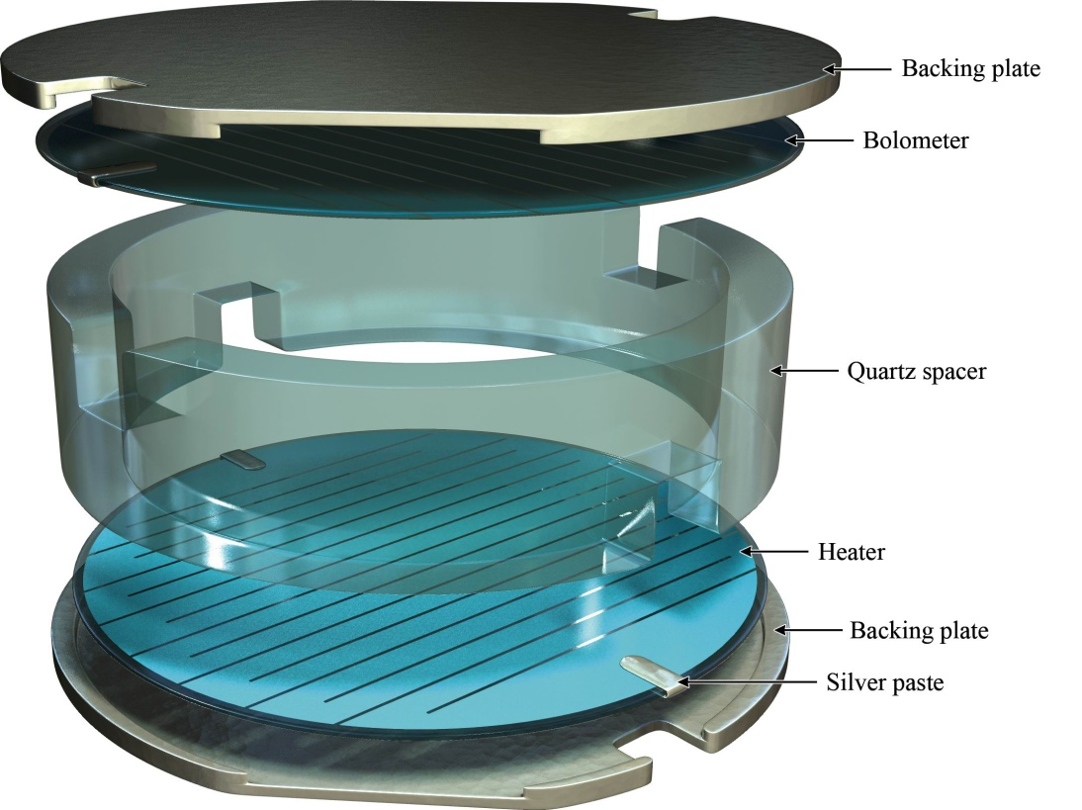
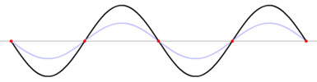
Resonator of second sound waves
We applied harmonic signal to heater
U~sin(ω*t),
P~sin²(ω*t)=[1+cos(2ω*t)]/2
Resonant frequency
  f_{G}=c₀/4L

Slide 7
Resonator
In experiments was used high quality cylindrical resonator (cover and bottom were parallel, wall was with high accurateness cylindrical – in some experiments we used cut off syringe), D~1.5 cm, L=2-8cm.
Heating meander occupied all lid area and we generated one dimensional wave
The eigenfrequencies are multiple harmonics

Slide 8



Quality of resonator 70 mm
The mechanical quality of the resonator is determined by parallel of reflecting walls
Δl/l ~ 5* 10⁻⁴, which corresponds to highest resonance frequency ~400 kHz
Model. The counterflow of the superfluid helium in resonator yields a some viscous friction at penetration depth, which depends from a frequency of a resonance vibrations
The energy loss at motion along walls in layer Λ at distance L, which is defined by interference conditions.. The wave disappears in resonator as only the sum of reflection N multiplies on Δl will be order of wavelength λ=c/f=c/2 πω~Δl*N, where c - is sound velocity. Wave at this case runs a distance
and quality of resonator will be defined as verses value of losses
The penetration depth is of the order of 2.5 μm for resonance frequency ~ 1000 Hz. Lets us suppose that the part of helium in length of Λ balks a motion of wave. The absolute value of resonator quality is of the order of
Bulk dissipation stays appreciable at frequencies higher 10 kHz

Slide 9
Measurements of standing waves at different resonances.
0
1
10
100
∞
Bad quality
Good quality
Balk dissipation
Low frequency f~1000 Hz, N~10

Slide 10
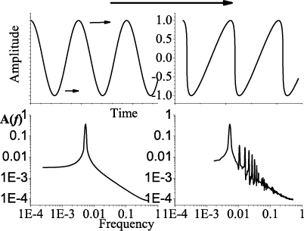
Energy Transformation in Superfluid Helium-4

Slide 11
Experimental studies of one dimensional nonlinear second sound waves in the cylindrical cell
Applied signal A=A₀*sin(ωt)
Temperature in second
sound wave
Fast Fourier
Transformation
Spectrum of temperature oscillations of the nonlinear second sound waves in a resonator

Slide 12
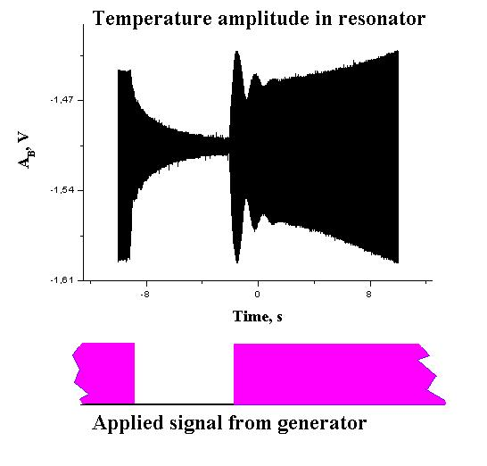
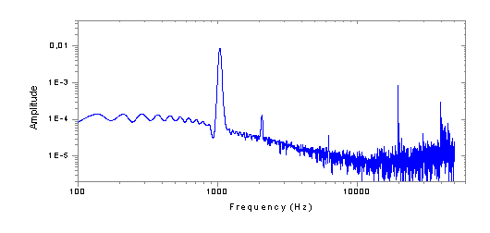
Formation of Kolmogorov’s spectrum
FFT spectrum

Slide 13
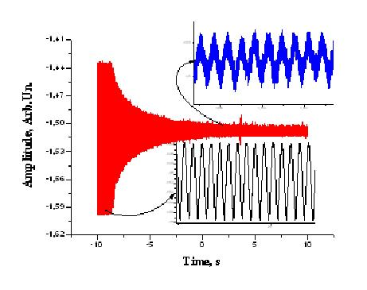
Decay of nonlinear energy spectrum
b)
We applied harmonic (~sin(ωt)) signal from generator to heater in cylinder resonator.
After formation the nonlinear wave spectrum (a) we switched off the pumping signal and have observed transformation of the harmonics with time (b).
a)

Slide 14
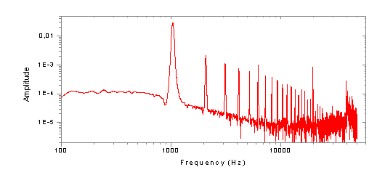

Slide 15
Chaos in harmonics after switch off the pump
Stop of energy pumping in the resonator drastically reduces multiple harmonics. The amplitudes of harmonics chaotically derange. Typically time of chaotic energy random walk is order of hundreds wave periods.
After 2 seconds the amplitude of the main (first) harmonic reduces with slower rate and can be described by an exponent dependence which correspond to the quality of resonator about 5000.
We found in Fourier Transformation of recording signal change in behavior of harmonic amplitude:
Chaos in energy spectrum

Slide 16

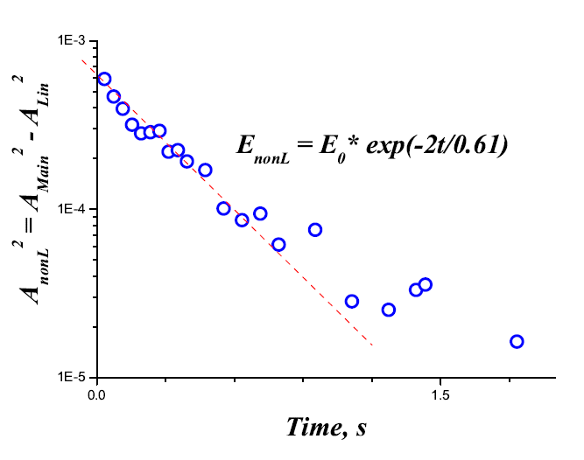

Linear and nonlinear times
After ceasing of pumping the main harmonic losses the energy into two channels the linear process, corresponding to quality of resonator at low excitation and nonlinear energy flux into higher harmonics:
. the last term appreciably accelerates the process of vibrations decay of the main harmonic. The prime time of the free decay nonlinear interaction transmits energy into multiple harmonics, amplitudes of which reduce, too.
After 2 s the energy flux into multiple harmonics stays vanishing and main harmonic vibration decays with linear time
The difference between should be ascribed to a nonlinear flux into direct energy cascade.

Slide 17
Measurements of standing waves at different resonances.
0
1
10
100
∞
Bad quality
Good quality
Balk dissipation
Low frequency f~1000 Hz, N~10;
Higher frequency f~5 kHz, N~100

Slide 18
Formation of Inverse Cascade
ω₁+ω₂→ω₃
ω₃ → ω₂+ω_{f}
A
1
2
3
4
5
Dissipation
f

Slide 19
Formation of Inverse Cascade
ω _{f} → ω₂+ω_{f}
A
20
10
4
5
40
80
100
120
f

Slide 20
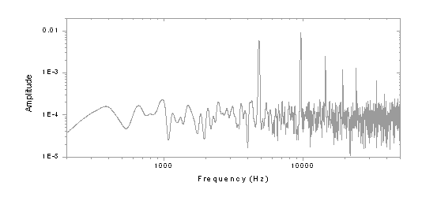

Slide 21
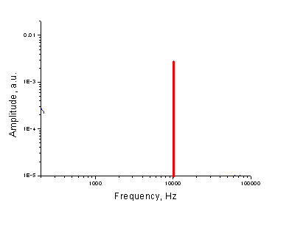
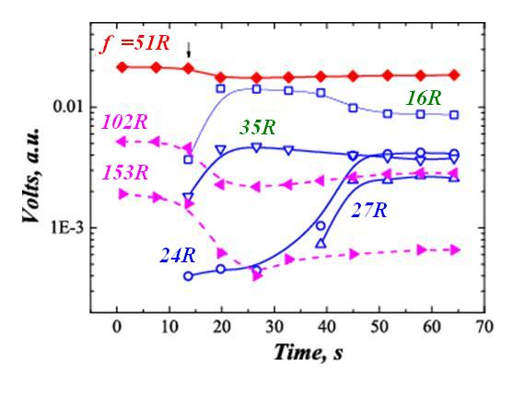
Inverse Energy Cascade
ω _{f} → ω₂+ω_{f}
ω₁+ω₂→ω₃
A
20
10
40
4
5
80
100
120
f

Slide 22
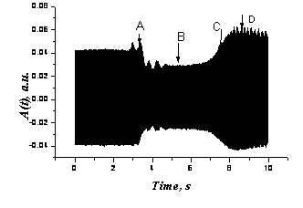
Direct and inverse cascades
ω₁ + ω₂ → ω₃
ω₁→ω₂+ω₃

Slide 23
Energy transformation at acoustic turbulence

Slide 24
Measurements of standing waves at different resonances.
0
1
10
100
∞
Bad quality
Good quality
Bulk dissipation
Low frequency f~1000 Hz, N~10;
Higher frequency f~5 kHz, N~100;
Very low frequency f~100 Hz, N~1

Slide 25
Direct formation of higher harmonics
4 Resonance f_{G} =185.9 Hz
f_{G} =194.2 Hz (f_{W} =8* f_{G} =4* f_{D})
δT~100 -200 μK

Slide 27
Conclusion
One-dimensional system of strong nonlinear wave of second sound allowed to modelling a behaviour of Burgers waves.
The direct cascade of energy flux was observed in discrete system.
At some condition the inverse cascade of energy formats in the system of nonlinear second sound waves
Was observed a new effect of direct formation of multiple harmonics

Slide 28
Direct formation of higher harmonics
f_{G} =198 Hz (f_{W} =6* f_{G} =3* f_{D})
f_{G} =194.2 Hz (f_{W} =8* f_{G} =4* f_{D})
f_{G} =206.5 Hz (f_{W} =4* f_{G} =2* f_{D})

Slide 29
Resonance position

Slide 30
Fractional frequency transformation
Standing waves
Heater
Bolometer
3
4
5
0
1
2
We have 5 waves at distance 6 length of resonator
The resonance circumstance:
2*N*L=n*λ

Slide 31
Thank you for your attention!

