Slide 1
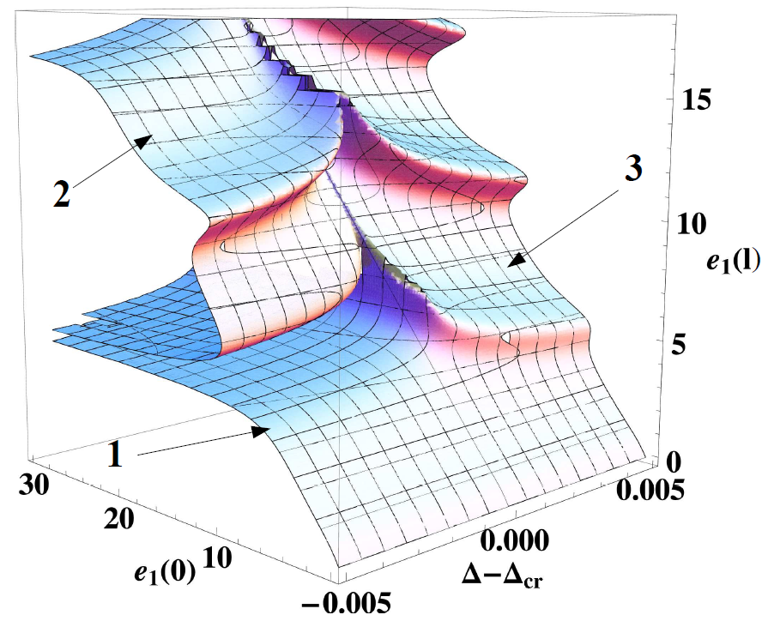
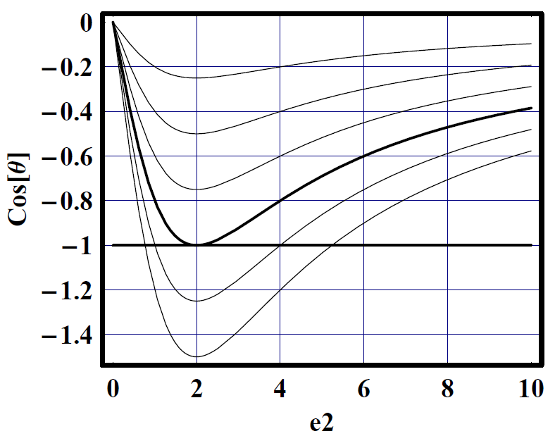
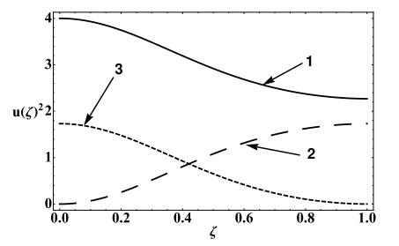
Milti-wave interaction in metamaterials
Ildar Gabitov, Zhaxylyk Kudyshev, Andrei Maimistov
ω
2ω

Slide 2
Nonlinear phenomena in negative index materials
Nonlinearity in negative index materials. What is new?
Two general cases:
Frequency interface
Broad spectrum
Multi-wave
interaction

Slide 3
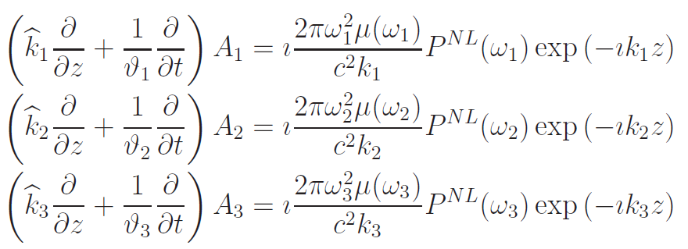
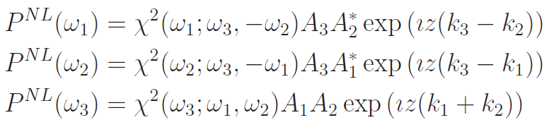
Three wave interaction: slowly varying amplitude approximation

Slide 4
Simplest case of three wave interaction: Second harmonic generation
A. Zakhidov, Agranovich
Yu. Kivshar et. al.
Popov, V. Shalaev
M. Scalora et. al.
Zh. Kudyshev et. al.
D. Smith, et. al.

Slide 5
Second Harmonics generation: Classical Case
N. Blombergen

Slide 6
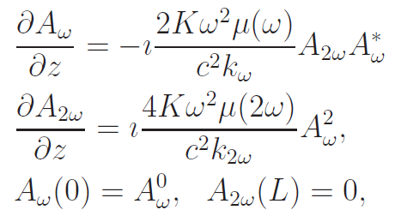

Second harmonic generation
-- boundary conditions
ω
2ω

Slide 7
Classical Case
If fields are periodically oscillating.

Slide 8

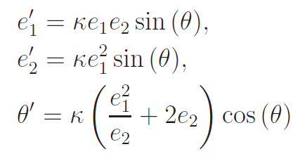


Here:
Maimistov, Kudyshev, I.G.

Slide 9

From the first two equations follows the modified M-R relation:
In conventional case we have conservation of energy.
In negative index material - conservation of total flux of the energy.
Popov, Shalaev

Slide 10
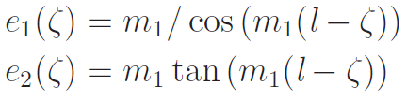


Energy of pump wave decay with z, therefore the phase difference is equal to .
Exact solutions general formulae:
Here
and
Important: m₁ is unknown!

Slide 11

Boundary conditions together with M-R relation lead to the implicit equation for :
Here e₁₀ is an amplitude of the pump wave. This transcendental equation can be solved numerically and it has multiple branches.

Slide 12
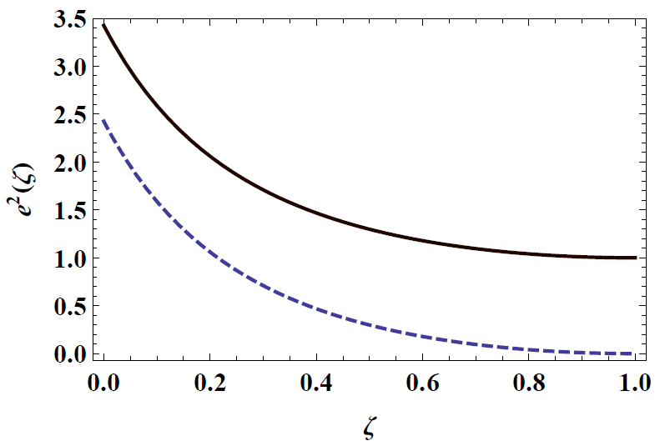
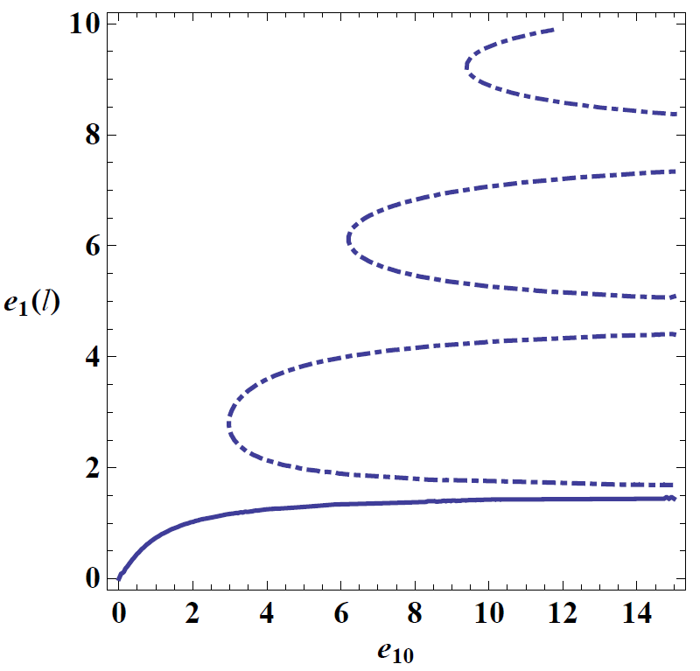
Solution of transcendental
equation
Spatial field profiles
Physical branch:
Irrelevant branches:
Field is singular in between of these branches

Slide 13
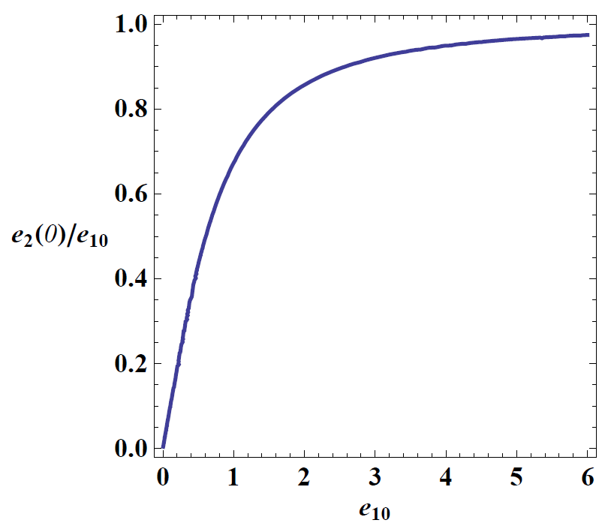
“Physical” branch shows saturation of output power of electric field at fundamental frequency with increase of input power. This indicates that with the increase of input power all excessive energy of pump signal converts to the energy of second harmonic signal.

Slide 14
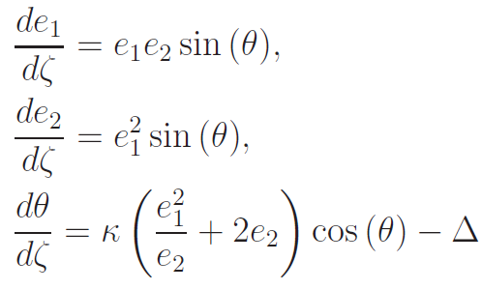



Second harmonic generation in presence of phase mismatch
Two integrals:

Slide 15


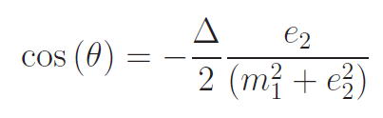


Second harmonic generation in presence of phase mismatch
-- critical mismatch

Slide 16




“Exact” solutions
Equation for the power of second harmonic field:
- is the Weierstrass function

Slide 17
Numerical solution

Slide 18

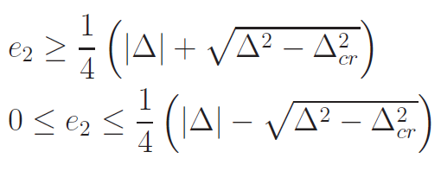
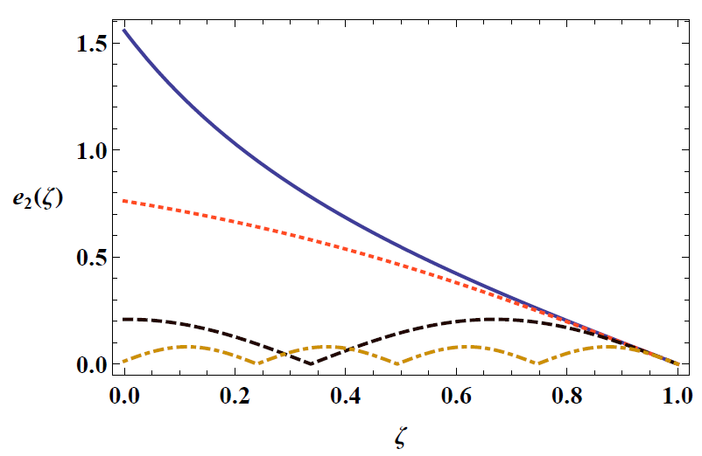
Second harmonic generation in presence of phase mismatch

Slide 19

Second harmonic generation in presence of phase mismatch
If
then second harmonic
does not radiate outside. Therefore, sample becomes transparent for fundamental mode.
The conversion efficiency of pump wave to second harmonic is limited by the value:

Slide 20
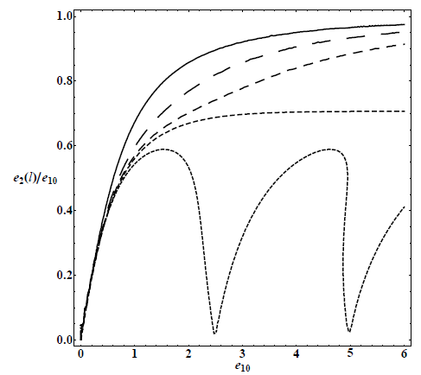
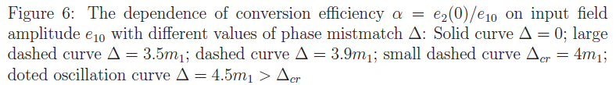
Conversion efficiency
Jump

Slide 21
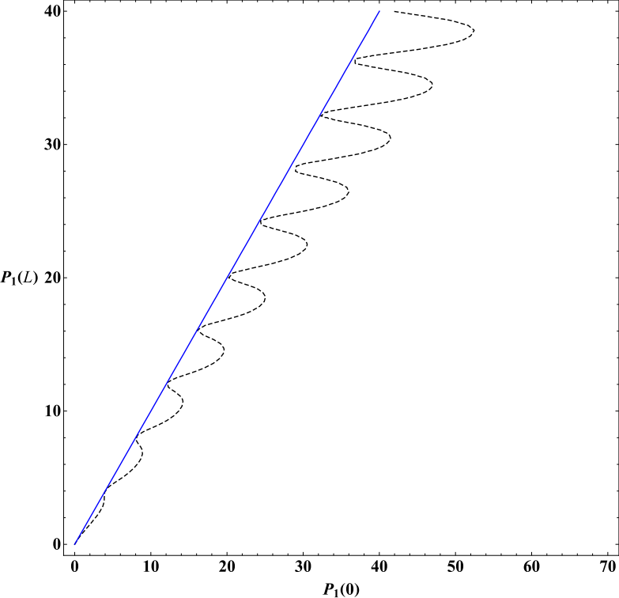
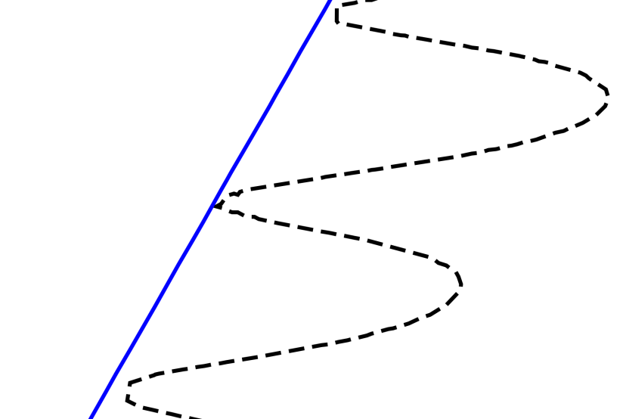
Multi-stability

Slide 22
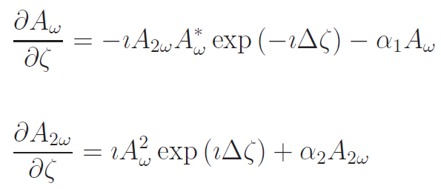
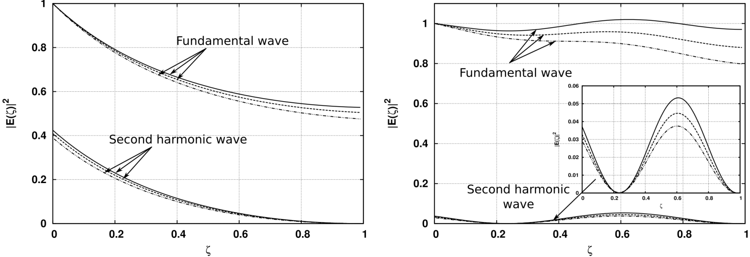
Second harmonic generation in presence of losses

Slide 23
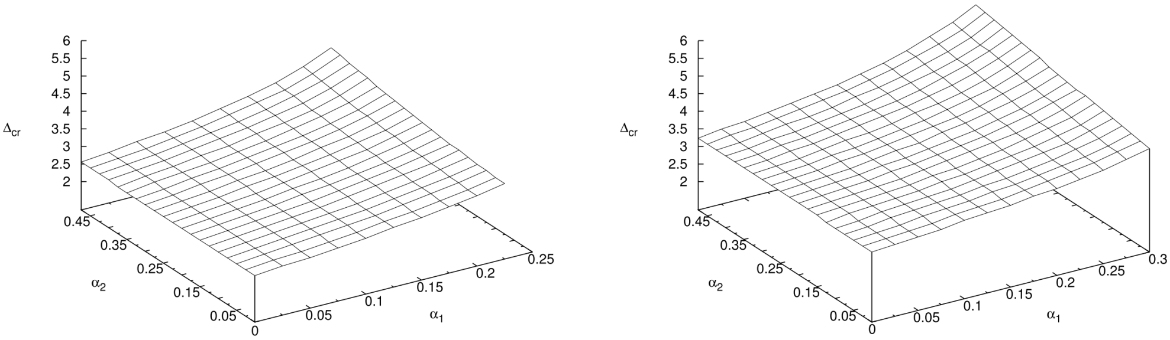

Slide 24
Parametric amplification:

Slide 25

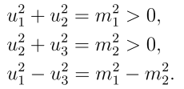

Two additional integrals

Slide 26

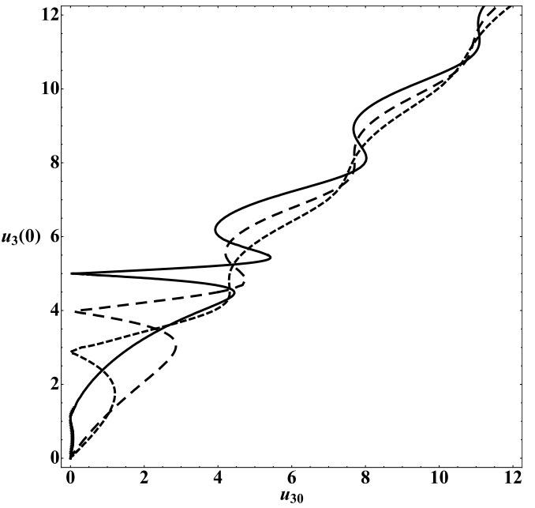

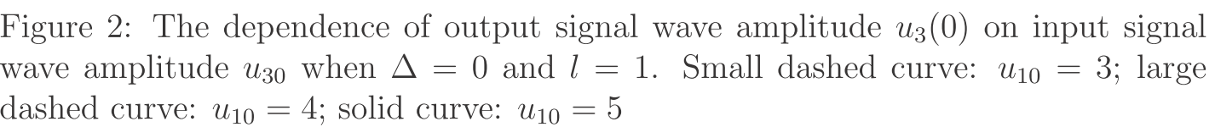
Full system consideration
Numerical solution of transcendental equation

Slide 27
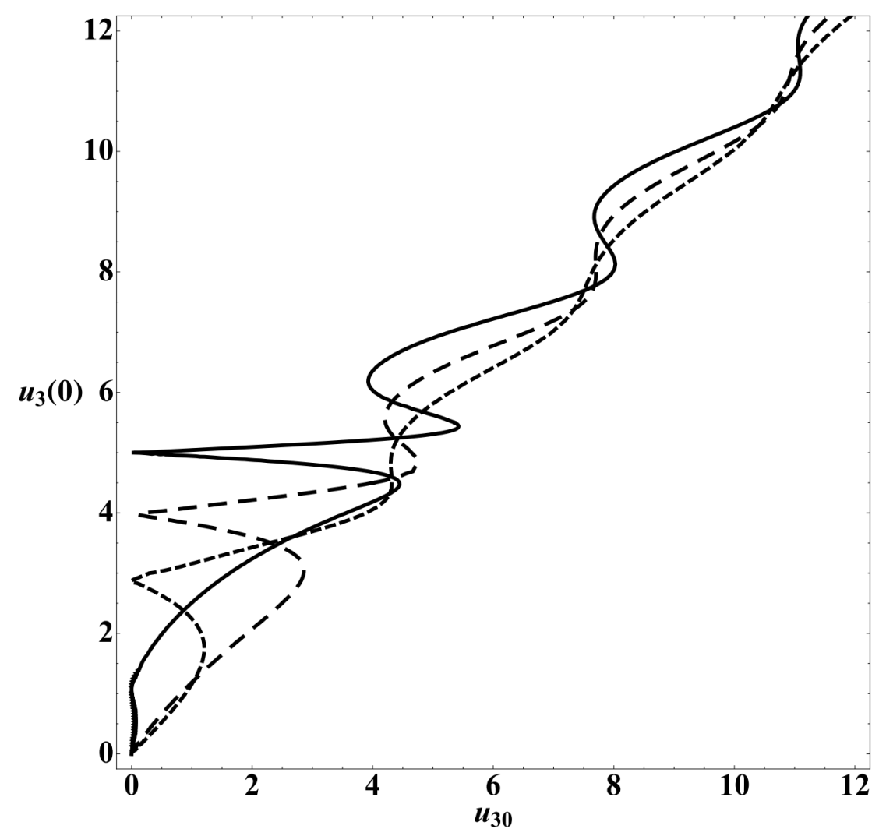
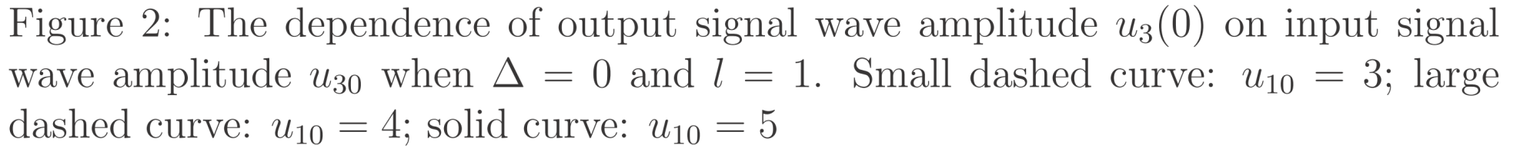
If there is non-zero output signal value corresponding to zero input signal then such branch is non physical.
Popov, Shalaev regime

Slide 28
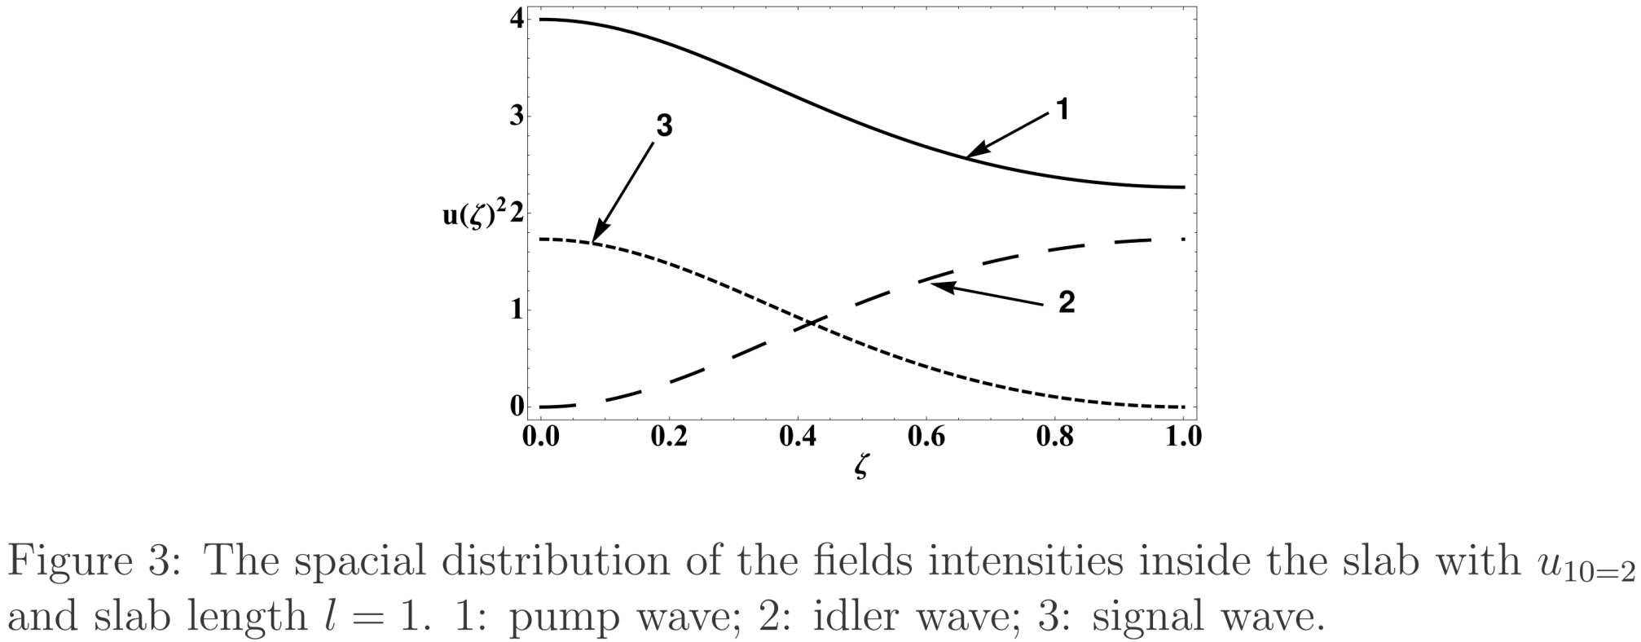
Spatial distribution of intensities: example

Slide 29


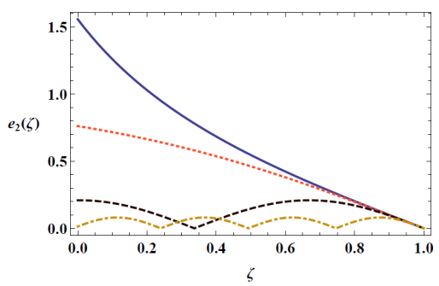
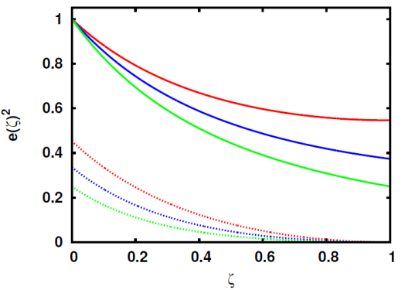
Conclusions

