Slide 1
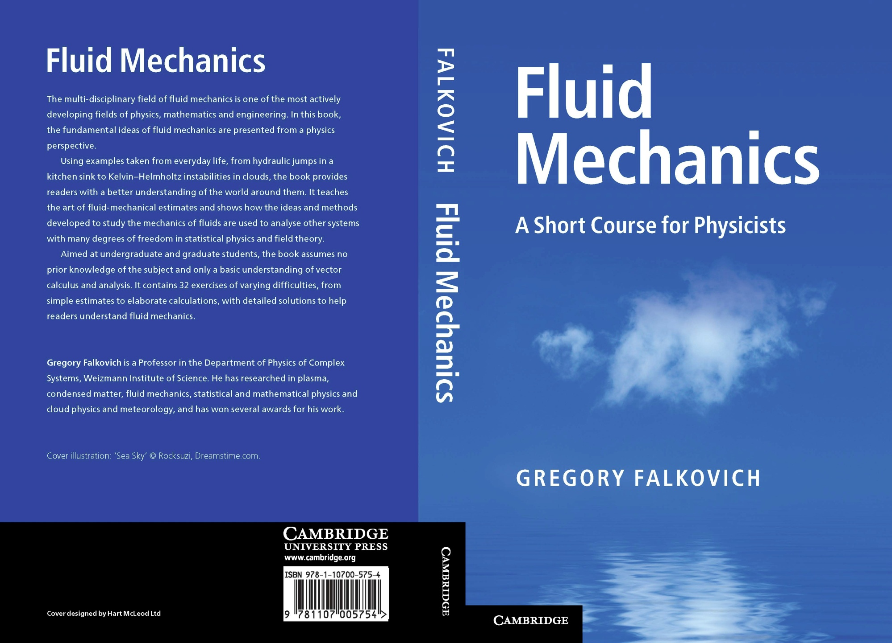

Slide 2
Phase transitions in turbulence
Coherence and fluctuations: turbulence as quantum phenomenon
N. Vladimirova,
G. Falkovich, S. Derevyanko
Академгородок, June 02, 2012

Slide 3
We expect from turbulence
fragmentation, mixing and loss of coherence.
However,
an inverse turbulent cascade proceeds
from small to large scales
and brings some self-organization
and eventually appearance of
a coherent system-size condensate.

Slide 4
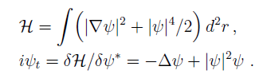


Gross-Pitaevsky model – nonlinear Schrodinger equation

Slide 5
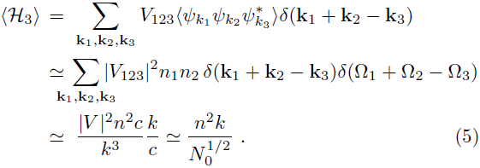


Slide 6

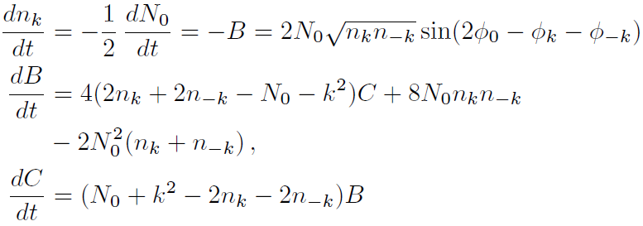



Slide 7


Optical turbulence
Two integrals of motion
– two cascades
With cold atoms one needs to supply constantly high-momentum atoms and simultaneously cool the system to preserve the energy .
Inverse
cascade
k

Slide 8
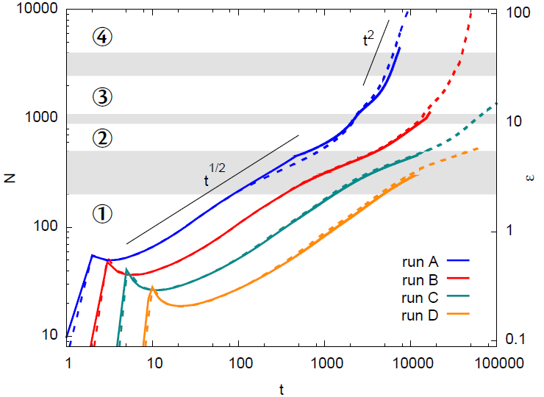


Slide 9
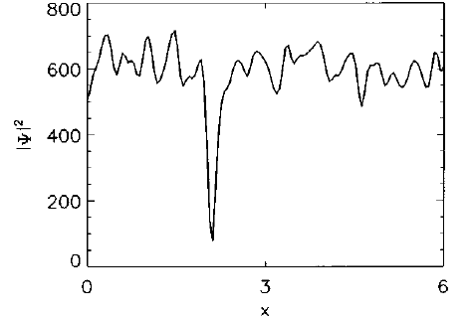
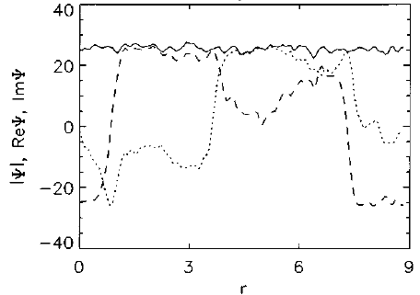
Condensate growth

Slide 10
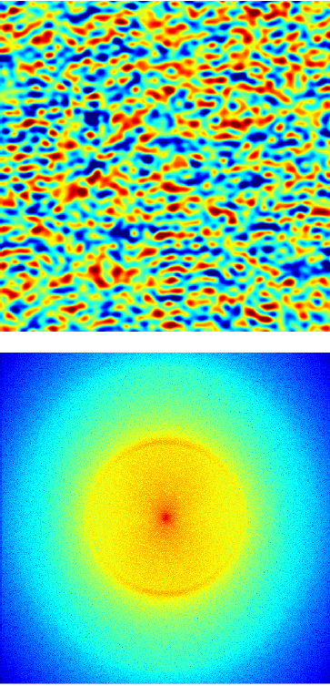
Early stage of condensate growth
Field amplitude in space
Fourier spectrum

Slide 11
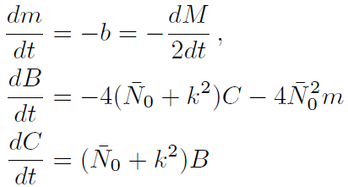

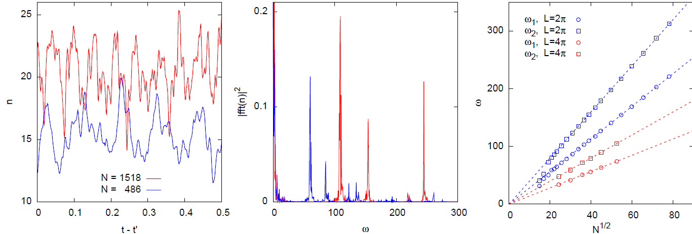
Collective oscillations

Slide 12
The surprises start
And then

Slide 13
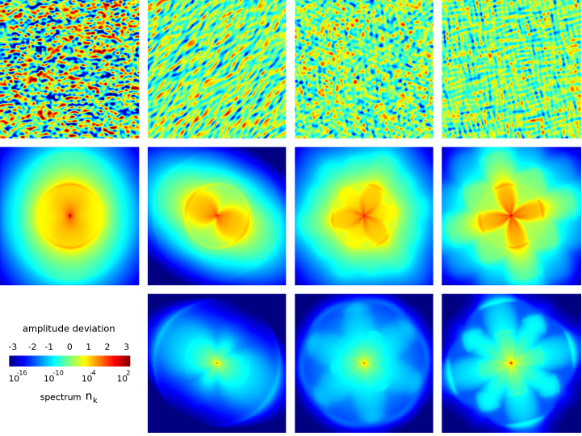

Slide 14
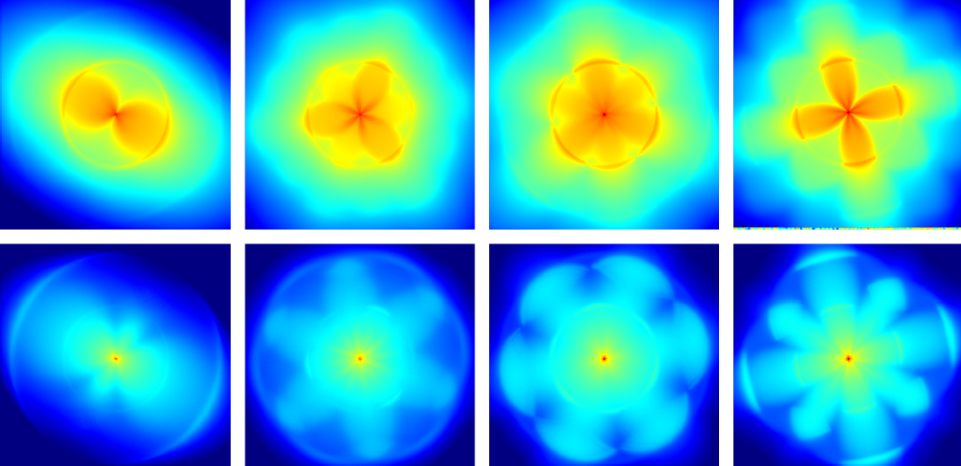
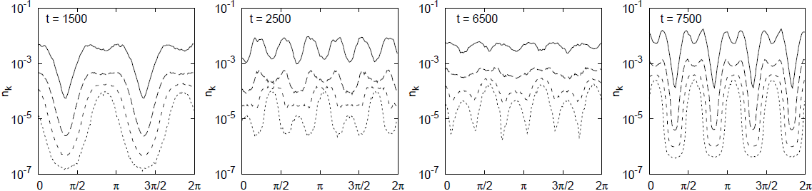

Slide 15
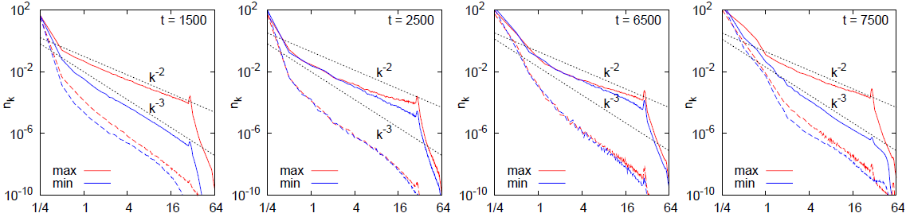
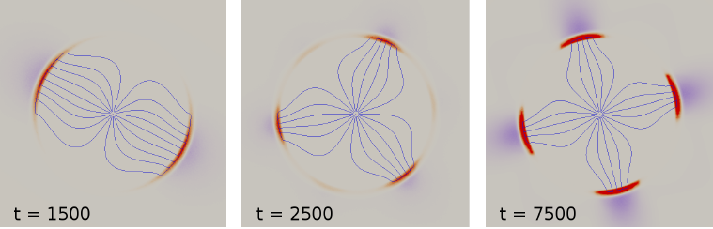
Spectra
Flux lines in Fourier space

Slide 16
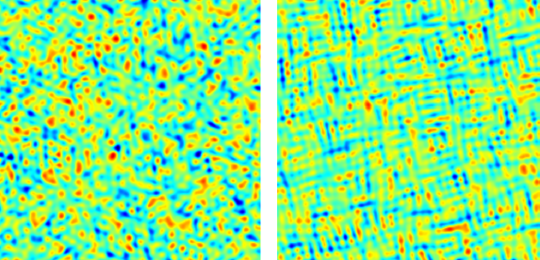
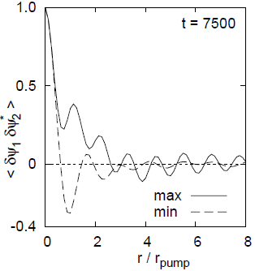
Hexatic phase?
Correlation function
of the over-condensate fluctuations

Slide 17
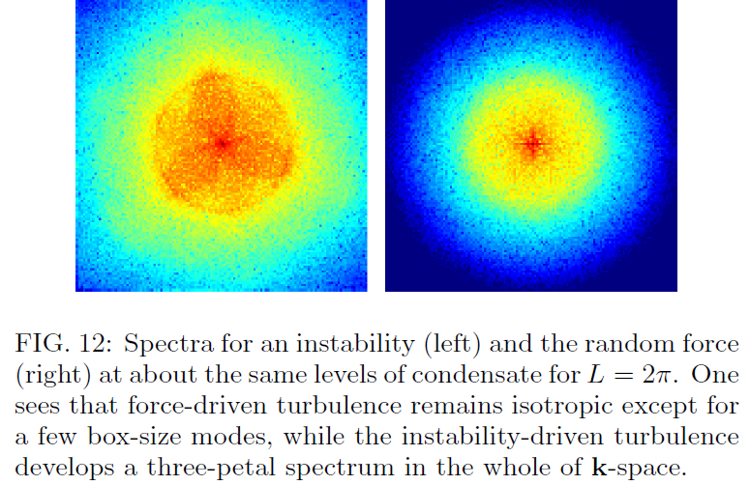

Slide 18


Slide 19
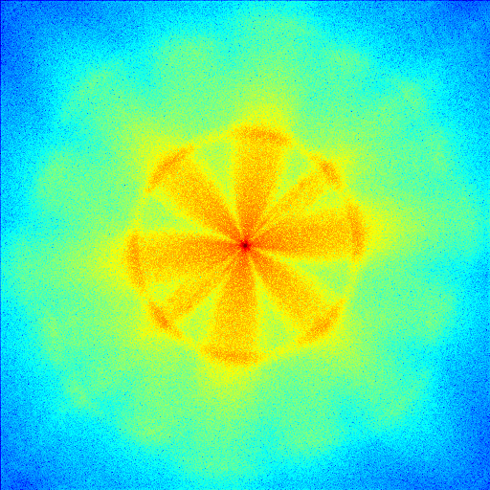

Slide 20
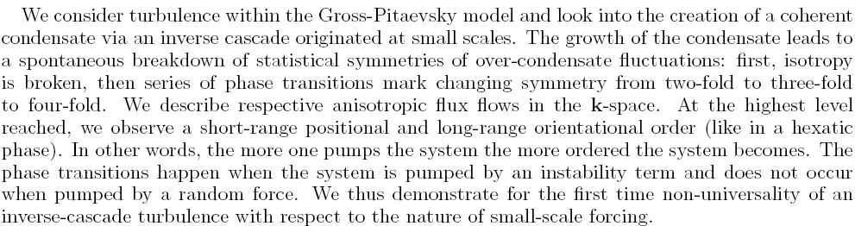
Conclusion

Slide 21
Condensation in turbulence

Slide 22
V. E. Zakharov, V. S. L'vov, G. Falkovich, Kolmogorov Spectra of Turbulence, Springer, Berlin, 1992
http://www.weizmann.ac.il/home/fnfal/papers/book.html

