Slide 1
Determination of the depth of the inclusion in the underlying medium
Orman Indira, PhD, senior lector
L. N. Gumilev Eurasian National University

Slide 2
Introduction
-The use of the method of geo-radar sounding is one of the most promising and dynamic areas of development of geophysical research.
-The main advantages of the method are high resolution, noise immunity in relation to distorting signals, as well as efficiency and cost-effectiveness. The method of geo-radar sounding makes it possible to study in detail the subsurface structure of soils or man-made structures, significantly reducing the cost of drilling control and measuring wells.

Slide 3
Gpr “loza-v”
The probing method makes it possible to determine with the help of the GPR "LOZA-V" the speed of propagation of an electromagnetic wave in the medium and, accordingly, the depth of the reflecting surface or object. The propagation velocity of an electromagnetic wave in a medium with a constant permittivity can be determined from the formula.

Slide 4
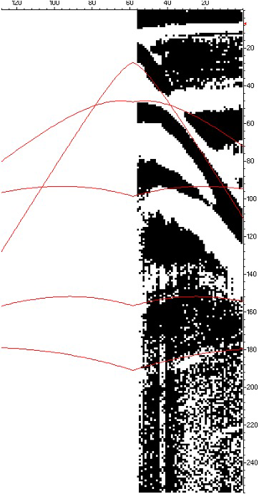
Gpr “loza-v”
To conduct probing, the transmitting and receiving parts of the georadar are removed from the carrier frame and their antennas are placed in parallel at a distance of 30 cm from each other. In the process of sounding, the antennas are carried in increments of 5-10 cm at a distance of 5-10 meters. Figure 1 shows the hodograph obtained using this measurement technique.
Fig.1 Hodograph

Slide 5
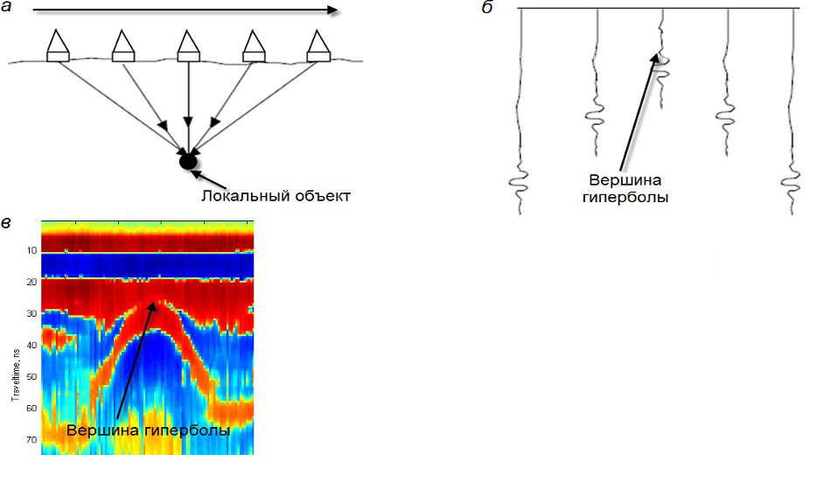
Hyperbolic contour
In practice, this means that if there are local objects in the profile zone, then a hyperbolic contour (Fig. 2), a hyperbola, will correspond to each such object on the received radar image.
Fig.2 Emitted electromagnetic wave

Slide 6
Formula
If we now highlight this hyperbole on the radar diagram, then we can describe it by mathematical dependence. Any point corresponding to the selected hyperbola with coordinates (x, tx) must be determined by the equation.
where x is the horizontal displacement from the top of the hyperbola to a given point, m; tx is the travel time from the transmitting antenna to this point and back to the receiver antenna, ns; V is the average propagation velocity of electromagnetic waves from the earth's surface to the top of the hyperbola, m/ns; h is the depth corresponding to the position of the top of the hyperbola, m; a – the survey step, m.

Slide 7
Interactive methods for determining the
geoelectric section
The georadar survey is carried out in the form of a series of measurements at individual points located on the profile. The traces obtained at each individual measurement form a radarogram. A radarogram is a graphical image constructed by the method of variable density, in which the coordinates of each pixel are denoted respectively: abscissa is the distance from the beginning of the profile, ordinate is the time of arrival of the signal. The amplitudes of the signals on the radarogram are encoded by a color from a given palette of colors or in grayscale. The location of the subsurface object is determined by the vertex of the hyperbola constructed from the points of the maximum values of the amplitudes of each trace.

Slide 8
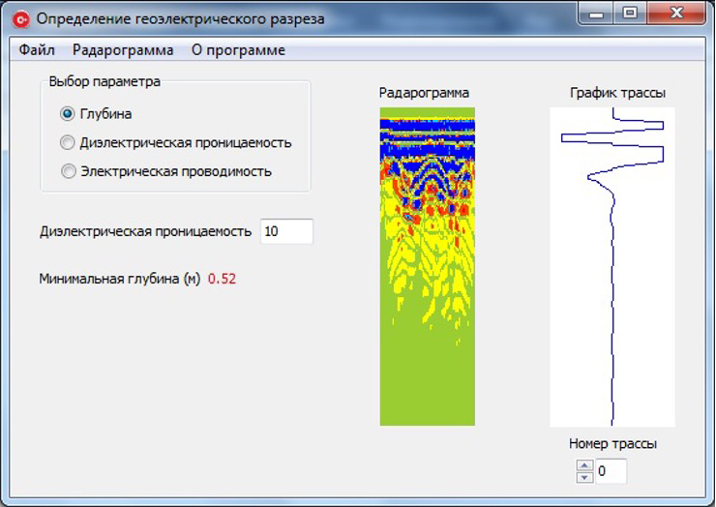
Calculation of the depth of a subsurface object
Calculation of the depth of the subsurface object in the program is carried out by selecting the "Depth" parameter. After the user enters the value of the relative permittivity of the medium, the program calculates the distance from the antenna to the subsurface object (Fig. 3).
Fig.3 Dialog screen for calculating the depth of a subsurface object

Slide 9
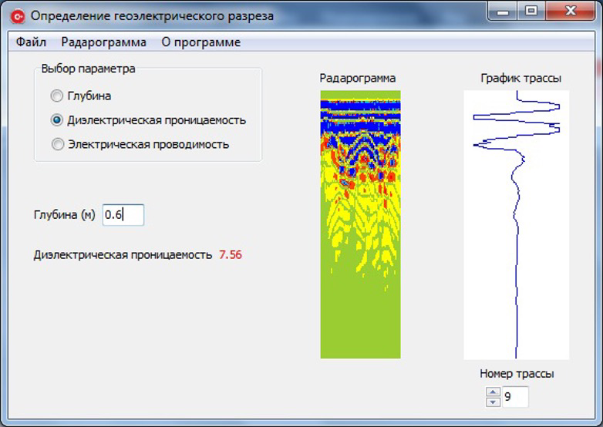
Calculation of the relative permittivity of the medium
The calculation of the relative permittivity of the medium in the program is carried out by selecting the parameter "Permittivity". After the user enters the relative permittivity of the medium, the program calculates the relative permittivity of the subsurface medium (Fig. 4).
Fig.4 Dialog screen for calculating the relative permittivity of the medium

Slide 10
Program Description
-Program functionality:
1. Entering data from the radarogram file;
2. Visualization of the radarogram profile;
3. Determination of the depth of the subsurface object;
4. Determination of the relative permittivity of the medium;
5. Determination of the electrical conductivity of the subsurface medium;
6. Saving the radarogram profile in various formats.
7. Viewing the graph of the route of the radar program
8. Saving the schedule of the route of the radar program in various formats.

Slide 11
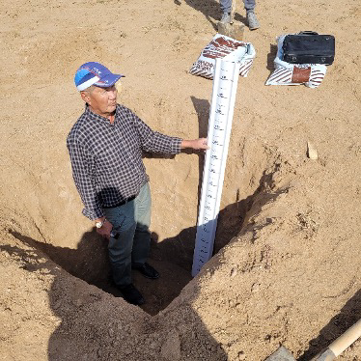
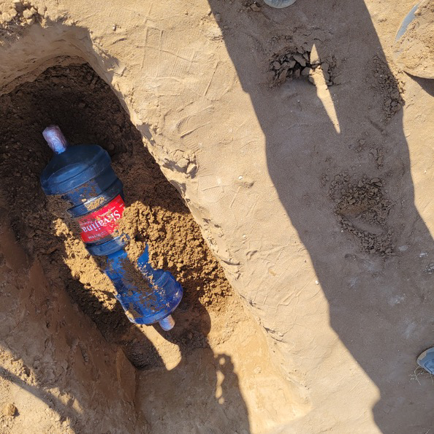
Testing of the program on an experimental radarogram
To determine the depth of occurrence of subsurface objects, a software module in C++ has been developed in the MS Visual studio environment. To check the operation of the program, radarograms of various objects were used:
a peat dome (Fig. 5); plastic bottles (Fig. 6).
Fig. 5 A peat dome
Fig. 6 Two plastic bottles

Slide 12
Conclusion
The results of the calculations carried out above on real data are confirmed with the data of the depth of objects, in particular, in the first experiment with a peat dome that was at a depth of about 0.7 meters, according to the radar image, it was found at a position of 0.73 meters, in the second example, plastic bottles were buried at a depth of 0.5 meters were found at a depth of 0.52 meters. Thus, the absolute error was about 0.2-0.3 cm.
-The presence of its own software module for determining the depth of occurrence of subsurface objects allows us to test the algorithms, taking into account the necessary properties of the subsurface environment.

Slide 13
Thank you for your attention!

